Slide 1

Topological QCD Vacuum and Hadron Structure
Poland 26’

Slide 2
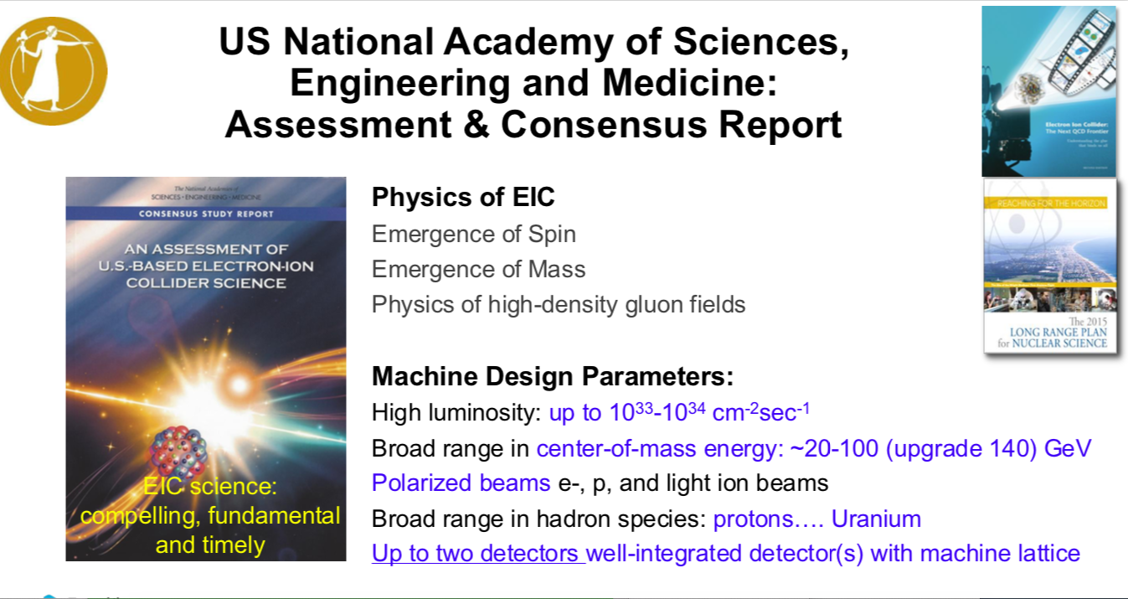
Deshpandhe 26’

Slide 3
Bridging
Hadronic Structure in CM:
Chiral symmetry
Potential models
BS formulations
…..
Euclidean vacuum:
ILM and Lattice
Chi-breaking
Confinement
….
Hadronic structure: LF
DAs, PDFs, GPDs, ...
Had mostly pQCD
Had with nPQCD missing
…..

Slide 4
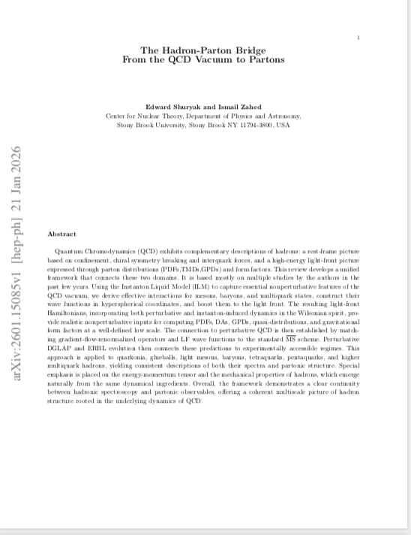
Upcoming Book

Slide 5
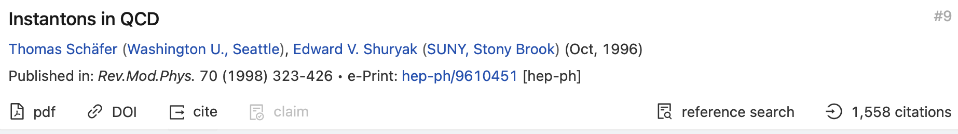
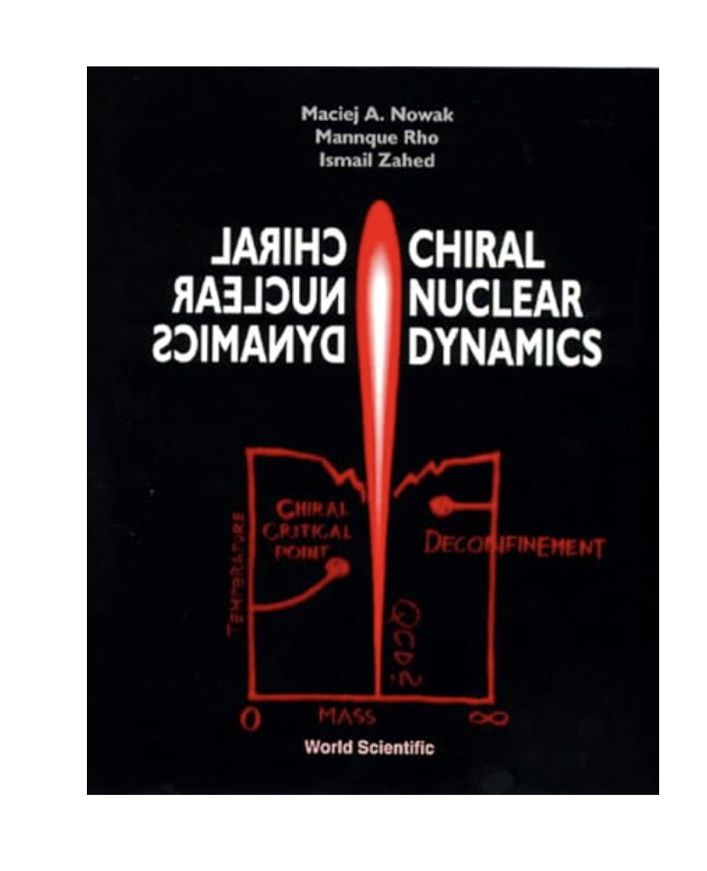
ILM Review/Book

Slide 6
Outline
Glue/LxR
LFWFs
EM, EMT FFs

Slide 7
ILM: Glue/ZMs

Slide 8
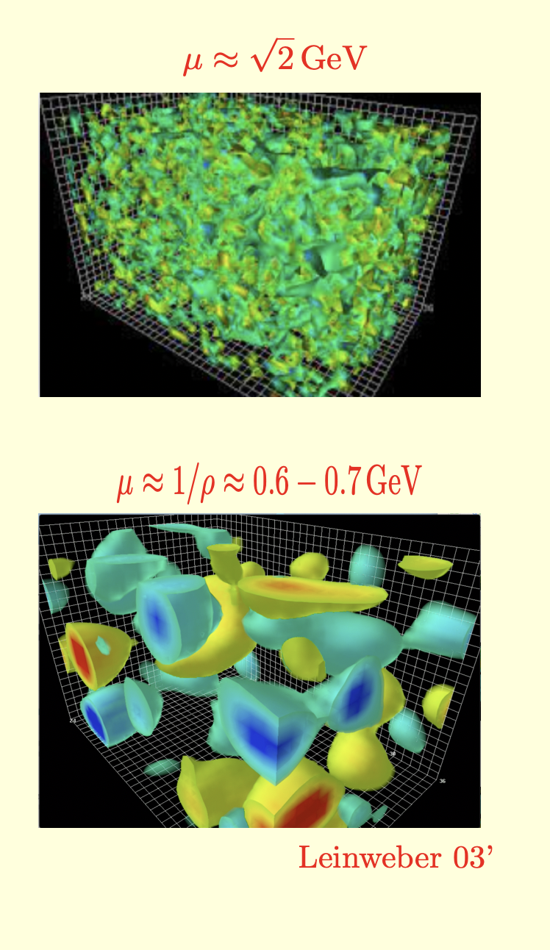
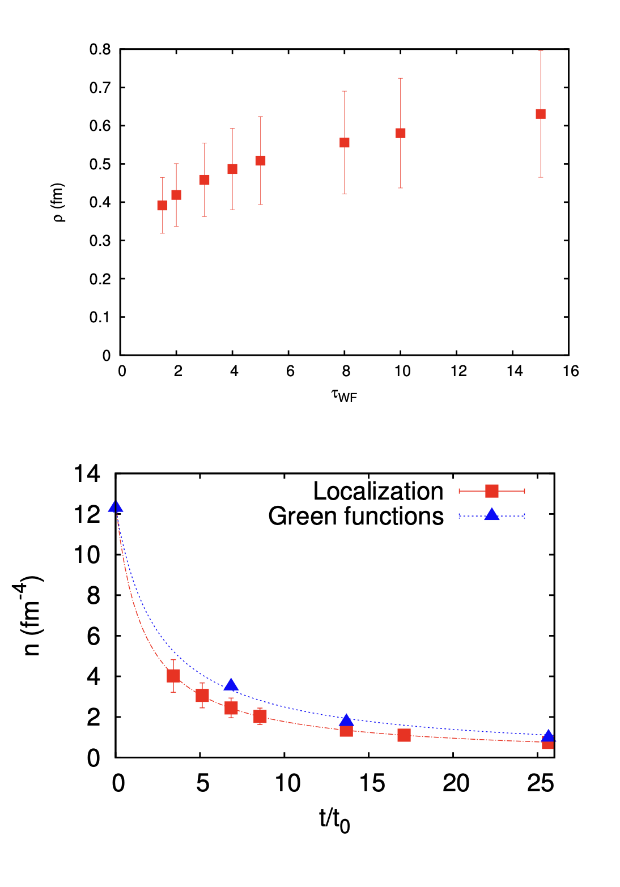
Topologically active vacuum
QCD Topological landscape

Slide 9
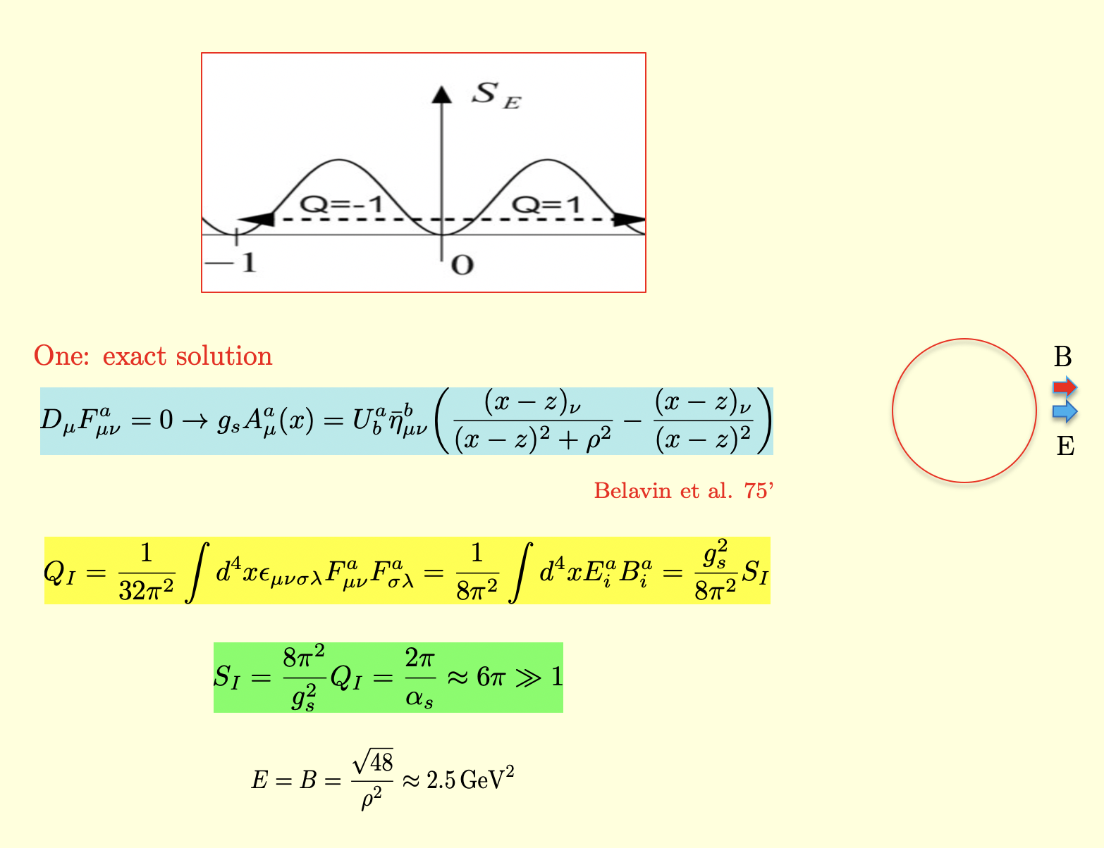
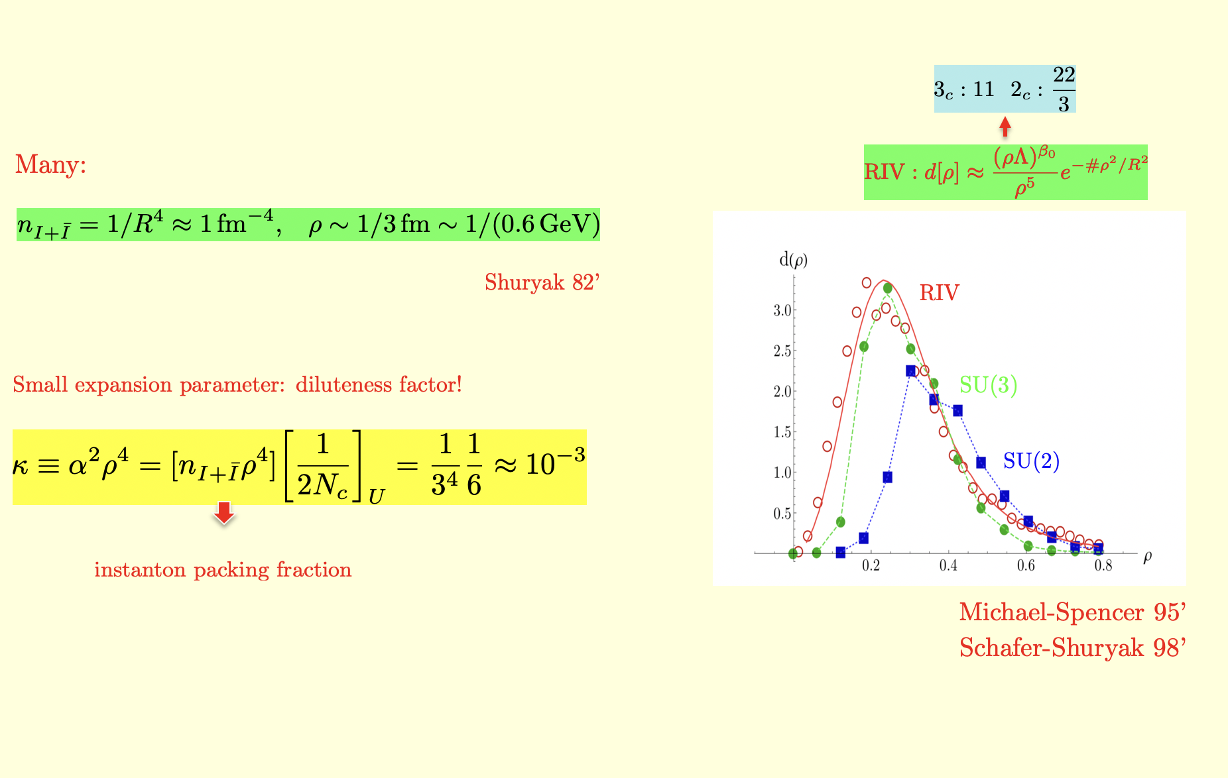
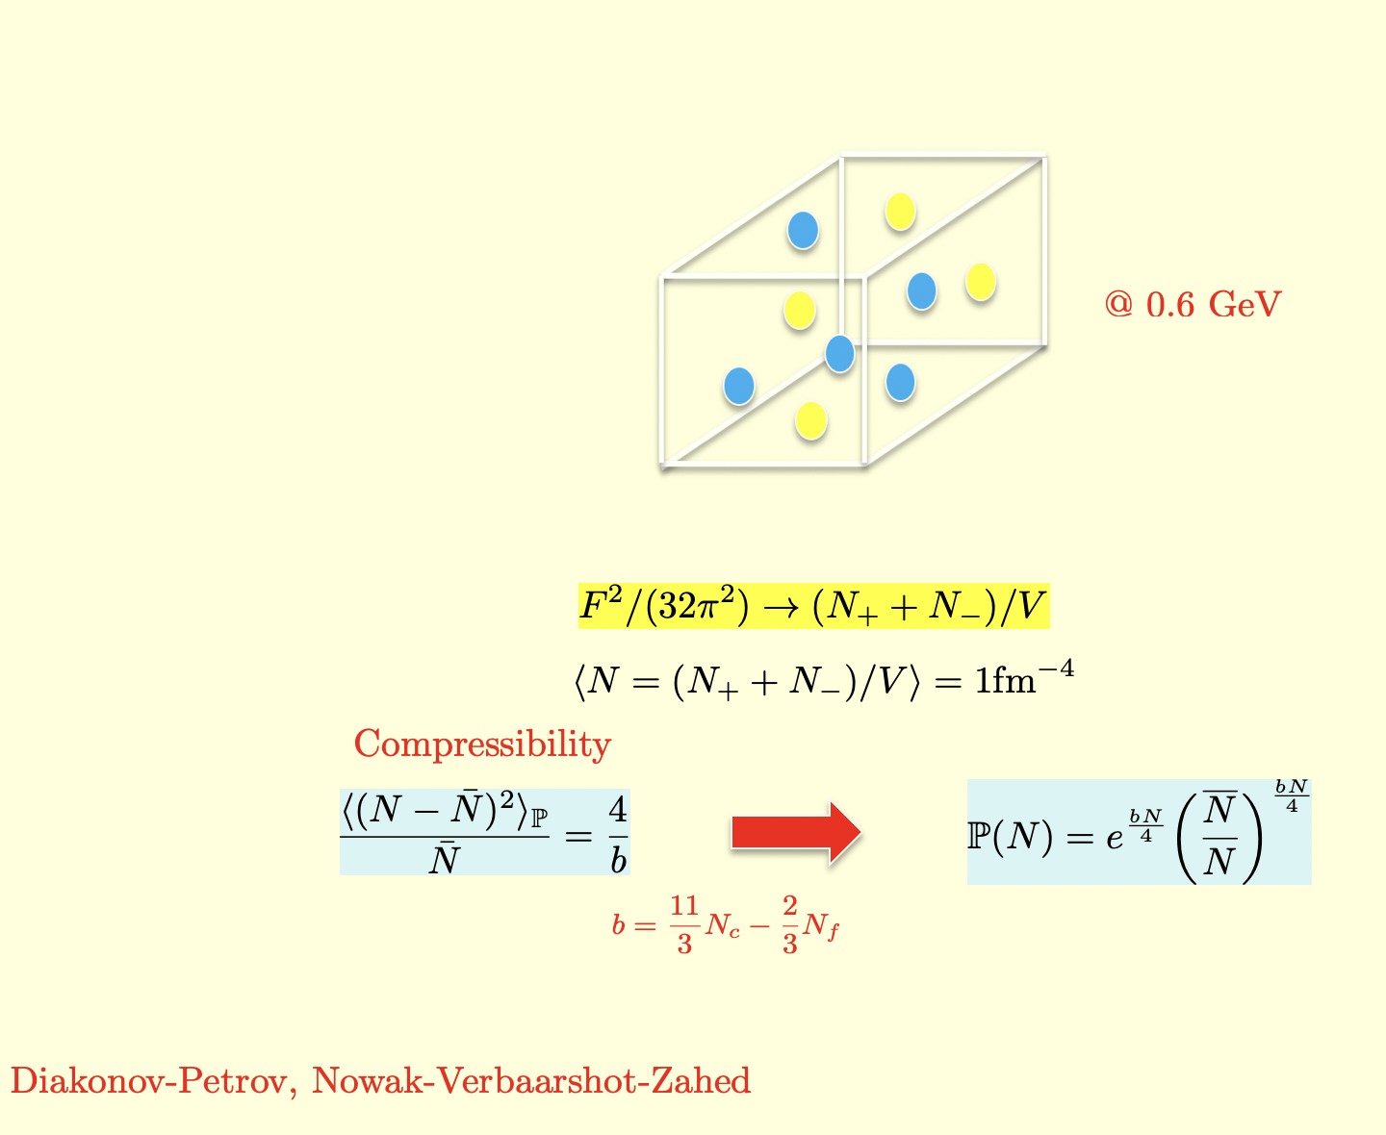
Instantons: summary
Glue: summary

Slide 10
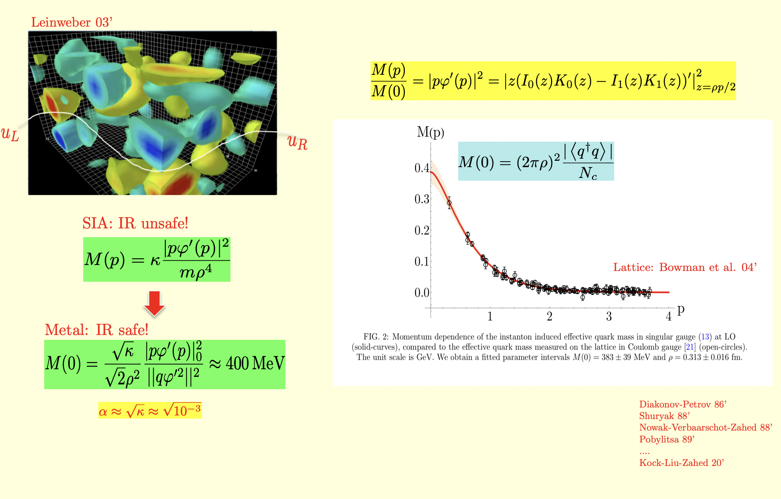
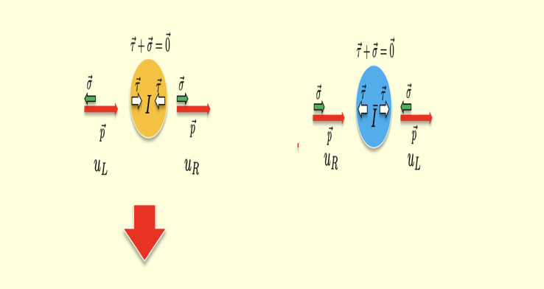
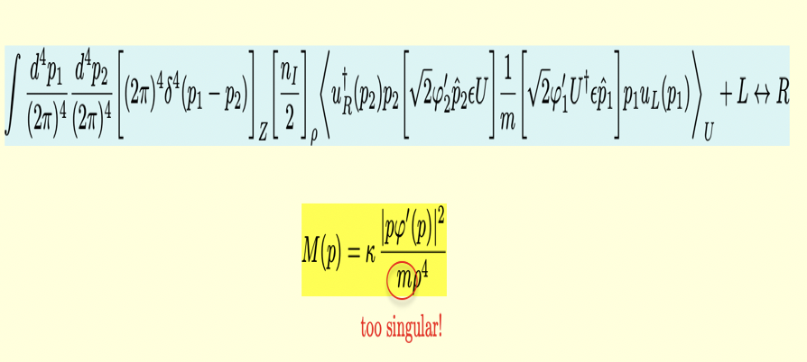
Emergent mass: ZM
Delocalization: qZM

Slide 11
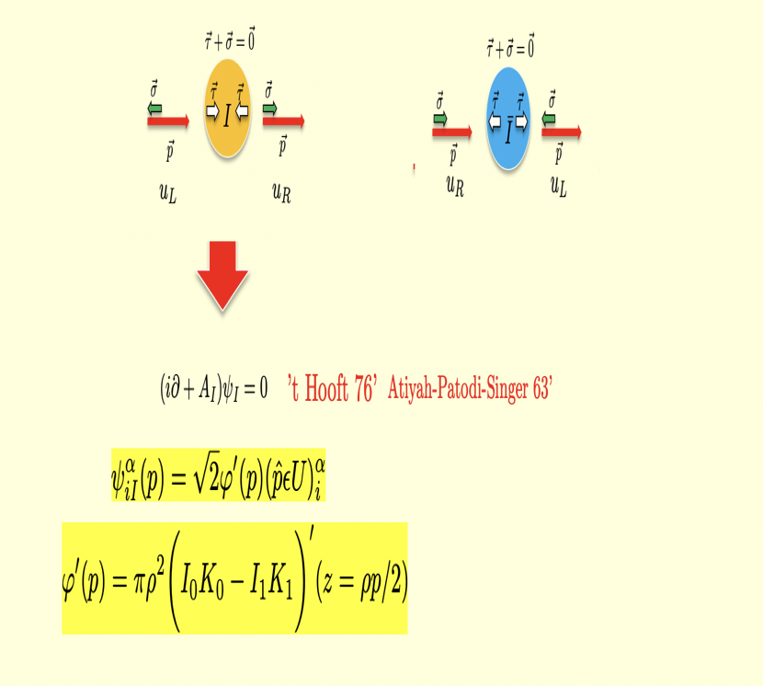
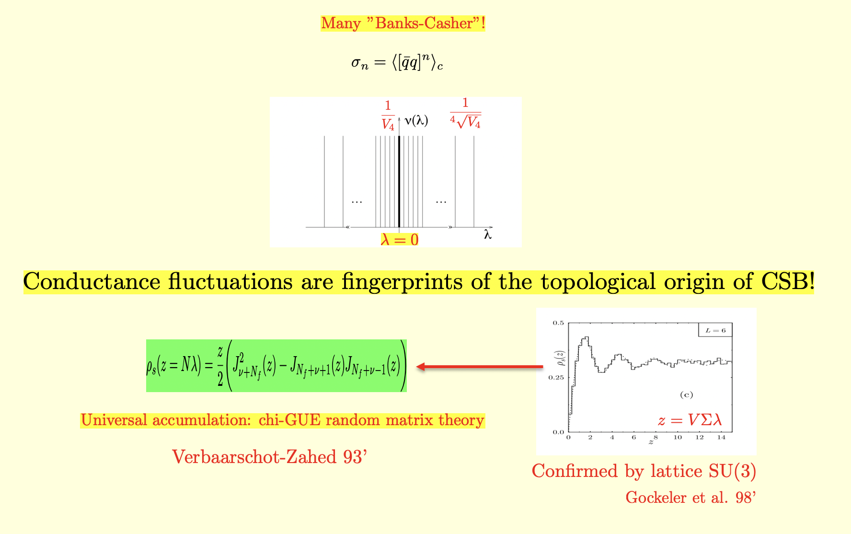
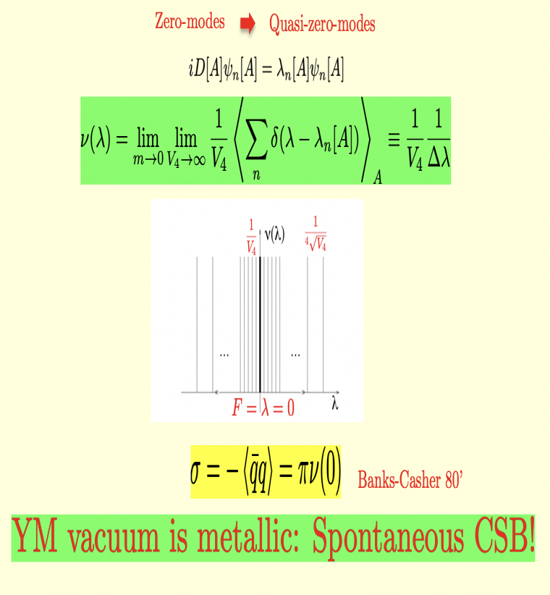
Banks-Casher: ZMZ in ILM
Many Banks-Casher in ILM

Slide 12
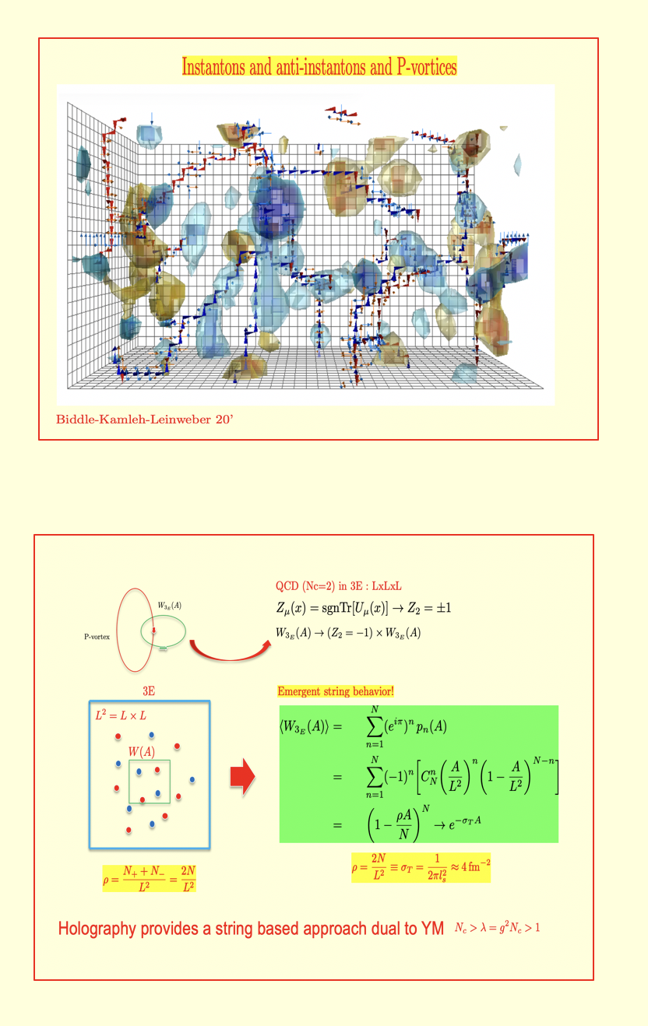
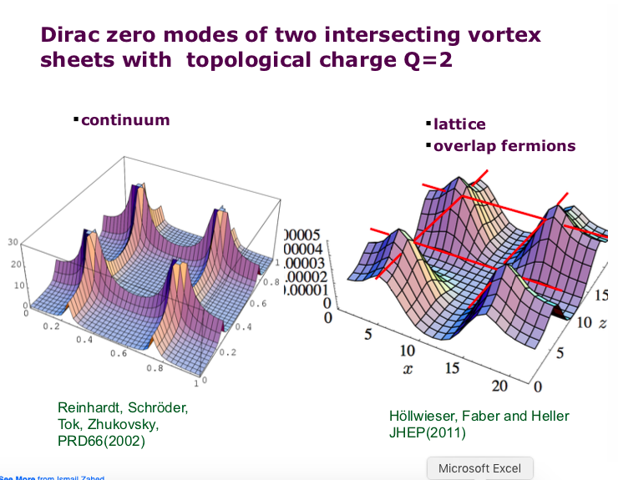
2D-3D Strings-Monopoles
Zero Modes in dual description

Slide 13
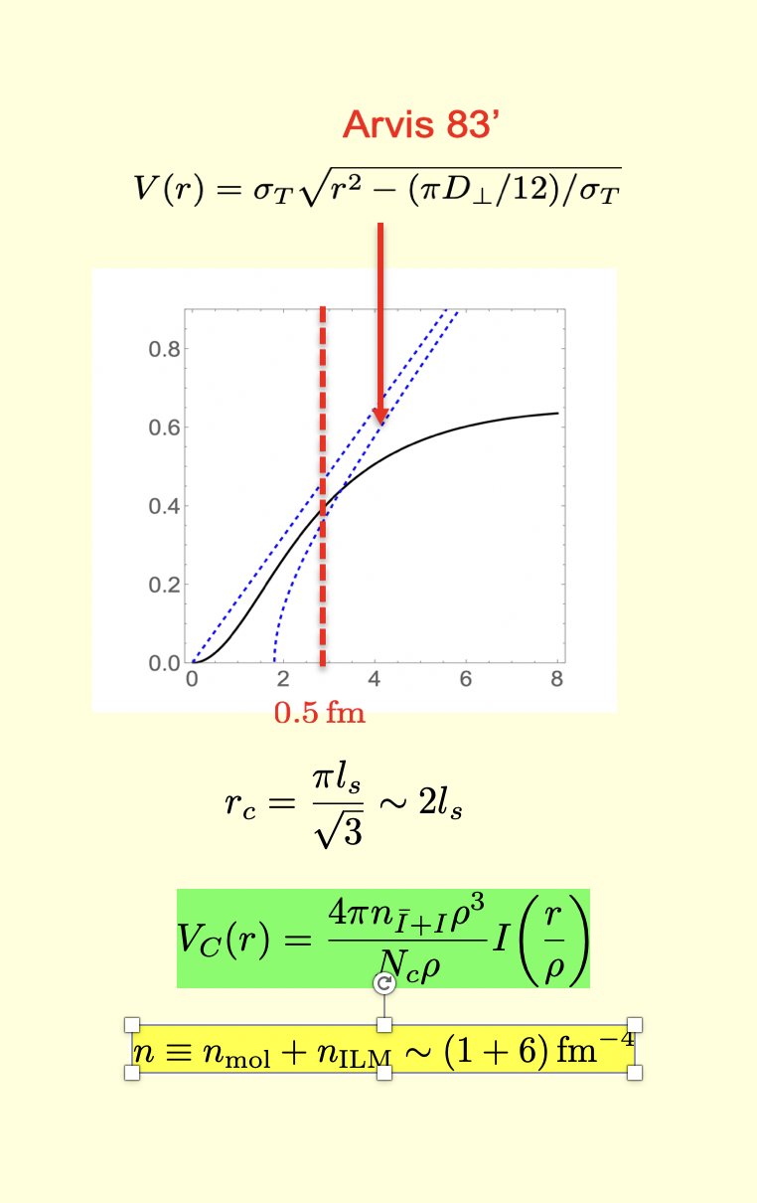
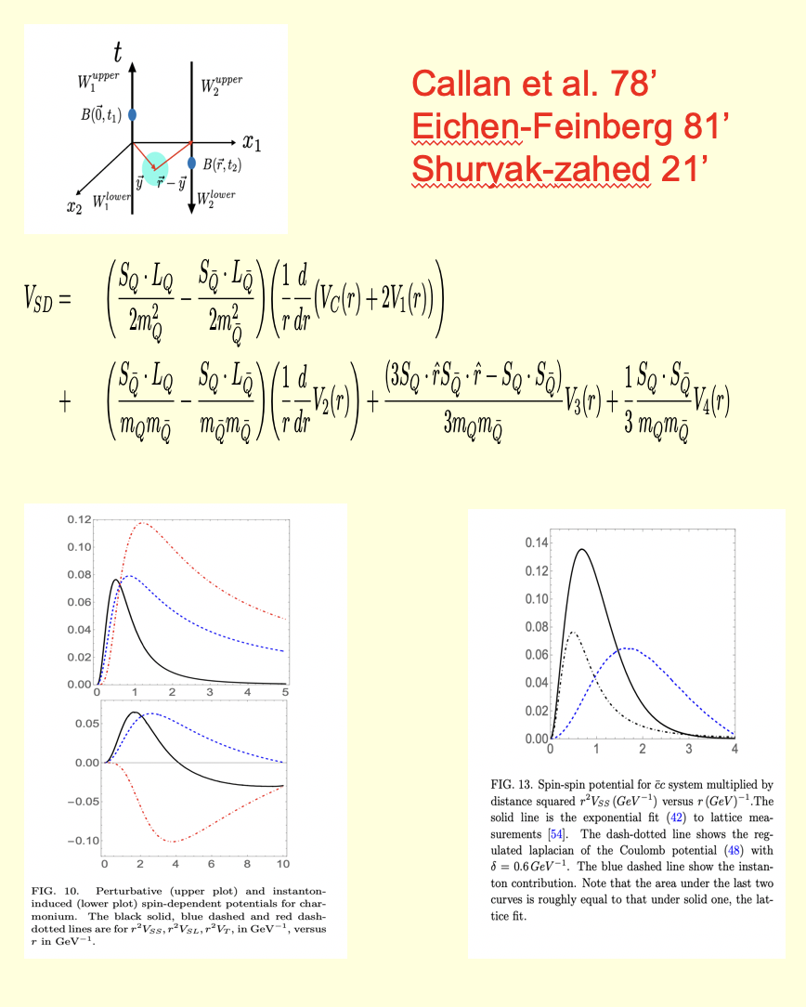
Central Potential Rest Frame
Spin Potential Rest Frame

Slide 14
ILM: Mass/Spin in CM

Slide 15
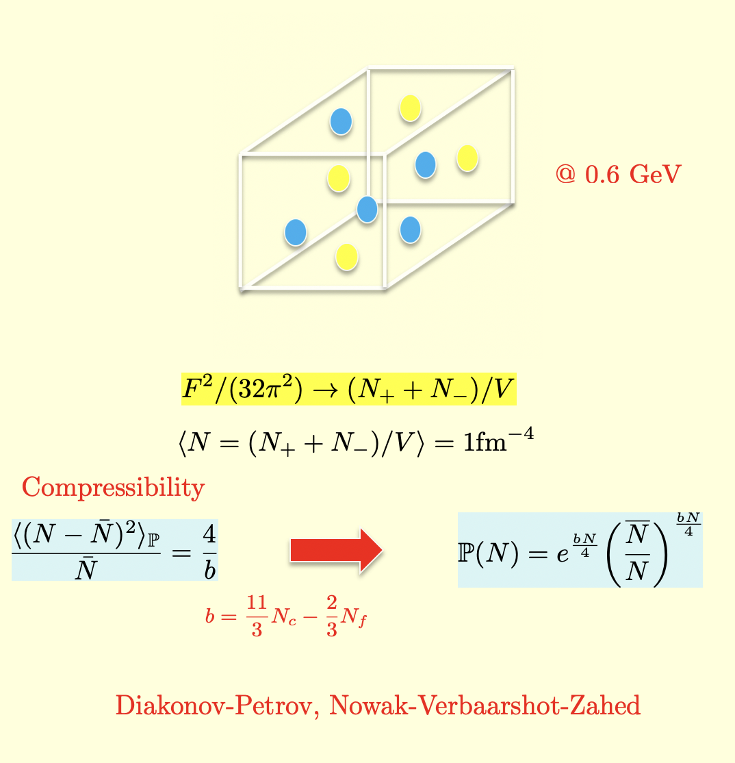
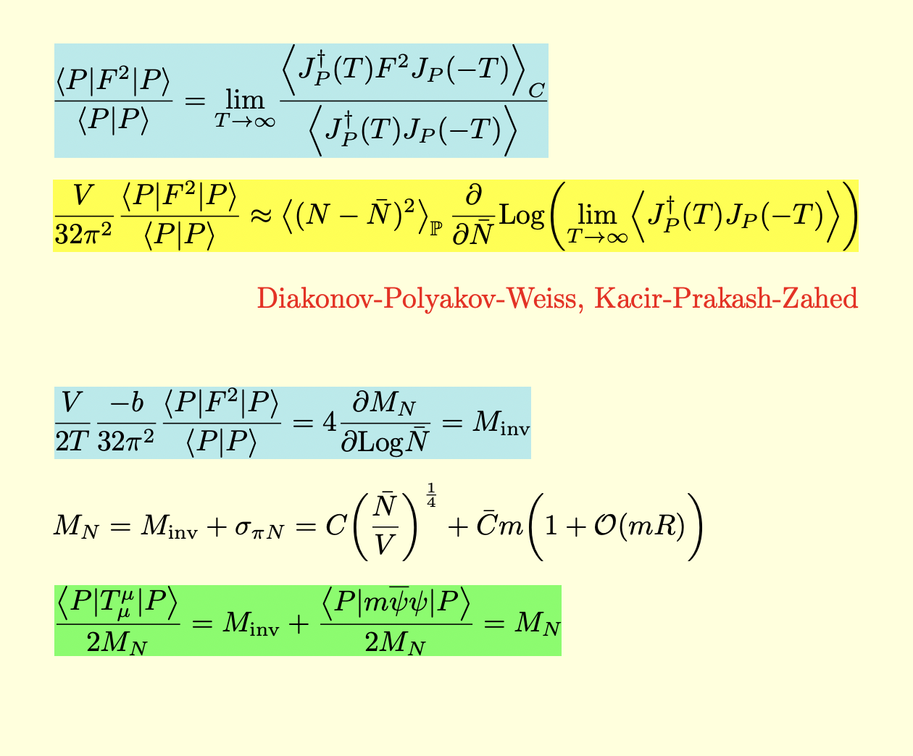
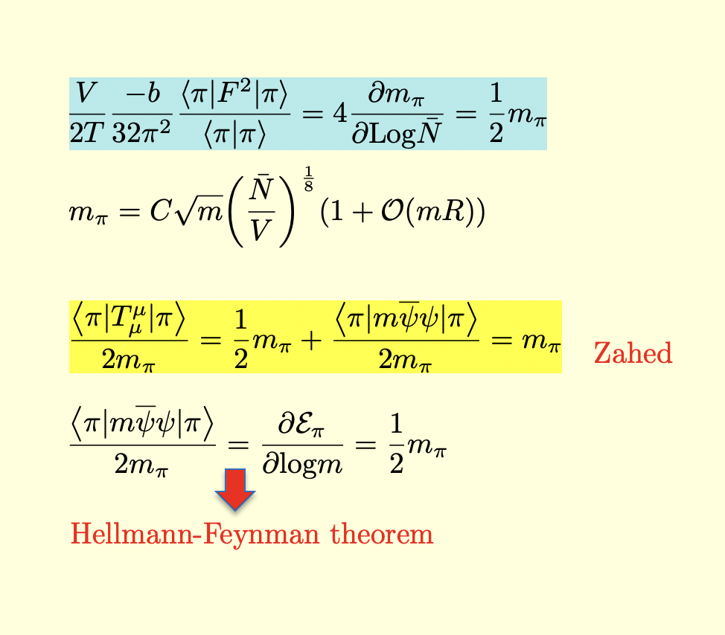
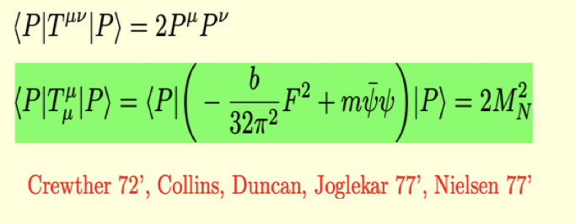
Mass Ward identity
vacuum compressibility
Nucleon mass sum rule
Pion mass sum rule

Slide 16
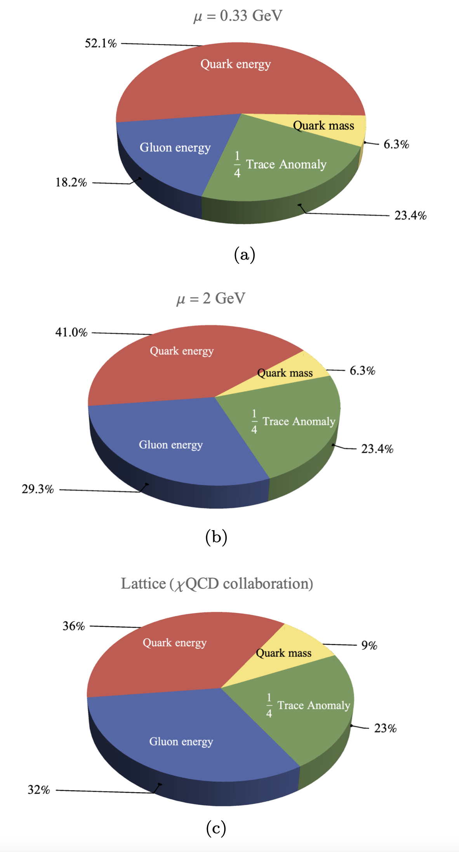
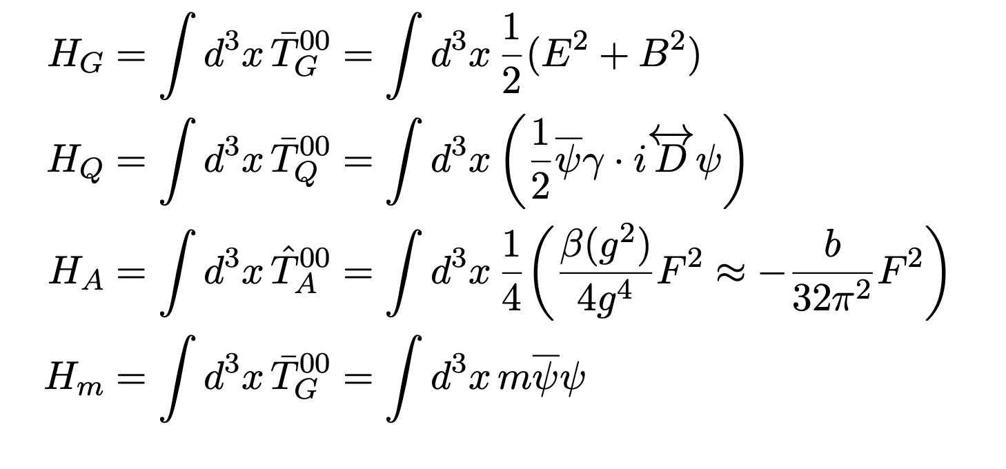
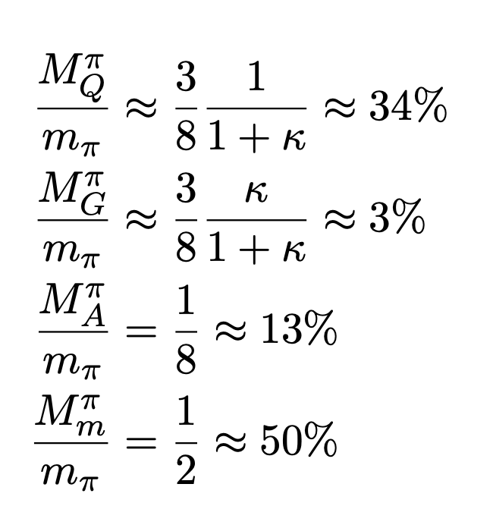
Ji nucleon mass budget
Ji nucleon mass budget

Slide 17
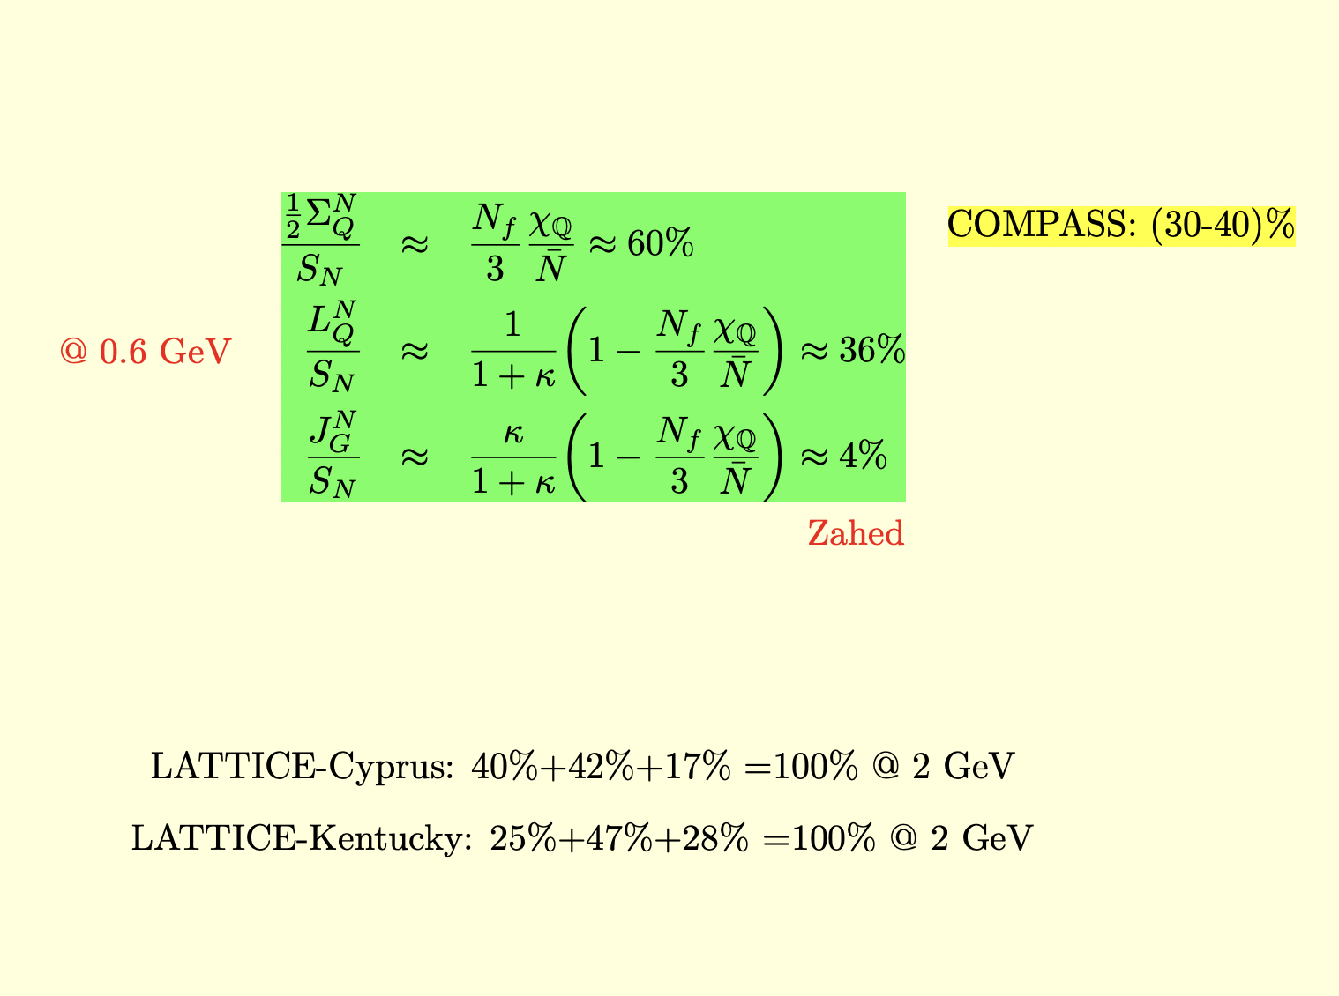
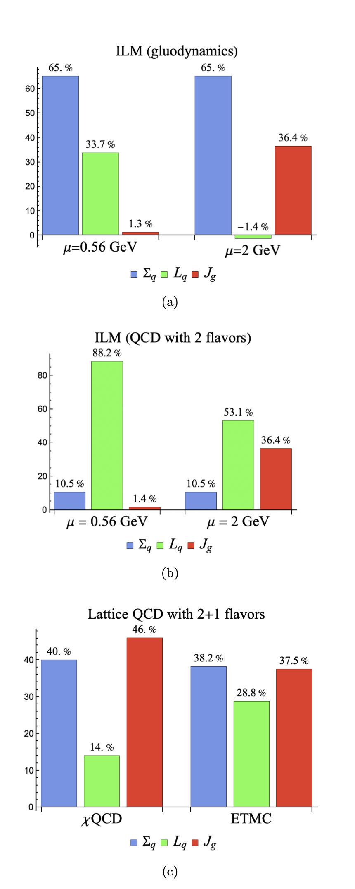
Ji spin decomposition
Ji Spin decomposition

Slide 18
ILM on LF

Slide 19
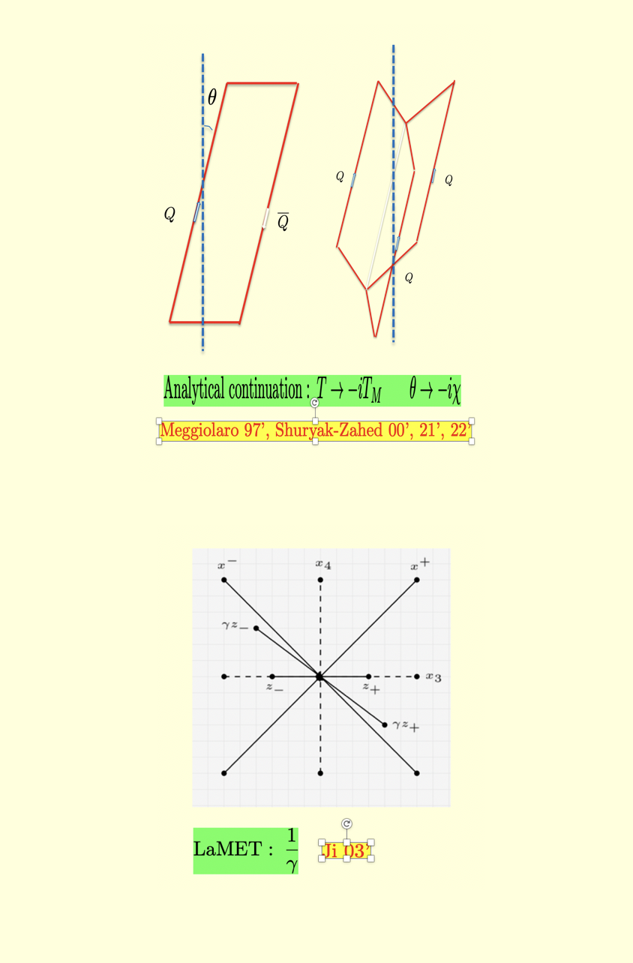
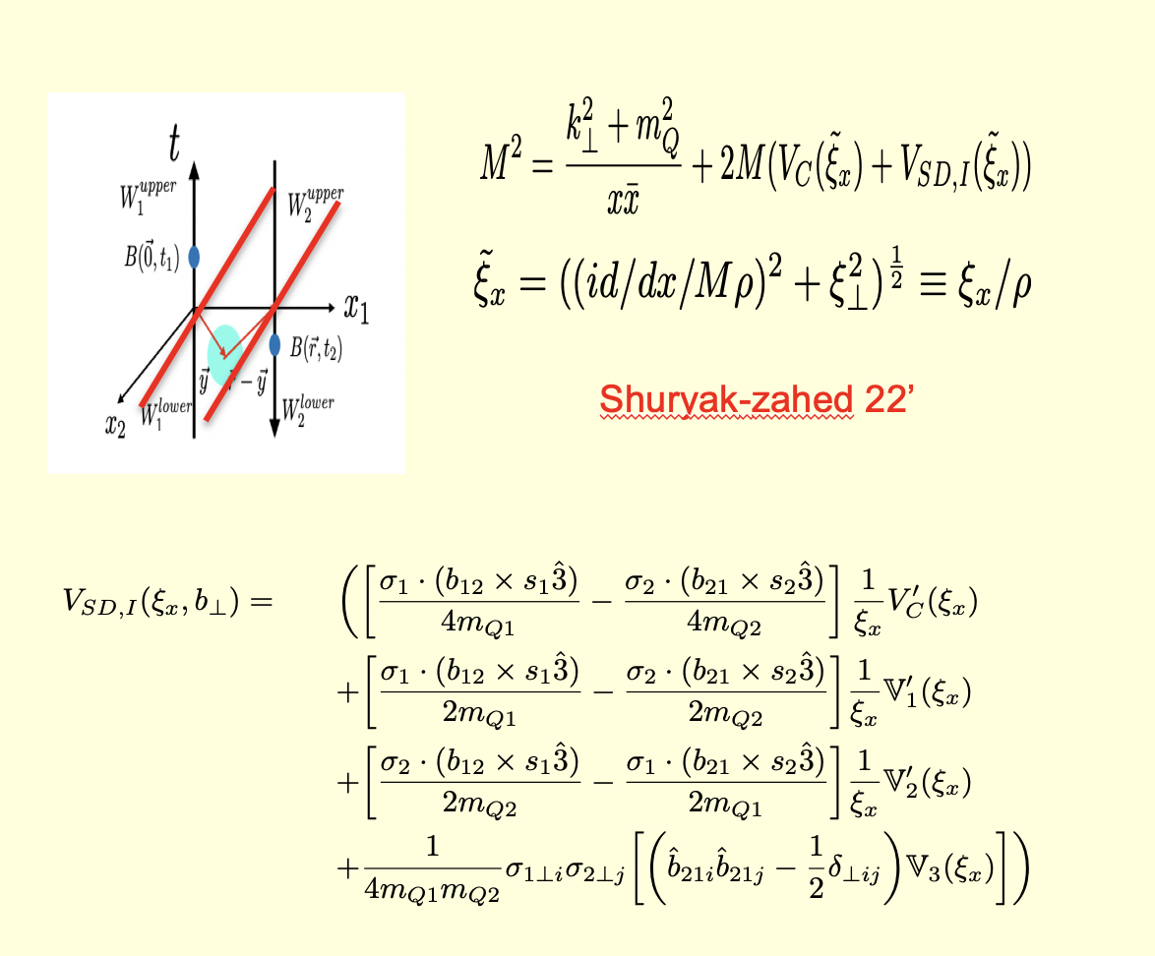
nZM Continuation E→ M
nZM Central and Spin E→ M
E. Shuryak and I. Zahed 22’

Slide 20
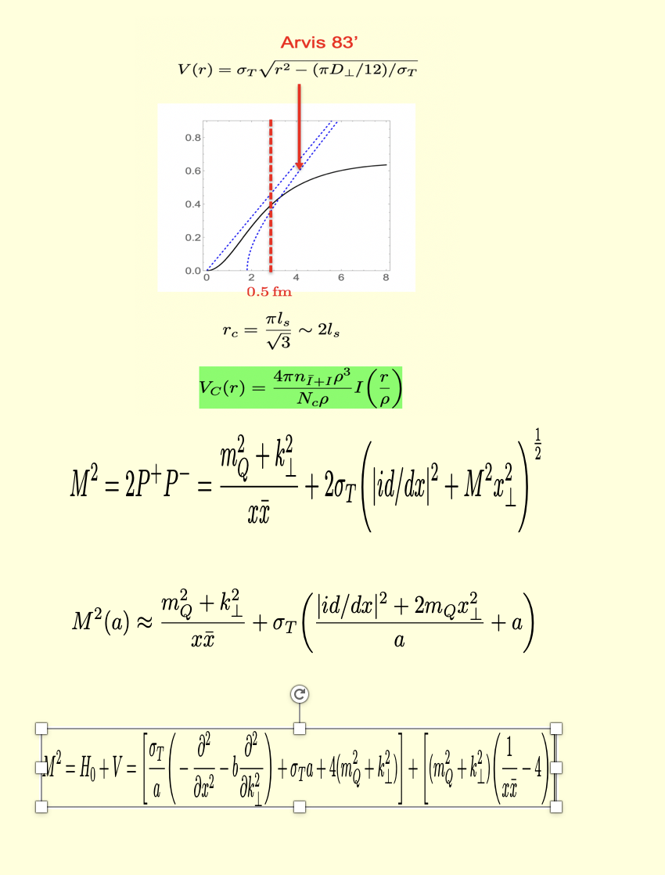
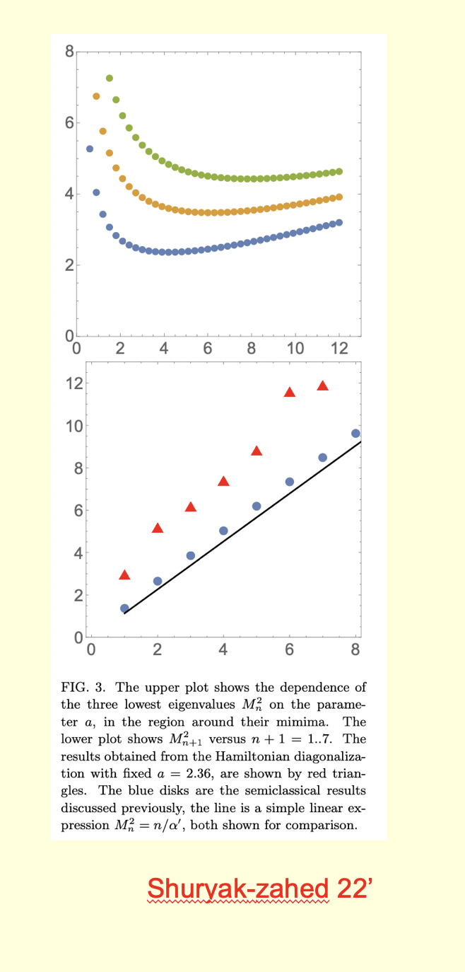
LF Hamiltonian heavy meson
Reggeized spectrum

Slide 21
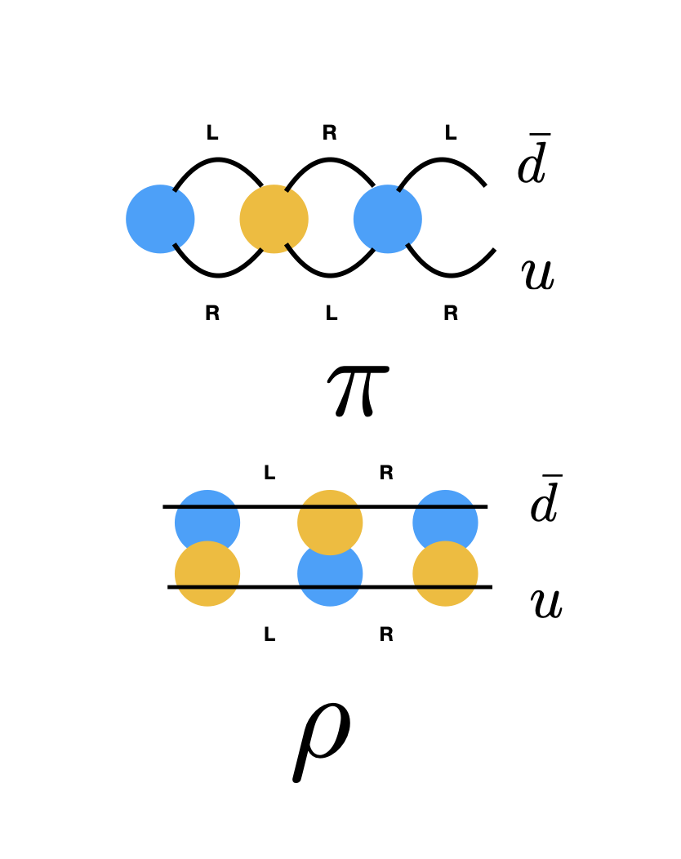
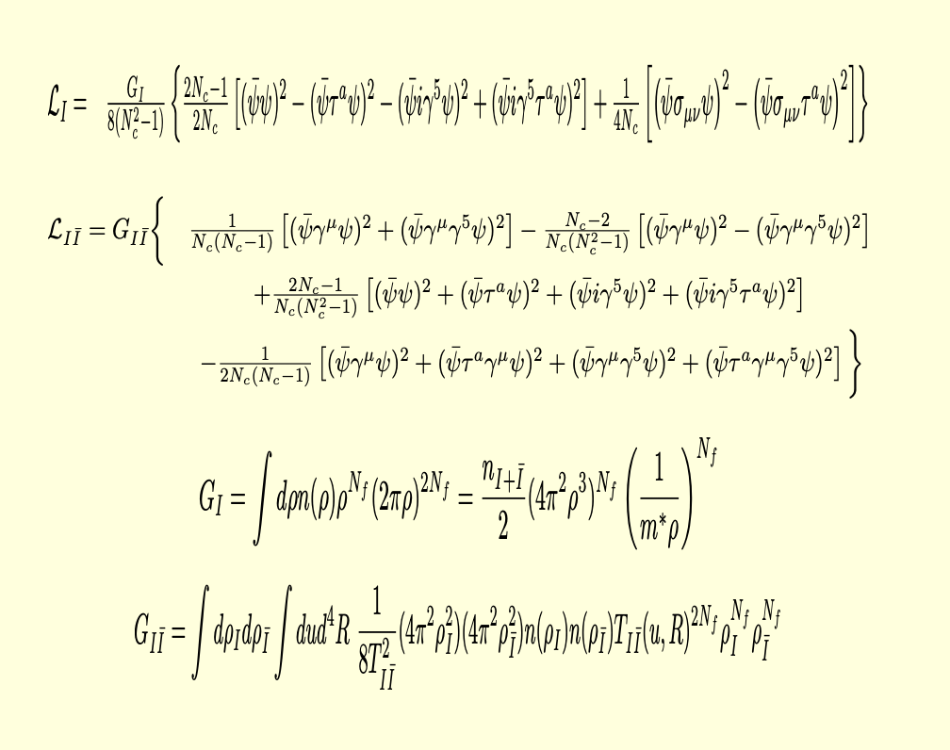
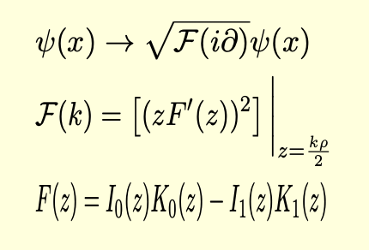
ZM in CM
Emergent ZM interactions in CM

Slide 22
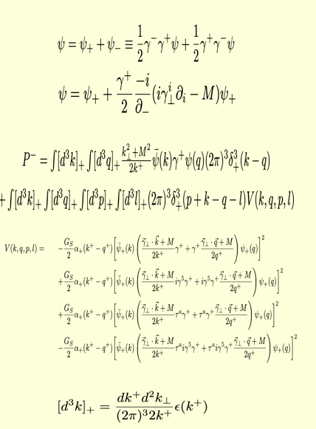
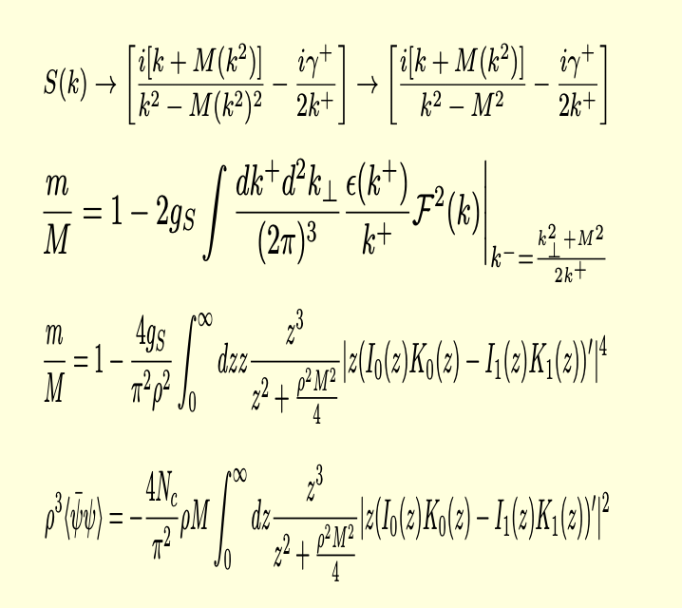
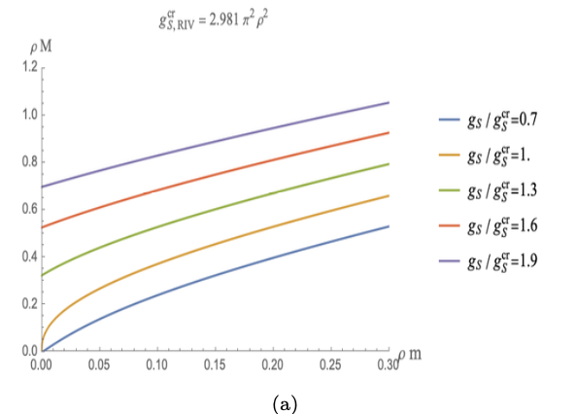
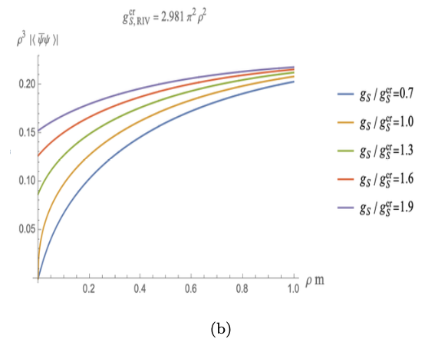
Emergent LF Hamiltonian: ZMs
Mass and condensate: LF frame

Slide 23
ILM: Pion-Rho LFWFs

Slide 24
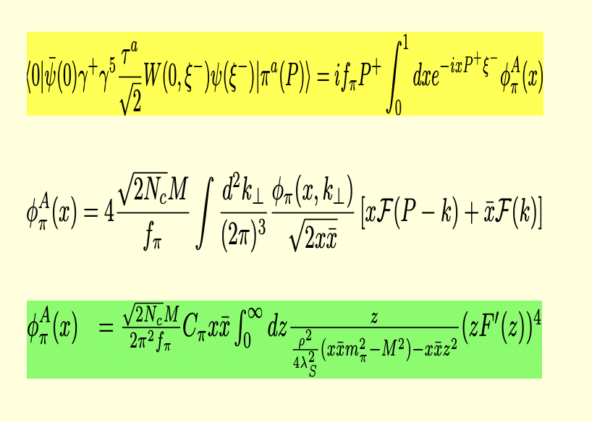
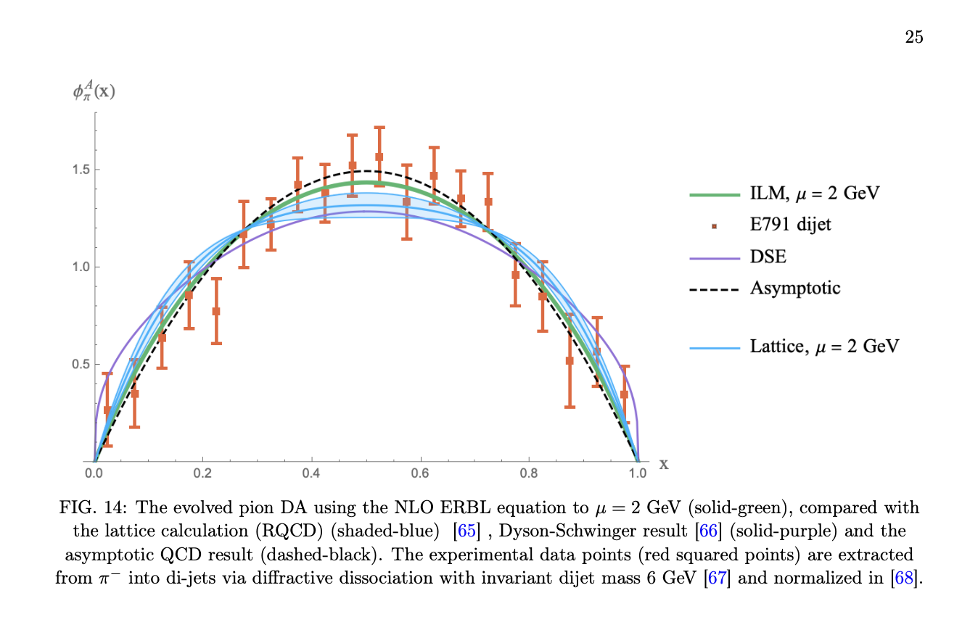
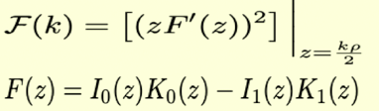
Twist-2 Pion DA in ILM
Twist-2 Pion DA

Slide 25
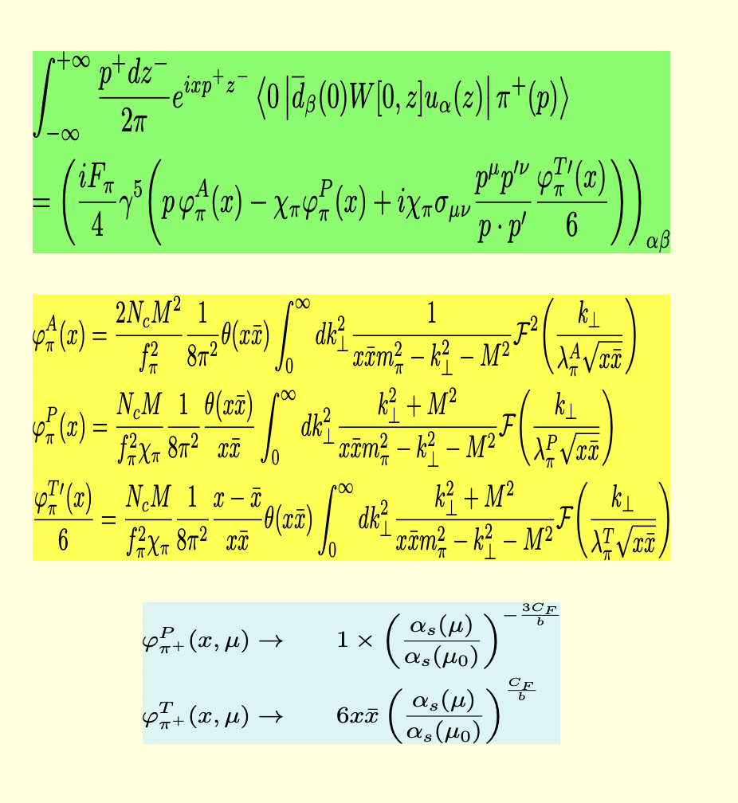
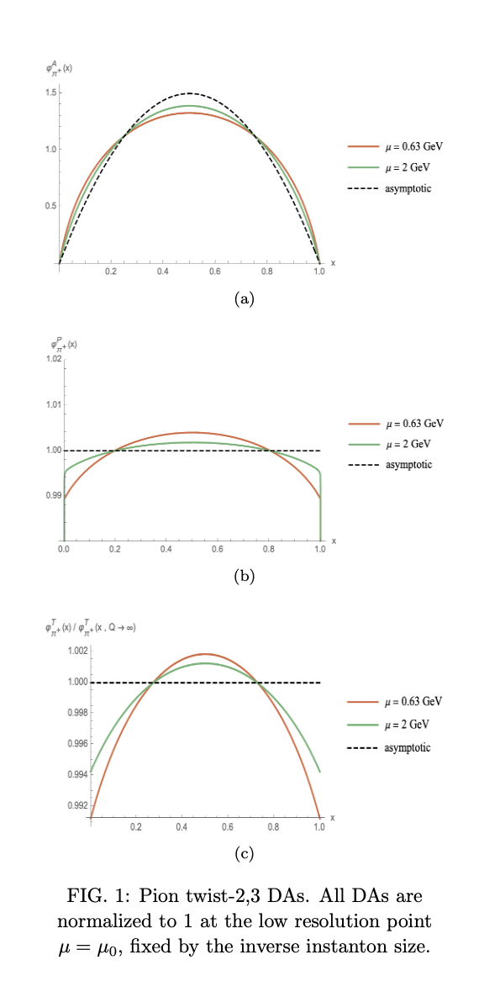
Twist-2,3 pion DA in ILM
Evolved Twist-2,3 pion DA

Slide 26
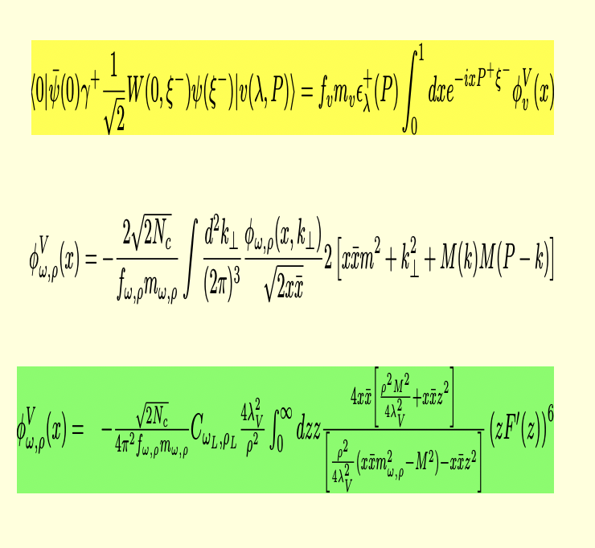
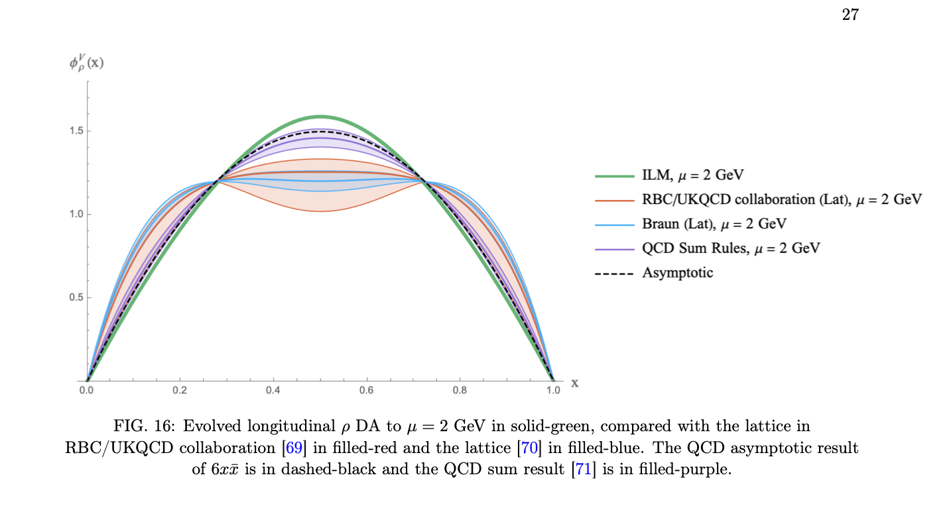
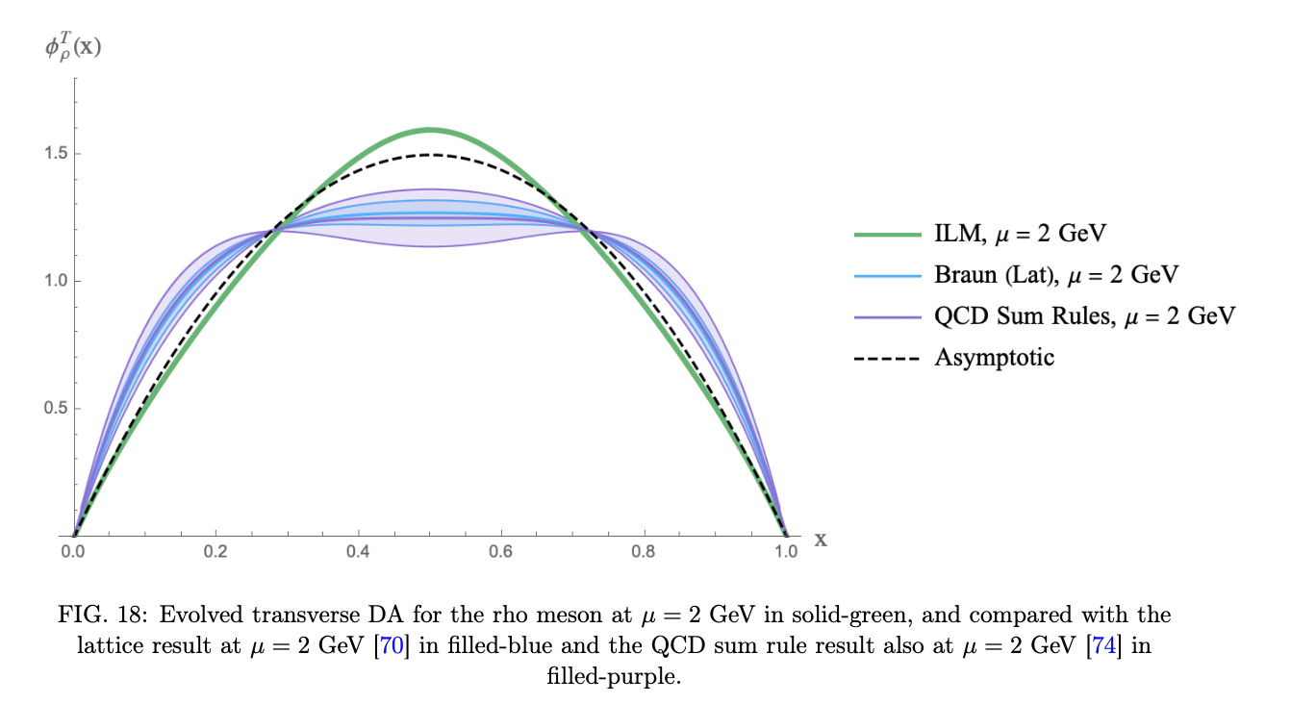
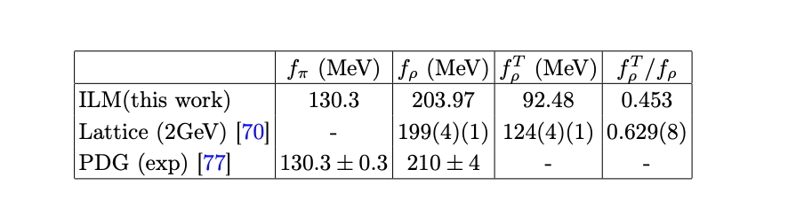
DA V-longitudinal in ILM
DA Rho-LT in ILM

Slide 27
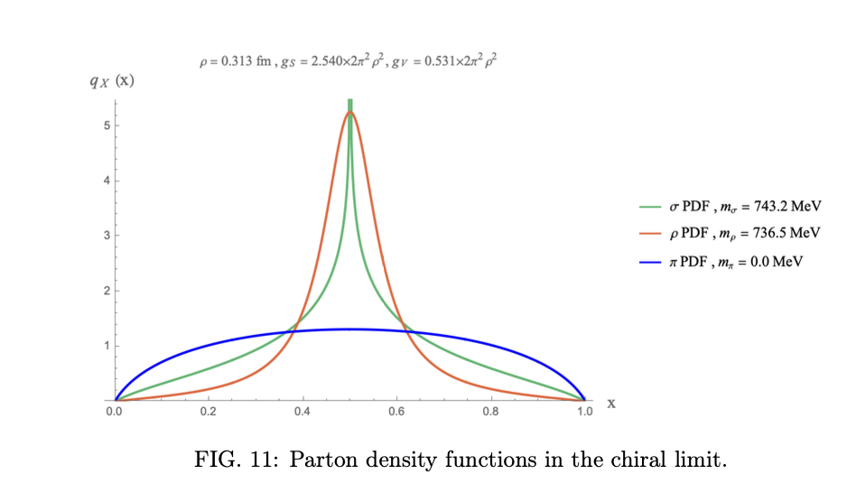
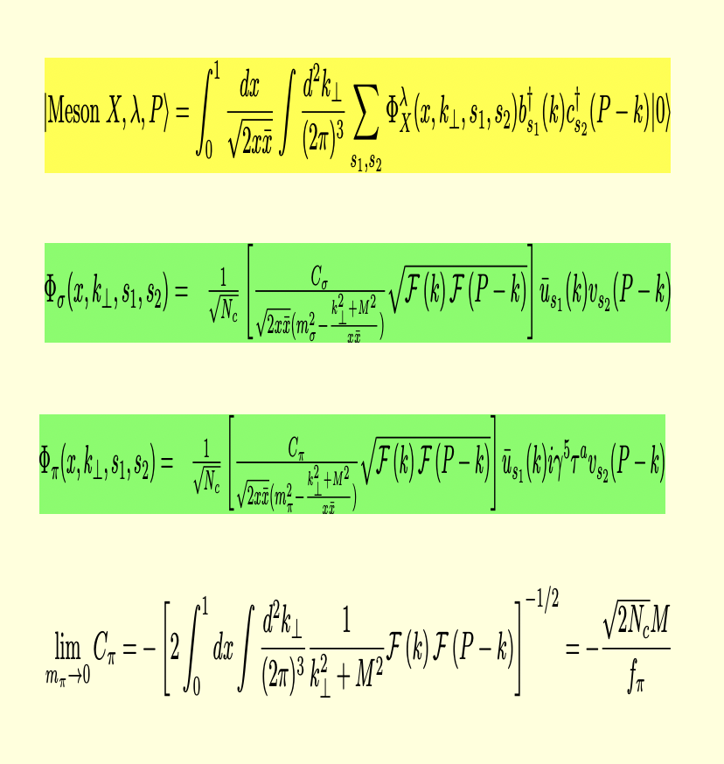

Light mesons in ILM
PDFs in ILM

Slide 28
Summary
Vacuum : 4D Glue
Mass/Spin : -Glue
Pi,K,Rho LFWFs : ZM profile

