Slide 1
O(N) NLSM from O(N) quartic model: OPE, condensates and renormalons
Yizhuang Liu, UJ
Based on 2507.02605

Slide 2
Outline
Part I: Introduction and motivation
Part II: OPE calculus for NLSM
Part III: Quartic O(N) model as a cutoff regularization for NLSM

Slide 3
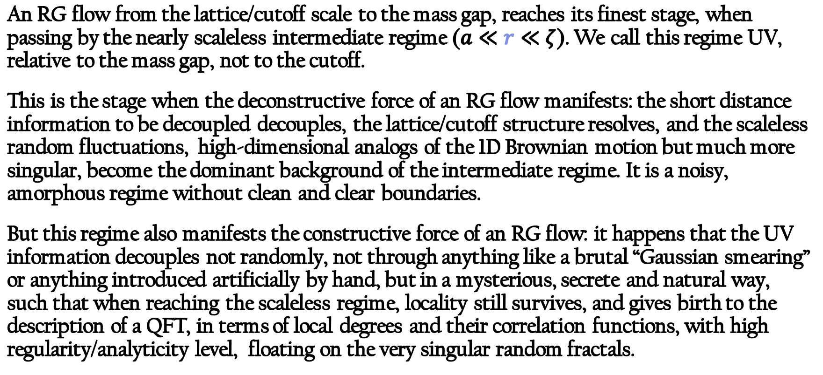
Introduction
An RG flow from the lattice/cutoff scale to the mass gap, reaches its finest stage, when passing by the nearly scaleless intermediate regime ($a≪r≪ζ$). We call this regime UV, relative to the mass gap, not to the cutoff.
This is the stage when the deconstructive force of an RG flow manifests: the short distance information to be decoupled decouples, the lattice/cutoff structure resolves, and the scaleless random fluctuations, high-dimensional analogs of the 1D Brownian motion but much more singular, become the dominant background of the intermediate regime. It is a noisy, amorphous regime without clean and clear boundaries.
But this regime also manifests the constructive force of an RG flow: it happens that the UV information decouples not randomly, not through anything like a brutal “Gaussian smearing” or anything introduced artificially by hand, but in a mysterious, secrete and natural way, such that when reaching the scaleless regime, locality still survives, and gives birth to the description of a QFT, in terms of local degrees and their correlation functions, with high regularity/analyticity level, floating on the very singular random fractals.

Slide 4
Introduction
More importantly, this regime witnesses the connecting role of an RG flow: the survived short distance information is assembled and reorganized here, and prepared smoothly in a way specified by the RG flow, to connect with the structures at larger distances.
It is this preparation stage, or asymptotic deviation stage, that is described by the fixed-point perturbation theory with Lagrangian prescriptions. These prescriptions are probably more on the side of UV/IR bookkeeping devices than on the side of QM/classical Lagrangian: they are usually based on specific ways of UV/IR separation and matching, and are used not to generate the full theory, but to compute the asymptotic expansions approaching/deviating the intermediate regime/fixed point.
When there are not too many logarithms and when the probed scales are not large, the UV/ IR separation underlying the Lagrangian-based algorithms could be sharp, but this distinction will finally become ambiguous, at least asymptotically.

Slide 5
Introduction
But the unambiguous UV/IR separation never truly exists, when the flow is highly logarithmic. We have seen cases, that UV/IR scales embrace tightly with each other, even at the leading order in the asymptotic expansions on top of the fixed-point power-laws.
In the perturbative algorithms, this reflects through the scale-scheme, UV/IR, renormalon....., all kinds of ambiguities and relativeness. However, perturbative algorithm still works, and asymptotic conjectures can still be written, when ambiguities/singularities cancel or factorize miraculously, in a way specified by the RGEs: a set of relations that allow to bring the logarithms from the numerator to the denominator, and make perturbative expansions asymptotic, in the MS-bar-like short-distance schemes.
Unlike the schemes based on true IR physics, the short-distance schemes really belong to the logarithmic, continuous and boundaryless RG flow in its finest stage.

Slide 6
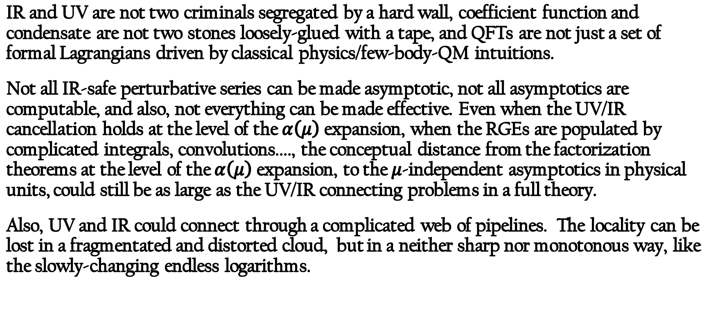
Introduction
IR and UV are not two criminals segregated by a hard wall, coefficient function and condensate are not two stones loosely-glued with a tape, and QFTs are not just a set of formal Lagrangians driven by classical physics/few-body-QM intuitions.
Not all IR-safe perturbative series can be made asymptotic, not all asymptotics are computable, and also, not everything can be made effective. Even when the UV/IR cancellation holds at the level of the $α\left(μ\right)$expansion, when the RGEs are populated by complicated integrals, convolutions...., the conceptual distance from the factorization theorems at the level of the $α\left(μ\right)$expansion, to the $μ$-independent asymptotics in physical units, could still be as large as the UV/IR connecting problems in a full theory.
Also, UV and IR could connect through a complicated web of pipelines. The locality can be lost in a fragmentated and distorted cloud, but in a neither sharp nor monotonous way, like the slowly-changing endless logarithms.

Slide 7
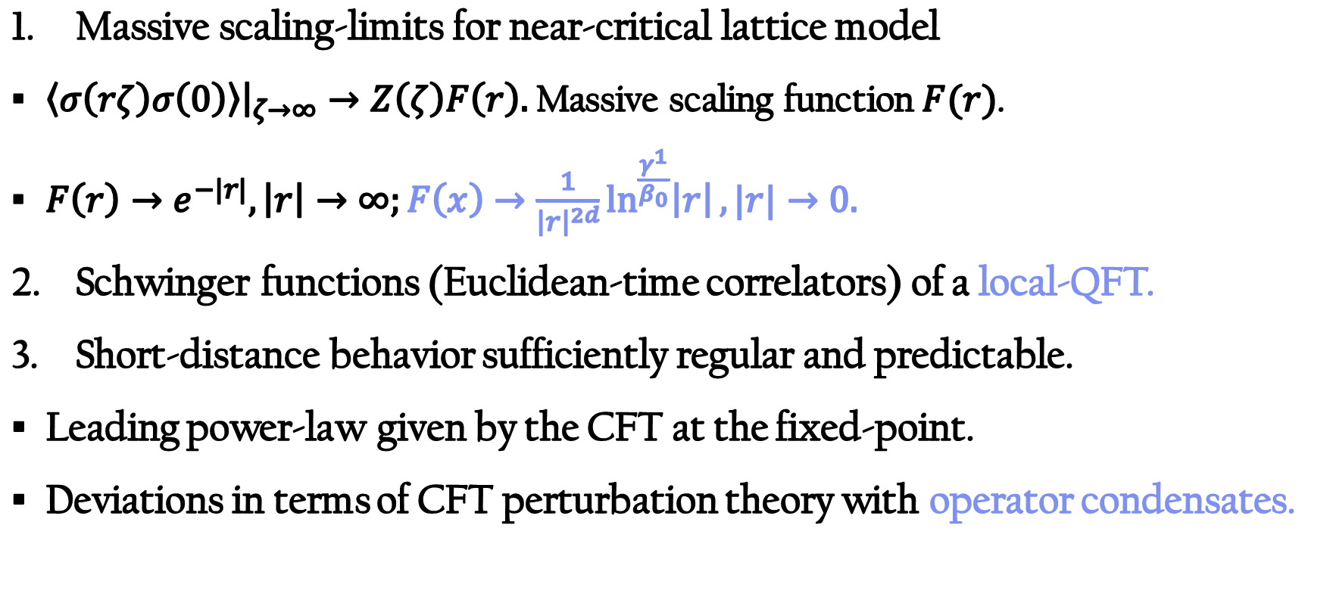
Behavior near UV fixed-point
Massive scaling-limits for near-critical lattice model
$\left\langle σ\left(rζ\right)σ\left(0\right)\right\rangle {\left.​\right|}_{ζ→∞}→Z\left(ζ\right)F\left(r\right).$Massive scaling function $F(r)$.
$F\left(r\right)→e^{−|r|},\left|r\right|→∞;F\left(x\right)→\frac{1}{{\left|r\right|}^{2d}}\ln^{\frac{γ^{1}}{β_{0}}}\left|r\right|,|r|→0.$
Schwinger functions (Euclidean-time correlators) of a local-QFT.
Short-distance behavior sufficiently regular and predictable.
Leading power-law given by the CFT at the fixed-point.
Deviations in terms of CFT perturbation theory with operator condensates.

Slide 8
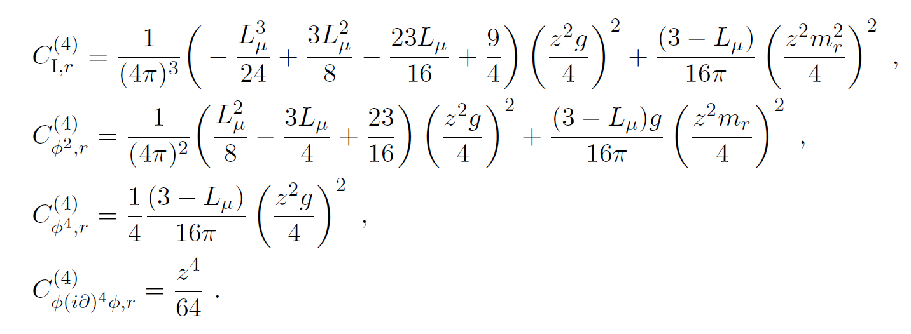


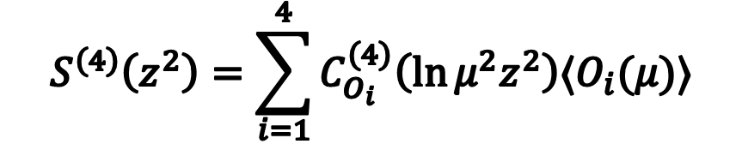
Example 1: coefficient functions in a supper-renormalizable QFT
At the $O(z^{4})$ order in the small distance expansion of the 2pt $⟨φ\left(z\right)φ(0)⟩$, in the 2D massive $φ^{4}$ , there are four operator condensates:
$O_{1}=1;O_{2}=φ^{2};O_{3}=φ^{4};O_{4}=φ{\left(∇^{2}\right)}^{2}φ$ .
Their coefficient functions at $O(z^{4})$ purely from massless PT. IR canceled by UV.
$$L_{μ}=\ln{\frac{μ^{2}z^{2}e^{2γ_{E}}}{4}}$$
$$S^{\left(4\right)}\left(z^{2}\right)=\sum_{i=1}^{4}{C_{O_{i}}^{\left(4\right)}\left(\ln{μ^{2}z^{2}}\right)⟨O_{i}(μ)⟩}$$

Slide 9
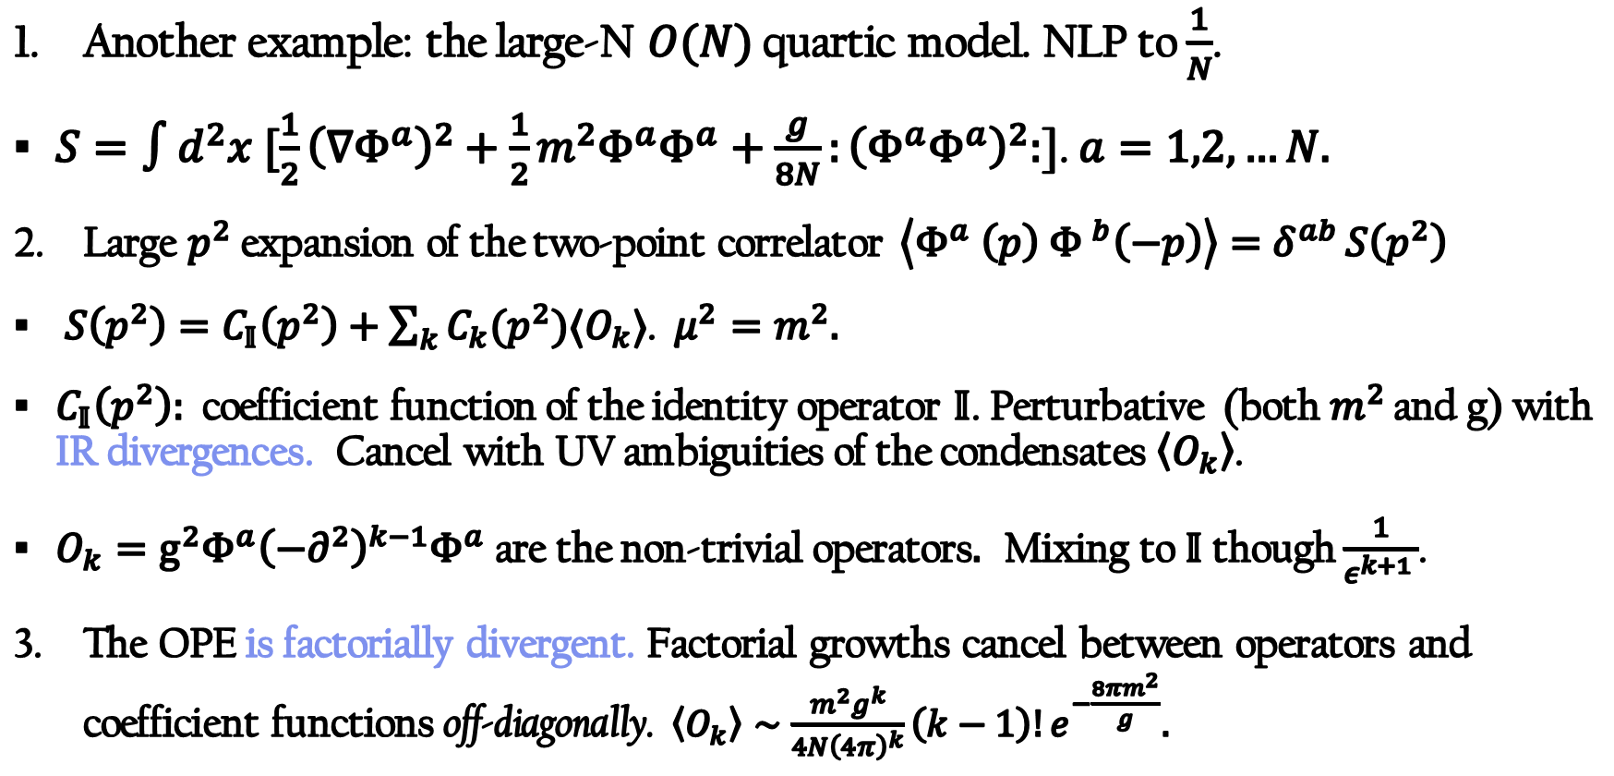
Example 2: OPE divergence (JHEP 08 (2025) 014)
Another example: the large-N $O(N)$ quartic model. NLP to $\frac{1}{N}$.
$S=∫d^{2}x [\frac{1}{2}{\left(∇Φ^{a}\right)}^{2}+\frac{1}{2}m^{2}Φ^{a}Φ^{a}+\frac{g}{8N}:{\left(Φ^{a}Φ^{a}\right)}^{2}:$]. $a=1,2,…N.$
Large $p^{2}$ expansion of the two-point correlator $\left\langle Φ^{a}{ \left(p\right) Φ }^{b}\left(−p\right)\right\rangle =δ^{ab }S\left(p^{2}\right)$
$S\left(p^{2}\right)=C_{𝕀}\left(p^{2}\right)+\sum_{k}{C_{k}(p^{2})⟨O_{k}⟩}$.$μ^{2}=m^{2}.$
$C_{𝕀}\left(p^{2}\right):$ coefficient function of the identity operator $𝕀$. Perturbative (both$m^{2}$ and g) with IR divergences. Cancel with UV ambiguities of the condensates$\left\langle O_{k}\right\rangle$.
$O_{k}={g^{2}Φ}^{a}{\left(−∂^{2}\right)}^{k−1}Φ^{a}$ are the non-trivial operators$.$ Mixing to $𝕀$ though $\frac{1}{ε^{k+1 }}$.
The OPE is factorially divergent. Factorial growths cancel between operators and coefficient functions off-diagonally. $\left\langle O_{k}\right\rangle ∼\frac{m^{2}g^{k}}{{4N\left(4π\right)}^{k}}\left(k−1\right)!e^{−\frac{8πm^{2}}{g}}.$

Slide 10
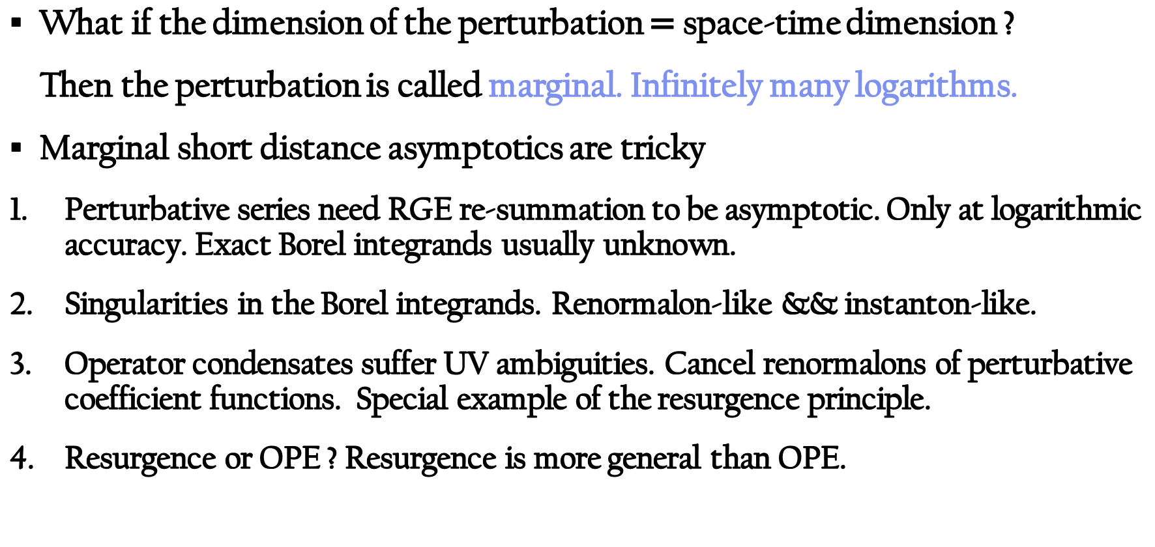
Marginal asymptotics
What if the dimension of the perturbation $=$ space-time dimension ?
Then the perturbation is called marginal. Infinitely many logarithms.
Marginal short distance asymptotics are tricky
Perturbative series need RGE re-summation to be asymptotic. Only at logarithmic accuracy. Exact Borel integrands usually unknown.
Singularities in the Borel integrands. Renormalon-like && instanton-like.
Operator condensates suffer UV ambiguities. Cancel renormalons of perturbative coefficient functions. Special example of the resurgence principle.
Resurgence or OPE ? Resurgence is more general than OPE.

Slide 11
Marginal asymptotics: free-energies
Marginal asymptotics are difficult to obtain from first principle.
Free-energy in the large-external field limit in integrable 2D QFTs.
O(N) NLSM (bosonic), Gross-Neveu model (fermionic).
Linear integral equations (Thermal dynamical Bethe equations). Wiener-Hopf analysis applicable.
PT is likely correct (checked to high order in the large-N NLSM). Renormalons identified in fermionic models.
However, exponentially small corrections (power correction) to free energy lack field-theorical understanding. No OPE for them.

Slide 12
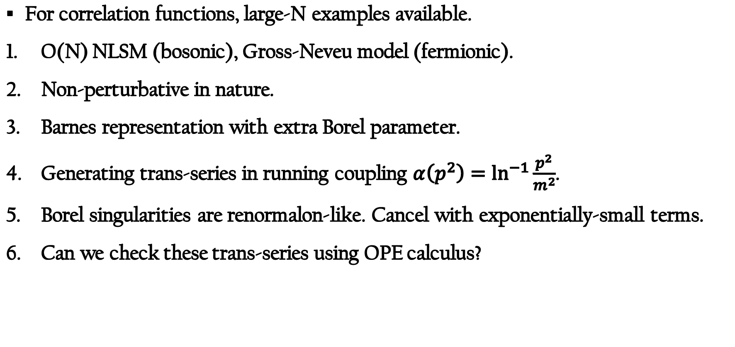
Marginal asymptotics: large-N for correlator
For correlation functions, large-N examples available.
O(N) NLSM (bosonic), Gross-Neveu model (fermionic).
Non-perturbative in nature.
Barnes representation with extra Borel parameter.
Generating trans-series in running coupling $α\left(p^{2}\right)=\ln^{−1}{\frac{p^{2}}{m^{2}}}$.
Borel singularities are renormalon-like. Cancel with exponentially-small terms.
Can we check these trans-series using OPE calculus?

Slide 13
Outline
Part I: Introduction and motivation
Part II: OPE calculus for NLSM
Part III: Quartic O(N) model as a cutoff regularization for NLSM

Slide 14
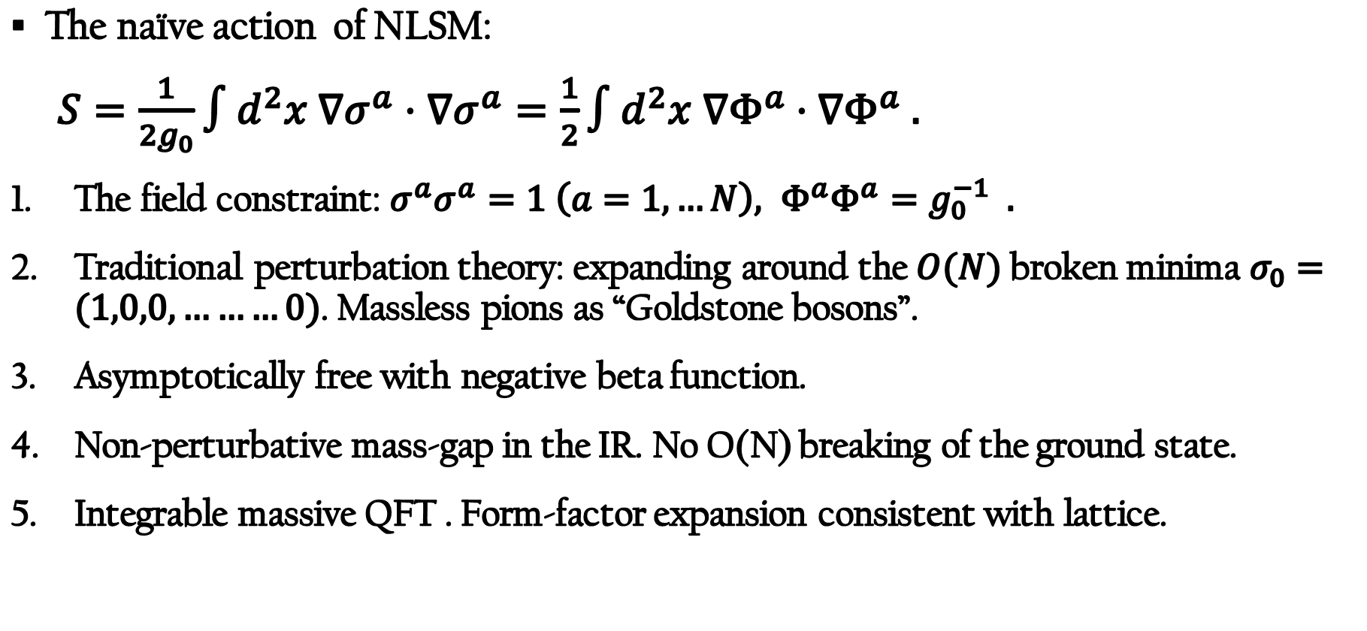
Perturbative and non-perturbative NLSM
The naïve action of NLSM:
$S=\frac{1}{2g_{0}}∫d^{2}x ∇σ^{a}⋅∇σ^{a}=\frac{1}{2}∫d^{2}x ∇Φ^{a}⋅∇Φ^{a} .$
The field constraint: $σ^{a}σ^{a}=1 \left(a=1,…N\right), Φ^{a}Φ^{a}=g_{0}^{−1} .$
Traditional perturbation theory: expanding around the $O(N)$ broken minima $σ_{0}=(1,0,0,………0)$. Massless pions as “Goldstone bosons”.
Asymptotically free with negative beta function.
Non-perturbative mass-gap in the IR. No O(N) breaking of the ground state.
Integrable massive QFT . Form-factor expansion consistent with lattice.

Slide 15
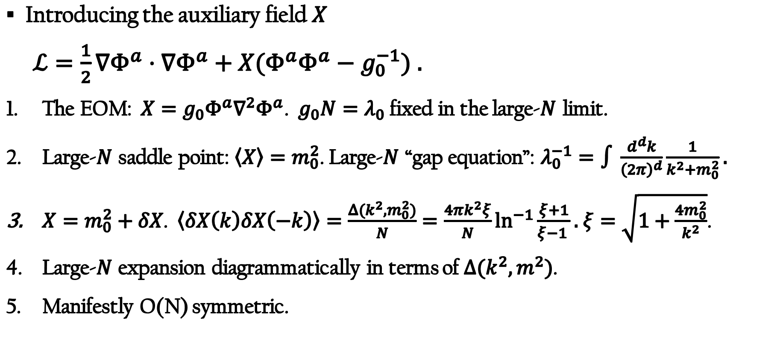
Large-N expansion of NLSM
Introducing the auxiliary field $X$
$ℒ=\frac{1}{2}∇Φ^{a}⋅∇Φ^{a}+X(Φ^{a}Φ^{a}−g_{0}^{−1}) .$
The EOM: $X=g_{0}Φ^{a}∇^{2}Φ^{a}$. $g_{0}N=λ_{0}$ fixed in the large-$N$ limit.
Large-$N$ saddle point: $\left\langle X\right\rangle =m_{0}^{2}$. Large-$N$ “gap equation”: $λ_{0}^{−1}=∫\frac{d^{d}k}{{\left(2π\right)}^{d}}\frac{1}{k^{2}+m_{0}^{2}}.$
$X=m_{0}^{2}+δX$. $\left\langle δX\left(k\right)δX\left(−k\right)\right\rangle =\frac{Δ(k^{2},m_{0}^{2})}{N}=\frac{4πk^{2}ξ}{N}\ln^{−1}{\frac{ξ+1}{ξ−1 }}.$ $ξ=\sqrt{1+\frac{4m_{0}^{2}}{k^{2}}}$.
Large-$N$ expansion diagrammatically in terms of $Δ(k^{2},m^{2})$.
Manifestly O(N) symmetric.

Slide 16
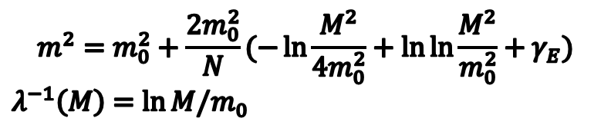
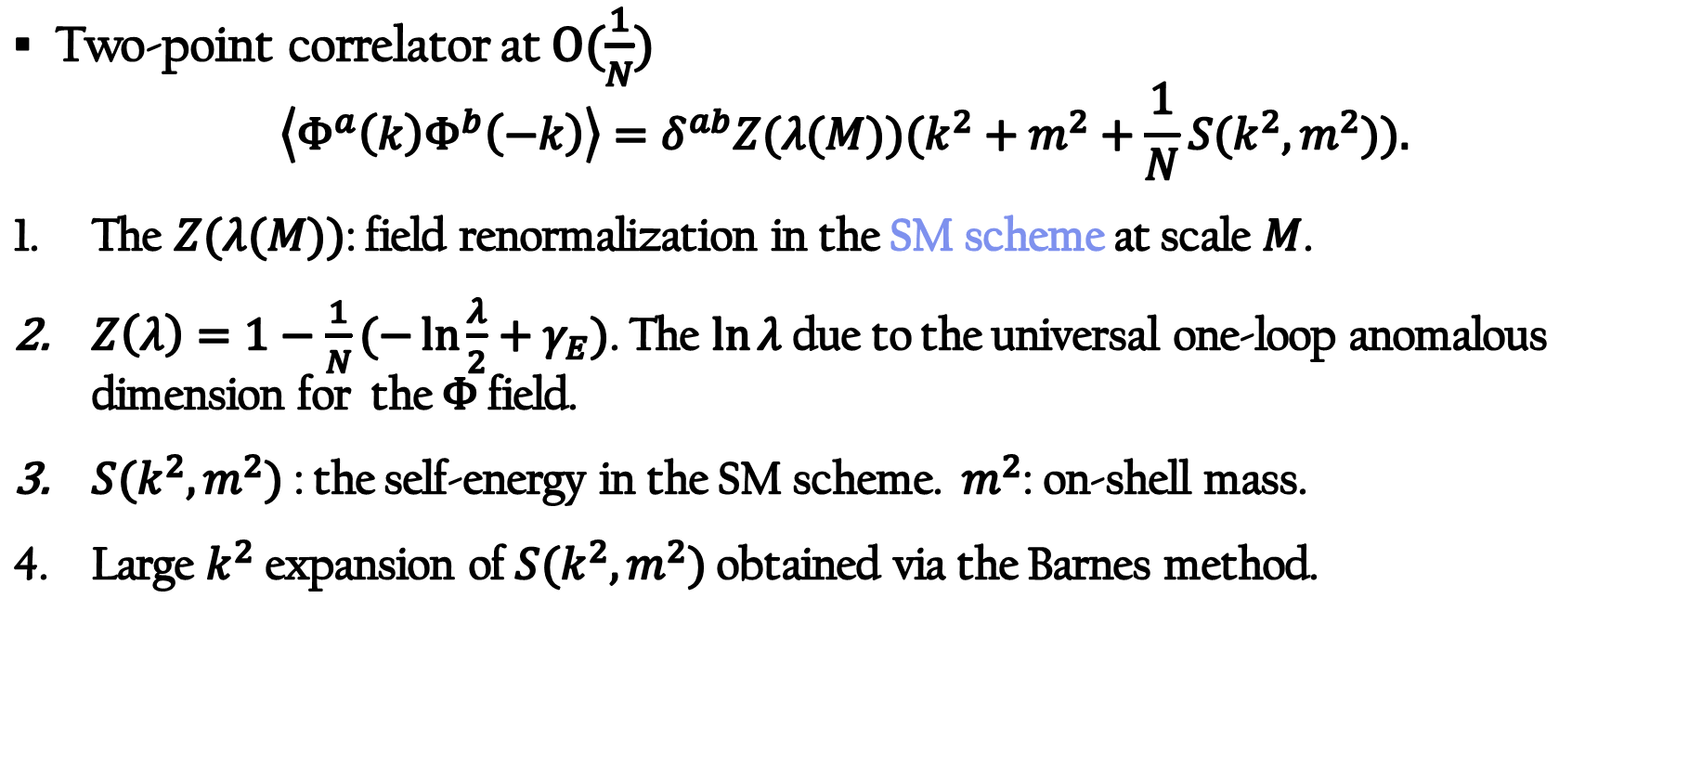
Large-N two-point correlator
$$m^{2}=m_{0}^{2}+\frac{2m_{0}^{2}}{N}(−\ln{\frac{M^{2}}{4m_{0}^{2}}+\ln{\ln{\frac{M^{2}}{m_{0}^{2}}+γ_{E}}}})$$
$λ^{−1}\left(M\right)=\ln{M/m_{0}}$
Two-point correlator at $O(\frac{1}{N})$
$$\left\langle Φ^{a}\left(k\right)Φ^{b}\left(−k\right)\right\rangle =δ^{ab}Z(λ(M))(k^{2}+m^{2}+\frac{1}{N}S(k^{2},m^{2})).$$
The $Z(λ(M))$: field renormalization in the SM scheme at scale $M$.
$Z\left(λ\right)=1−\frac{1}{N}(−\ln{\frac{λ}{2}+γ_{E}})$. The $\ln{λ}$ due to the universal one-loop anomalous dimension for the $Φ$ field.
$S(k^{2},m^{2})$ : the self-energy in the SM scheme. $m^{2}$: on-shell mass.
Large $k^{2}$ expansion of $S(k^{2},m^{2})$ obtained via the Barnes method.
M. Campostrini and P. Rossi 1992

Slide 17
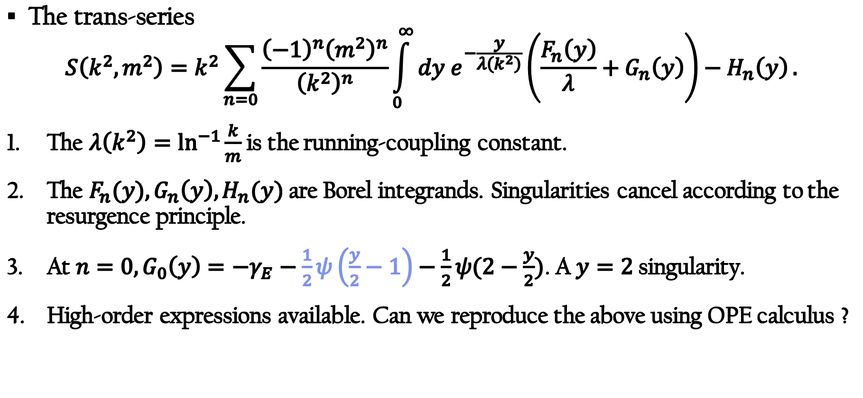
Large-N trans-series
The trans-series
$$S\left(k^{2},m^{2}\right)=k^{2}\sum_{n=0}{\frac{{\left(−1\right)}^{n}{\left(m^{2}\right)}^{n}}{{\left(k^{2}\right)}^{n}}\int_{0}^{∞}{dy e^{−\frac{y}{λ\left(k^{2}\right)}}}\left(\frac{F_{n}\left(y\right)}{λ}+G_{n}\left(y\right)\right)−H_{n}\left(y\right)}.$$
The $λ\left(k^{2}\right)=\ln^{−1}{\frac{k}{m}}$ is the running-coupling constant.
The $F_{n}(y),G_{n}\left(y\right),H_{n}(y)$ are Borel integrands. Singularities cancel according to the resurgence principle.
At $n=0,G_{0}\left(y\right)=−γ_{E}−\frac{1}{2}ψ\left(\frac{y}{2}−1\right)−\frac{1}{2}ψ(2−\frac{y}{2})$. A $y=2$ singularity.
High-order expressions available. Can we reproduce the above using OPE calculus ?
Beneke/Braun 1998; Marcos/Reis/Ramon 2023

Slide 18
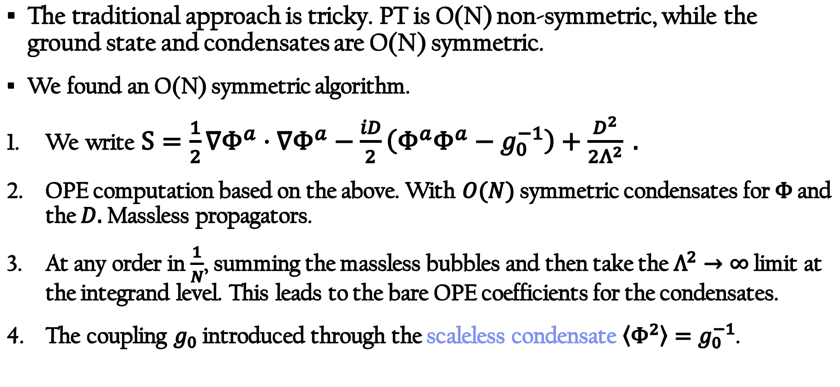
OPE calculus for NLSM
The traditional approach is tricky. PT is O(N) non-symmetric, while the ground state and condensates are O(N) symmetric.
We found an O(N) symmetric algorithm.
We write $S=\frac{1}{2}∇Φ^{a}⋅∇Φ^{a}−\frac{iD}{2}\left(Φ^{a}Φ^{a}−g_{0}^{−1}\right)+\frac{D^{2}}{2Λ^{2}} .$
OPE computation based on the above. With $O(N)$ symmetric condensates for $Φ$ and the $D.$ Massless propagators.
At any order in $\frac{1}{N}$, summing the massless bubbles and then take the $Λ^{2}→∞$ limit at the integrand level. This leads to the bare OPE coefficients for the condensates.
The coupling $g_{0}$ introduced through the scaleless condensate $\left\langle Φ^{2}\right\rangle =g_{0}^{−1}$.

Slide 19
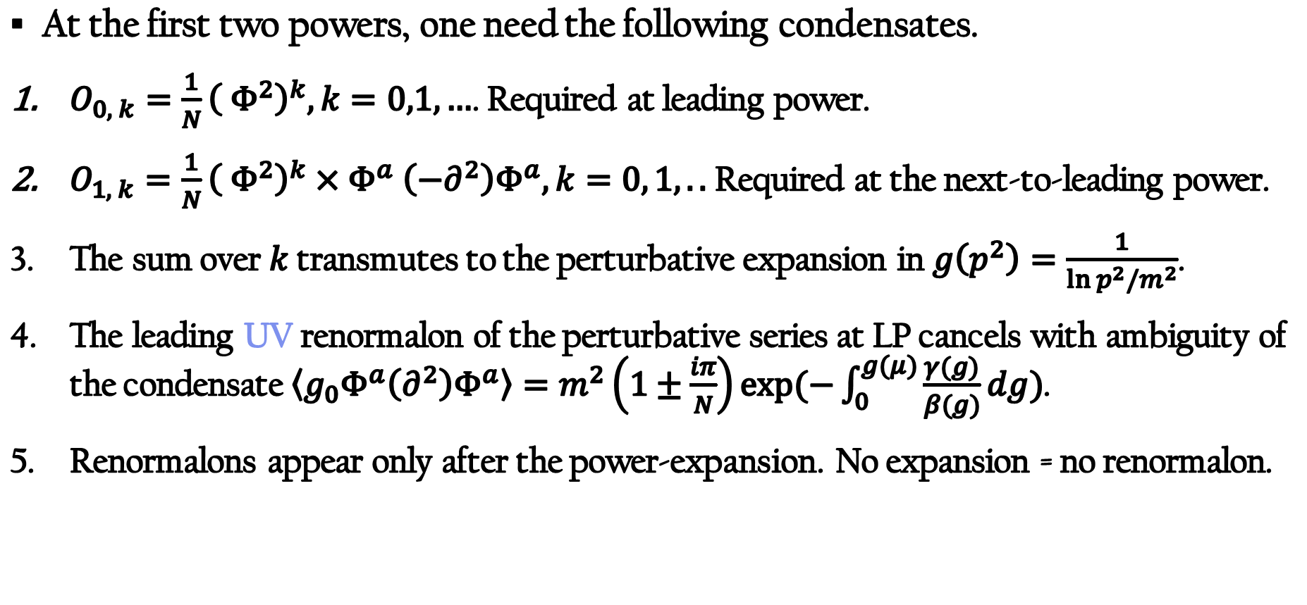
Structure of condensates: LP and NLP
At the first two powers, one need the following condensates.
$O_{0, k}=\frac{1}{N}{\left( Φ^{2}\right)}^{k}, k=0,1,…$. Required at leading power.
$O_{1, k}=$ $\frac{1}{N}{\left( Φ^{2}\right)}^{k}{×Φ}^{a}\left(−∂^{2}\right)Φ^{a}, k=0, 1,..$ Required at the next-to-leading power.
The sum over $k$ transmutes to the perturbative expansion in $g\left(p^{2}\right)=\frac{1}{\ln{p^{2}/m^{2}}}$.
The leading UV renormalon of the perturbative series at LP cancels with ambiguity of the condensate$\left\langle g_{0}Φ^{a}\left(∂^{2}\right)Φ^{a}\right\rangle =m^{2}\left(1±\frac{iπ}{N}\right)\exp{(−\int_{0}^{g(μ)}{\frac{γ(g)}{β(g)}dg})}$.
Renormalons appear only after the power-expansion. No expansion = no renormalon.

Slide 20


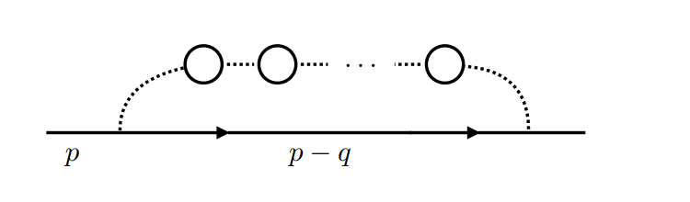
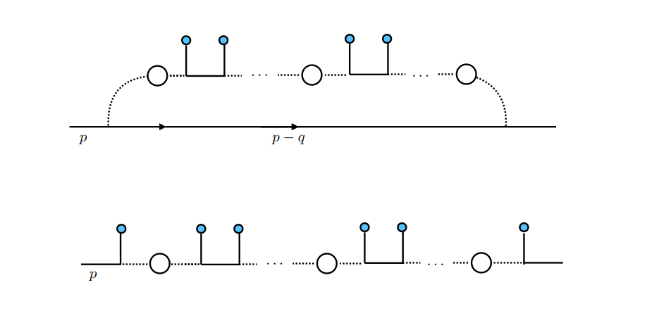
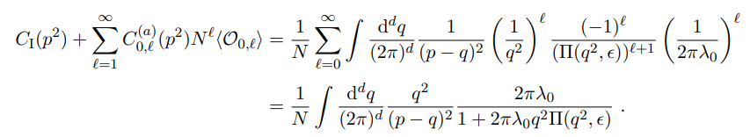


Summing over the bubbles
The coefficient function of the identity operator (upper). Dashed lines are the propagator of $D$ field.
The coefficient functions of the $O_{0, k}=\frac{1}{N}{\left( Φ^{2}\right)}^{k}$operator insertions (blue dots).
Two series of diagrams (a) and (b) for the scaleless condensates. Cancellation of IR singularity.
a
b

Slide 21
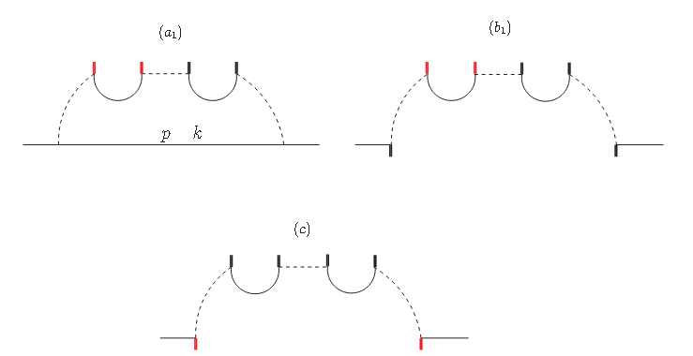
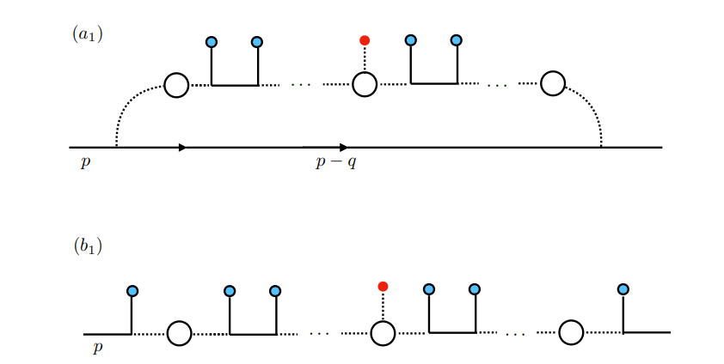
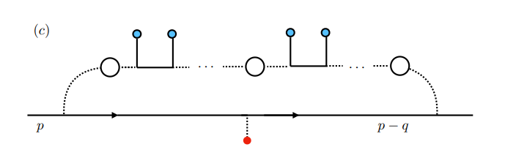
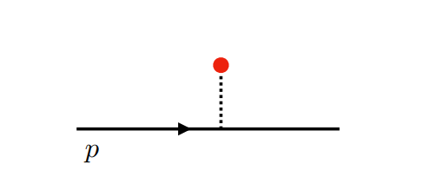
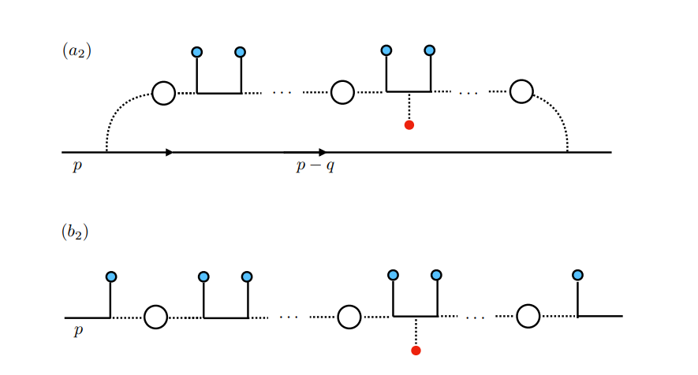

Summing over the bubbles
The coefficient functions for the $⟨X⟩$ insertions.
Tree-level (upper right) and another five series of diagrams.
Another three series for the $⟨Φ^{a}∇^{2}Φ^{a}⟩$ insertion.
Using EOM, reduced to $O_{1, k}=$ $\frac{1}{N}{\left( Φ^{2}\right)}^{k}{×Φ}^{a}\left(−∂^{2}\right)Φ^{a}$.

Slide 22
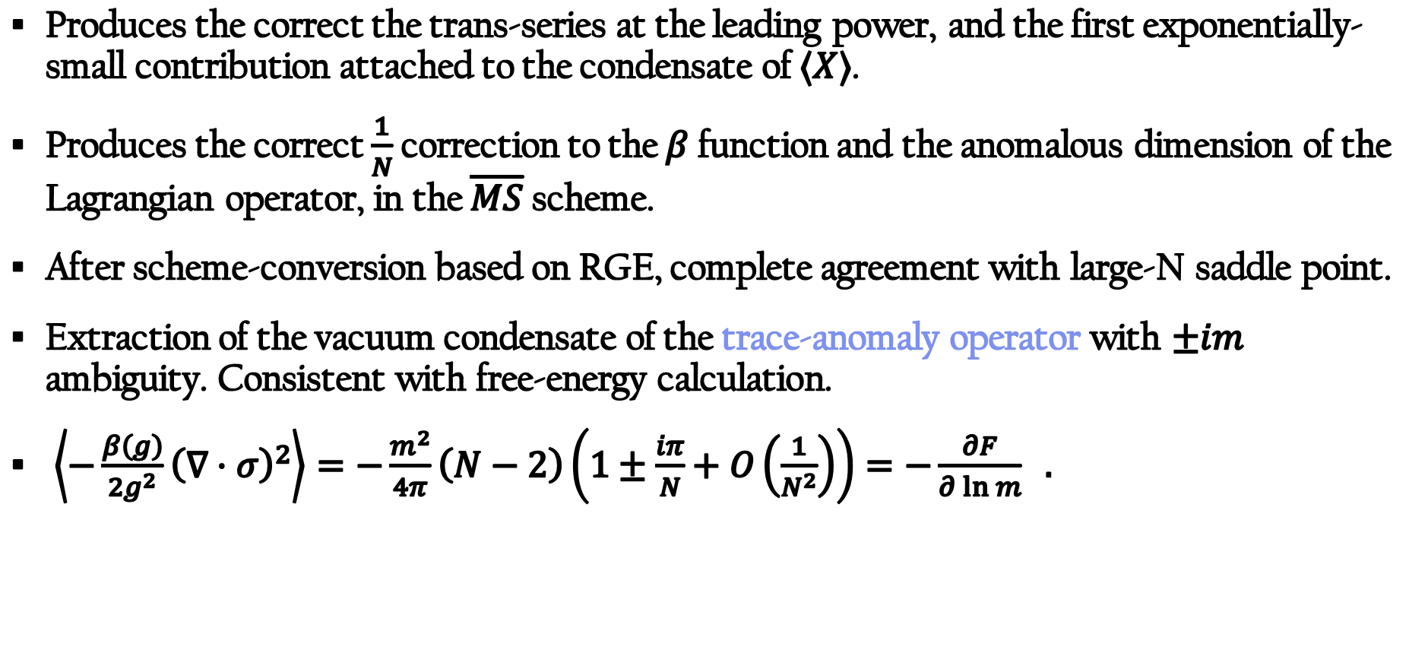
Results of the OPE computation
Produces the correct the trans-series at the leading power, and the first exponentially-small contribution attached to the condensate of $⟨X⟩$.
Produces the correct $\frac{1}{N}$ correction to the $β$ function and the anomalous dimension of the Lagrangian operator, in the $\overline{MS}$ scheme.
After scheme-conversion based on RGE, complete agreement with large-N saddle point.
Extraction of the vacuum condensate of the trace-anomaly operator with $±im$ ambiguity. Consistent with free-energy calculation.
$\left\langle −\frac{β\left(g\right)}{2g^{2}}{\left(∇⋅σ\right)}^{2}\right\rangle =−\frac{m^{2}}{4π}\left(N−2\right)\left(1±\frac{iπ}{N}+O\left(\frac{1}{N^{2}}\right)\right)=−\frac{∂F}{∂\ln{m}} .$

Slide 23
Outline
Part I: Introduction and motivation
Part II: OPE calculus for NLSM
Part III: An RG flow from the quartic O(N) to NLSM

Slide 24
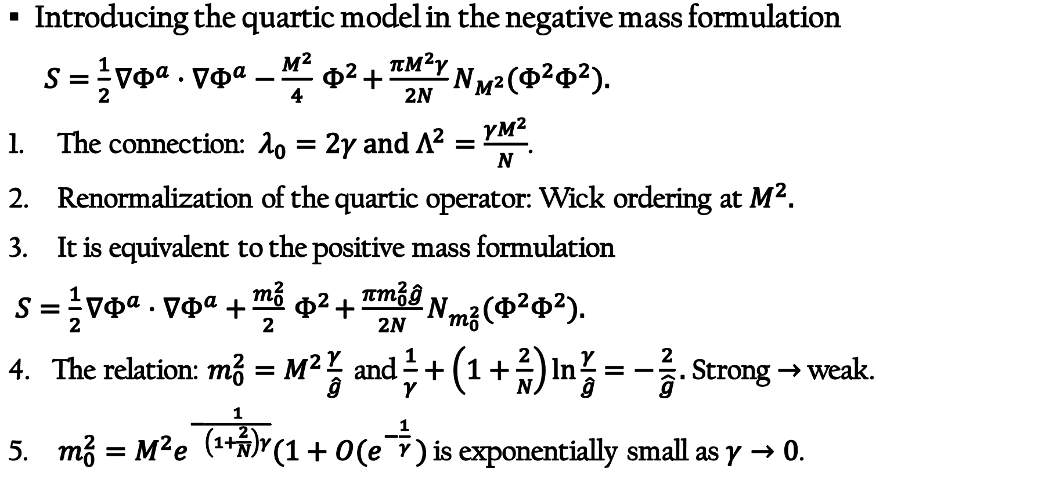
Quartic O(N) model
Introducing the quartic model in the negative mass formulation
$S=\frac{1}{2}∇Φ^{a}⋅∇Φ^{a}−\frac{M^{2}}{4}{ Φ}^{2}+\frac{πM^{2}γ}{2N}N_{M^{2}}(Φ^{2}Φ^{2}).$
The connection: $λ_{0}=2γ and Λ^{2}=\frac{γM^{2}}{N}$.
Renormalization of the quartic operator: Wick ordering at $M^{2}.$
It is equivalent to the positive mass formulation
$S=\frac{1}{2}∇Φ^{a}⋅∇Φ^{a}+\frac{m_{0}^{2}}{2}{ Φ}^{2}+\frac{πm_{0}^{2}\hat{g}}{2N}N_{m_{0}^{2}}(Φ^{2}Φ^{2}).$
The relation: $m_{0}^{2}=M^{2}\frac{γ}{\hat{g}}$ and $\frac{1}{γ}+\left(1+\frac{2}{N}\right)\ln{\frac{γ}{\hat{g}}=−\frac{2}{\hat{g}}}.$ Strong $→$ weak.
$m_{0}^{2}=M^{2}e^{−\frac{1}{\left(1+\frac{2}{N}\right)γ}}(1+O(e^{−\frac{1}{γ} })$ is exponentially small as $γ→0$.

Slide 25
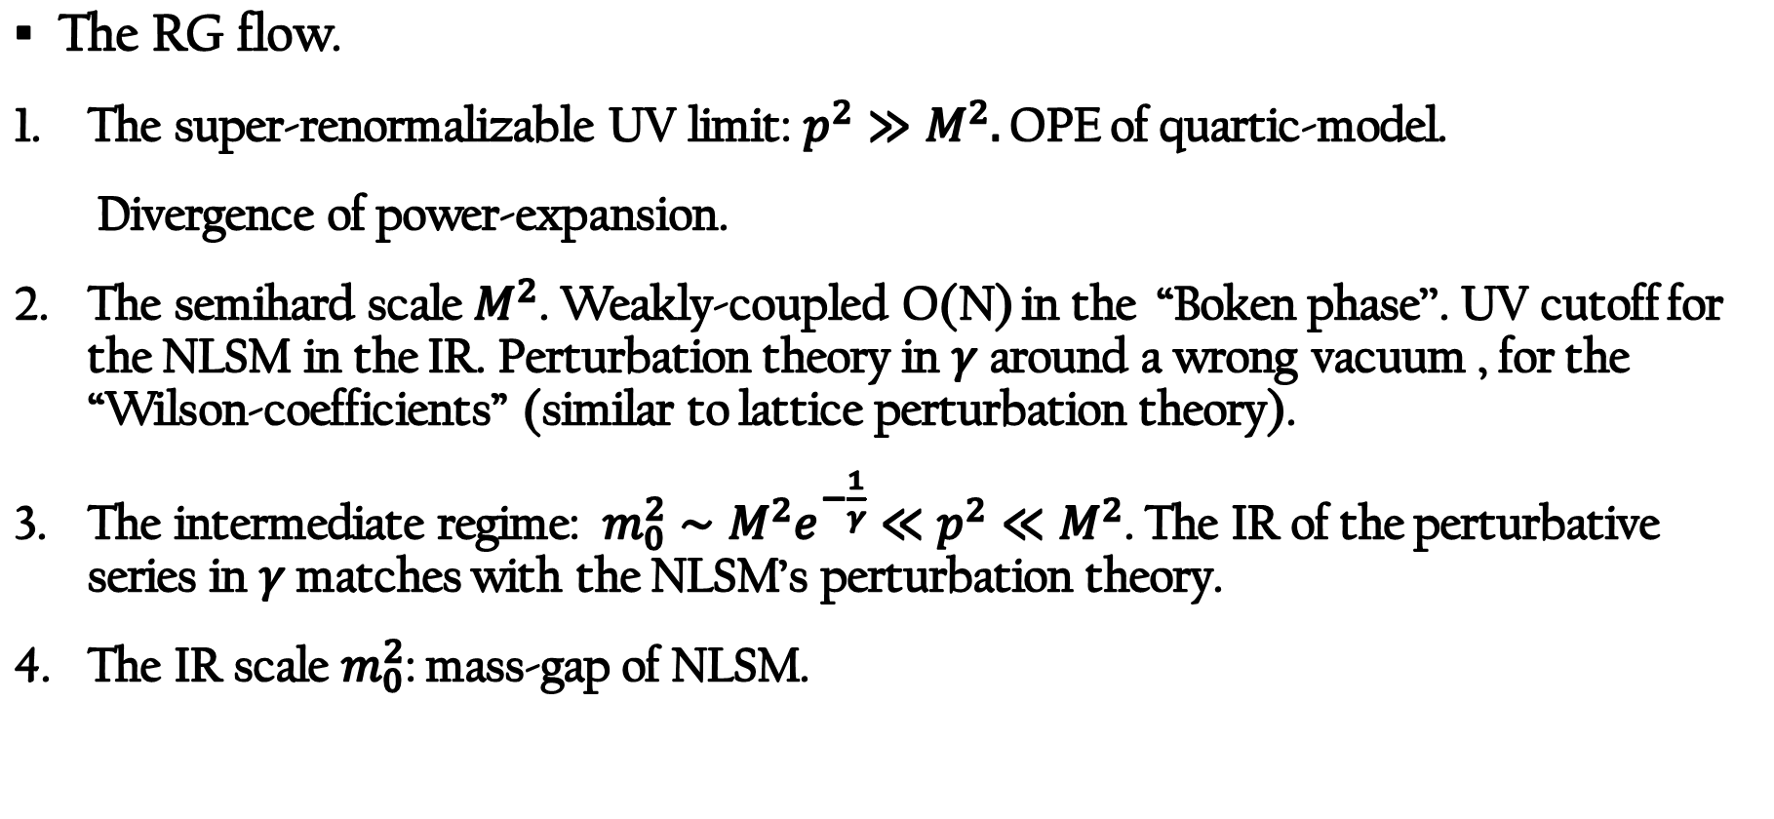
Quartic O(N) and NLSM
The RG flow.
The super-renormalizable UV limit: $p^{2}≫M^{2}.$ OPE of quartic-model.
Divergence of power-expansion.
The semihard scale $M^{2}$. Weakly-coupled O(N) in the “Boken phase’’. UV cutoff for the NLSM in the IR. Perturbation theory in $γ$around a wrong vacuum , for the “Wilson-coefficients” (similar to lattice perturbation theory).
The intermediate regime: ${m_{0}^{2}∼M^{2}e^{−\frac{1}{γ}}≪p}^{2}≪M^{2}$. The IR of the perturbative series in $γ$ matches with the NLSM’s perturbation theory.
The IR scale $m_{0}^{2}$: mass-gap of NLSM.

Slide 26
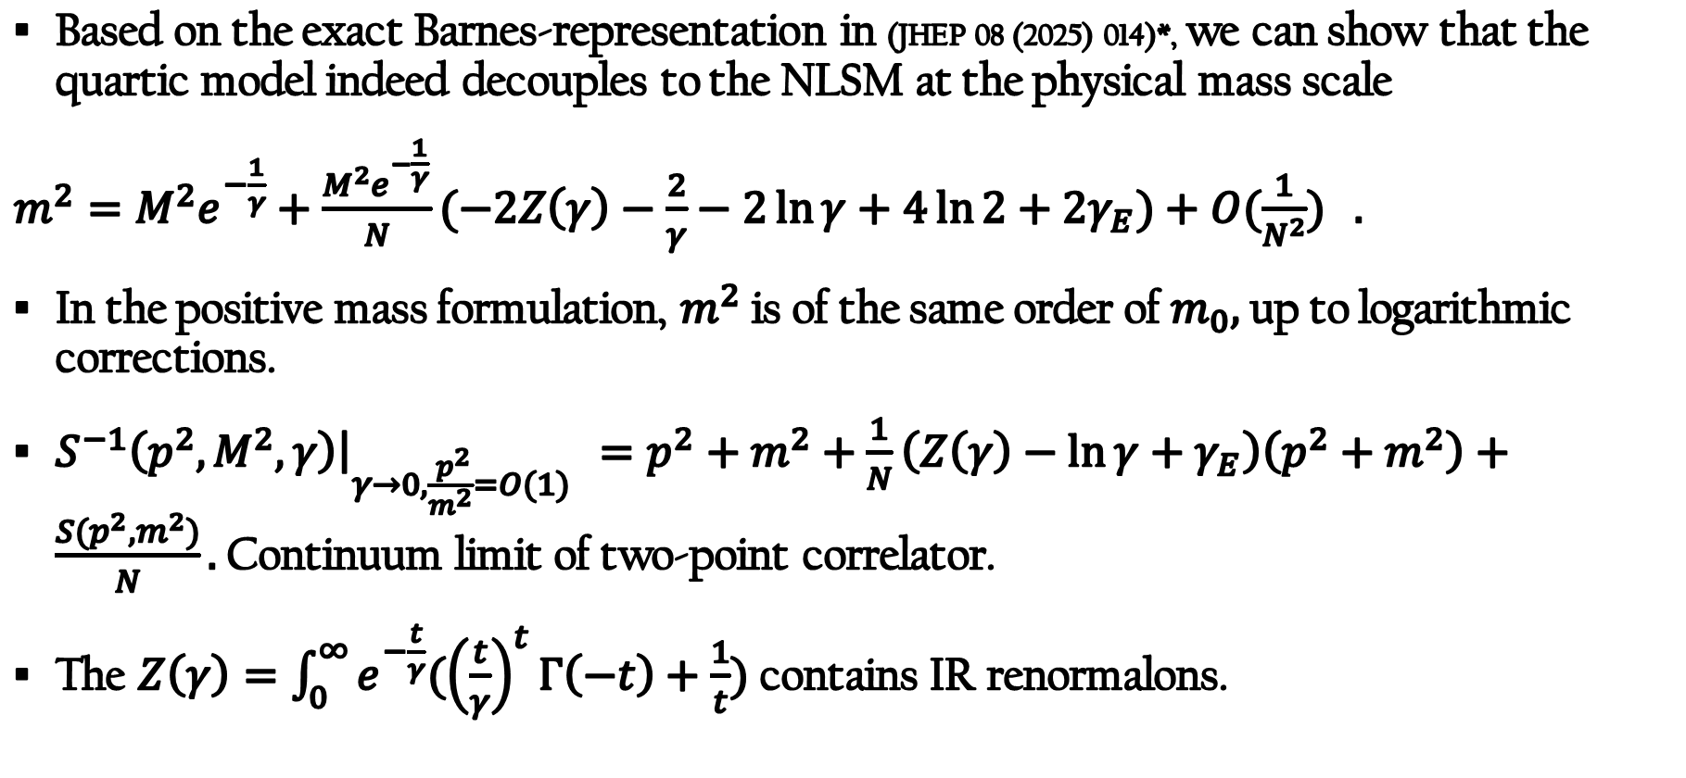
NLSM from quartic model
Based on the exact Barnes-representation in (JHEP 08 (2025) 014)*, we can show that the quartic model indeed decouples to the NLSM at the physical mass scale
$m^{2}=M^{2}e^{−\frac{1}{γ}}+\frac{M^{2}e^{−\frac{1}{γ}}}{N}(−2Z\left(γ\right)−\frac{2}{γ}−2\ln{γ+4\ln{2+2γ_{E})+O(\frac{1}{N^{2}})} . }$
In the positive mass formulation, $m^{2}$ is of the same order of $m_{0},$ up to logarithmic corrections.
$S^{−1}\left(p^{2},M^{2},γ\right){\left.​\right|}_{γ→0, \frac{{ p}^{2}}{m^{2}}=O(1) }=p^{2}+m^{2}+\frac{1}{N}\left(Z\left(γ\right)−\ln{γ+γ_{E}}\right)\left(p^{2}+m^{2}\right)+\frac{S(p^{2},m^{2})}{N}.$ Continuum limit of two-point correlator.
The $Z\left(γ\right)=\int_{0}^{∞}{e^{−\frac{t}{γ}}({\left(\frac{t}{γ}\right)}^{t}Γ\left(−t\right)+\frac{1}{t})}$ contains IR renormalons.
*Marcos 2025 has another derivation for the mass formula

Slide 27
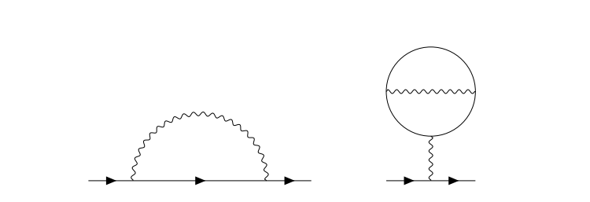
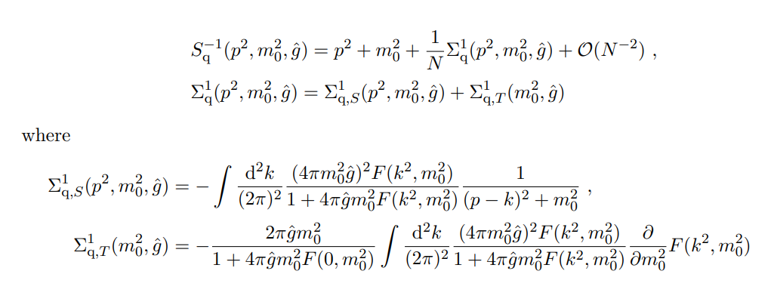
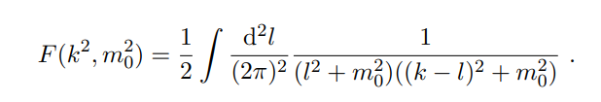


NLSM from quartic model : cancelation of UV renormalon
$G_{0}\left(y\right)=−γ_{E}−\frac{1}{2}ψ\left(\frac{y}{2}−1\right)−\frac{1}{2}ψ(2−\frac{y}{2})$.
In the quartic model, there are two series of diagrams at 1/N.
The wavy lines are massive bubbles in the quartic model.
Power divergences cancel with each other as $\hat{g}→∞:$
In the NLSM’s OPE, reflect through the cancellation of two UV renormalons.

Slide 28
Conclusion
UV fixed points of local QFTs.
Operator condensates appear even in short distance expansion of super-renormalizable QFTs. UV/IR ambiguities cancellation.
OPE in 2D large-N NLSM. Summation over infinitely many scaleless condensates. Ambiguity of the trace-anomaly condensate cancels with an UV renormalon.
Quartic O(N) as a cutoff regularization for NLSM. IR renormalons in the field renormalons. Cancellation of power divergence.

