Slide 1
Decay of structure-function-type correlators in the forward limit
Yizhuang Liu, UJ
6.Feb.2026

Slide 2
This work is based on the recent collaboration with Xiangdong Ji and Yushan Su.
The paper is 2601.12189

Slide 3
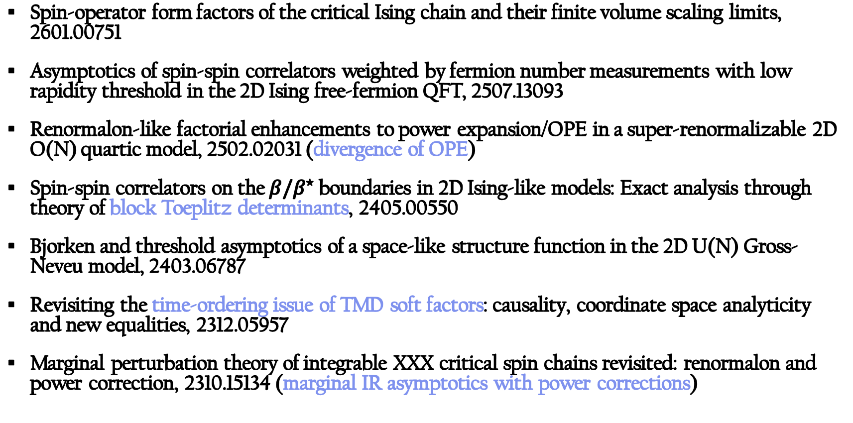
Some of the speaker’s recent works
Spin-operator form factors of the critical Ising chain and their finite volume scaling limits, 2601.00751
Asymptotics of spin-spin correlators weighted by fermion number measurements with low rapidity threshold in the 2D Ising free-fermion QFT, 2507.13093
Renormalon-like factorial enhancements to power expansion/OPE in a super-renormalizable 2D O(N) quartic model, 2502.02031 (divergence of OPE)
Spin-spin correlators on the $β/β^{⋆}$ boundaries in 2D Ising-like models: Exact analysis through theory of block Toeplitz determinants, 2405.00550
Bjorken and threshold asymptotics of a space-like structure function in the 2D U(N) Gross-Neveu model, 2403.06787
Revisiting the time-ordering issue of TMD soft factors: causality, coordinate space analyticity and new equalities, 2312.05957
Marginal perturbation theory of integrable XXX critical spin chains revisited: renormalon and power correction, 2310.15134 (marginal IR asymptotics with power corrections)

Slide 4
Outline
Part I: Introduction
Part II: General arguments
Part III: Several examples

Slide 5
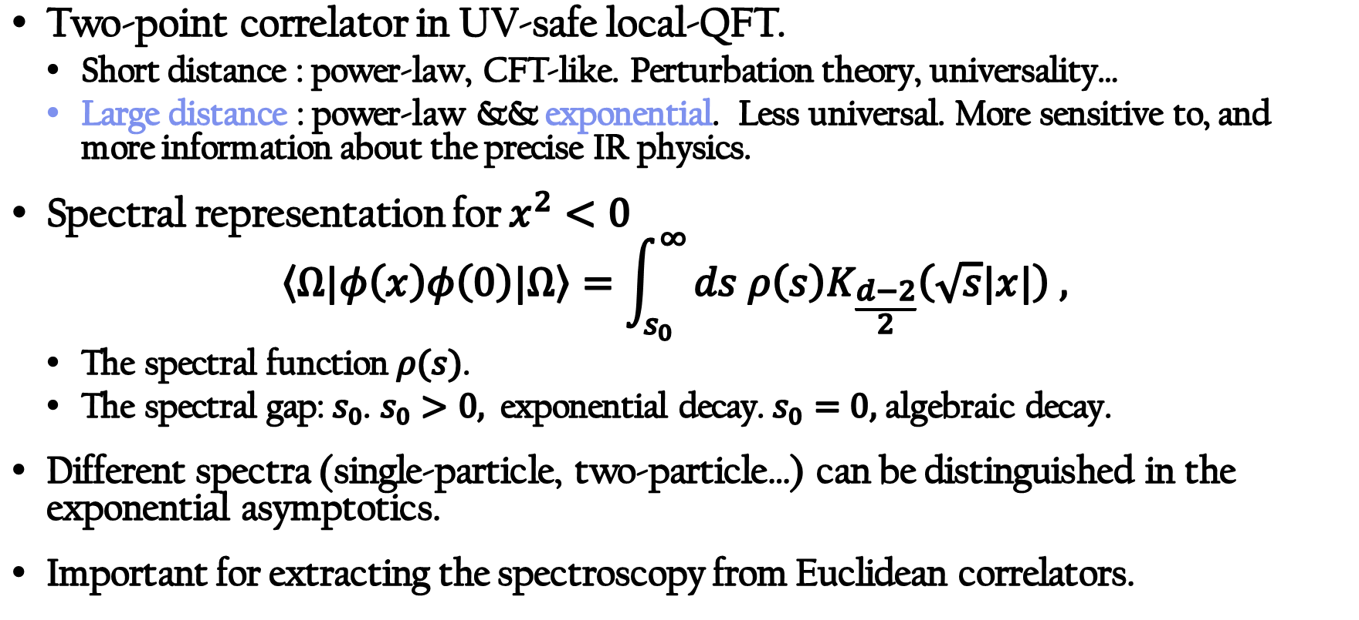
Exponential decay of two-point correlators
Two-point correlator in UV-safe local-QFT.
  Short distance : power-law, CFT-like. Perturbation theory, universality…
  Large distance : power-law && exponential. Less universal. More sensitive to, and more information about the precise IR physics.
Spectral representation for $x^{2}<0$
$$\left\langle Ω|φ\left(x\right)φ\left(0\right)|Ω\right\rangle =\int_{s_{0}}^{∞}{ds ρ\left(s\right)K_{\frac{d−2}{2}}\left(\sqrt{s}|x|\right) , }$$
  The spectral function $ρ(s)$.
  The spectral gap:${ s}_{0}$. $s_{0}>0,$ exponential decay.$s_{0}=0,$algebraic decay.
Different spectra (single-particle, two-particle…) can be distinguished in the exponential asymptotics.
Important for extracting the spectroscopy from Euclidean correlators.

Slide 6
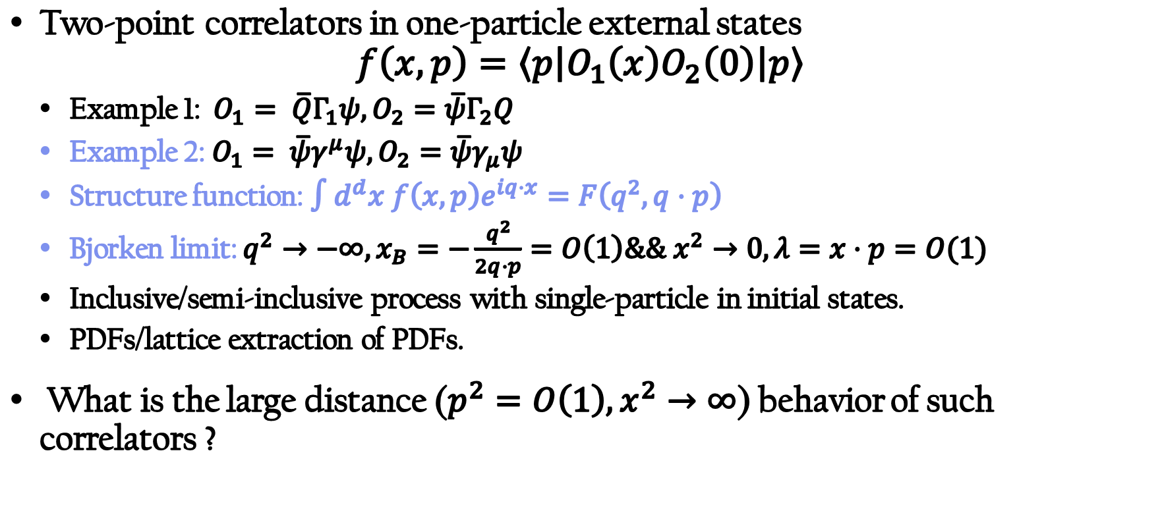
Two-point correlators in one-particle external states
Two-point correlators in one-particle external states
$$f\left(x,p\right)=\left\langle p\left|O_{1}\left(x\right)O_{2}\left(0\right)\right|p\right\rangle$$
  Example 1: $O_{1}= \overline{Q}Γ_{1}ψ, O_{2}=\overline{ψ}Γ_{2}Q$
  Example 2: $O_{1}= \overline{ψ}γ^{μ}ψ, O_{2}=\overline{ψ}γ_{μ}ψ$
  Structure function: $∫d^{d}x f\left(x,p\right)e^{iq⋅x}=F\left(q^{2},q⋅p\right)$
  Bjorken limit: $q^{2}→−∞, x_{B}=−\frac{q^{2}}{2q⋅p}=O\left(1\right)\&\& x^{2}→0, λ=x⋅p=O(1)$
  Inclusive/semi-inclusive process with single-particle in initial states.
  PDFs/lattice extraction of PDFs.
What is the large distance ($p^{2}=O\left(1\right),x^{2}→∞$) behavior of such correlators ?

Slide 7
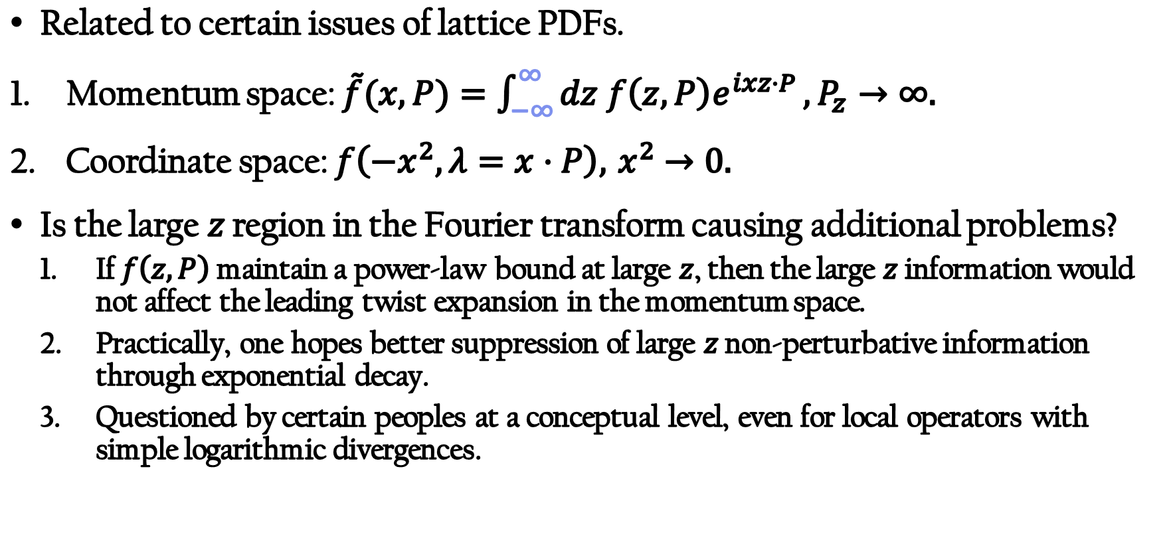
Decay of correlators in external states: backgrounds
Related to certain issues of lattice PDFs.
Momentum space: $\tilde{f}(x,P)=\int_{−∞}^{∞}{dz f\left(z,P\right)e^{ixz⋅P}}, P_{z}→∞.$
Coordinate space: $f\left({−x}^{2},λ=x⋅P\right), { x}^{2 }→0.$
Is the large $z$ region in the Fourier transform causing additional problems?
  If $f\left(z,P\right)$ maintain a power-law bound at large $z$, then the large $z$ information would not affect the leading twist expansion in the momentum space.
  Practically, one hopes better suppression of large 𝑧 non-perturbative information through exponential decay.
  Questioned by certain peoples at a conceptual level, even for local operators with simple logarithmic divergences.

Slide 8
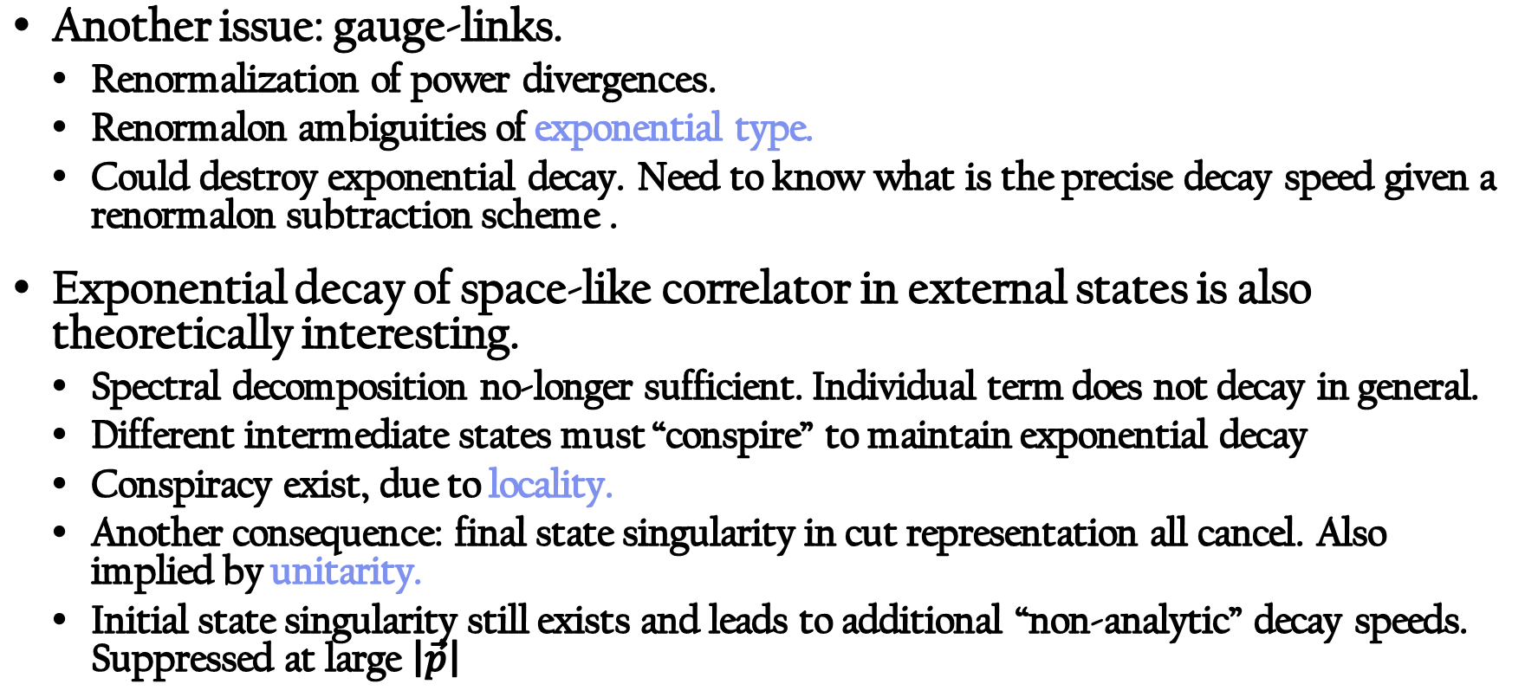
Decay of correlators in external states
Another issue: gauge-links.
  Renormalization of power divergences.
  Renormalon ambiguities of exponential type.
  Could destroy exponential decay. Need to know what is the precise decay speed given a renormalon subtraction scheme .
Exponential decay of space-like correlator in external states is also theoretically interesting.
  Spectral decomposition no-longer sufficient. Individual term does not decay in general.
  Different intermediate states must “conspire” to maintain exponential decay
  Conspiracy exist, due to locality.
  Another consequence: final state singularity in cut representation all cancel. Also implied by unitarity.
  Initial state singularity still exists and leads to additional “non-analytic” decay speeds. Suppressed at large $\left|\vec{p}\right|$

Slide 9
Basis assumptions
In the rest of the talk, we present a recent analysis of the exponential decay of space-like structure function type correlator.
Basic assumptions of the study :
  We assume that the continuum limit has been taken, and the usual axioms: regularity (temperedness/power-law bounds of spectral distribution at high-energy), Lorentz-invariance and space-like-commutativity hold.
  Furthermore, the theory is fully gapped without massless excitations.
Why these assumptions are reasonable ?
  Scaling limits of lattice models with reflection positivity && linear growth condition && Euclidean symmetry are known to satisfy the Wightman-Osterwalder-Schrader axioms.
  Commonly conjectured for QCD. Implicitly assumed for lattice QCD applications.

Slide 10
Outline
Part I: Introduction
Part II: General arguments
Part III: Several examples

Slide 11
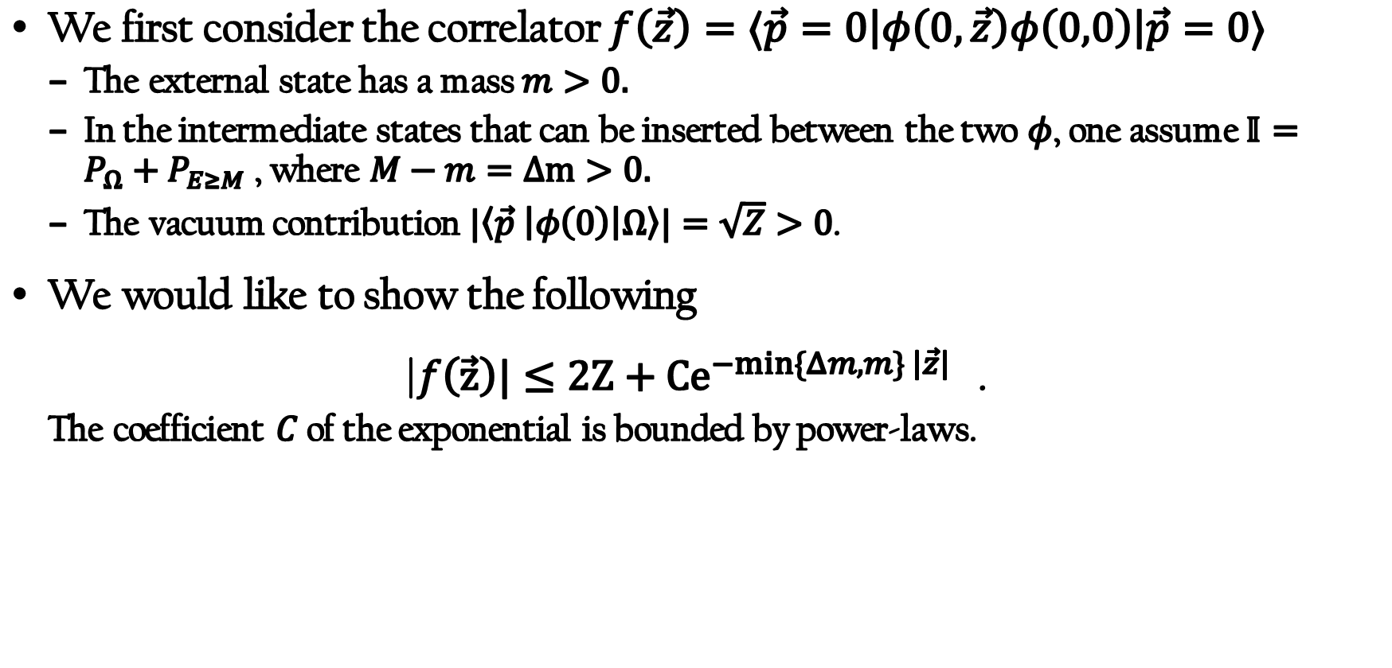
First case: $\vec{p}=0$, heavy intermediate states
We first consider the correlator $f\left(\vec{z}\right)=⟨\vec{p}=0\left|φ\left(0,\vec{z}\right)φ\left(0,0\right)\right|\vec{p}=0⟩$
  The external state has a mass $m>0.$
  In the intermediate states that can be inserted between the two $φ$, one assume $𝕀=P_{Ω}+P_{E≥M}$ , where $M−m=Δm>0.$
  The vacuum contribution $|\left\langle \vec{p} \left|φ\left(0\right)\right|Ω\right\rangle |=\sqrt{Z}>0$.
We would like to show the following
|$f\left(\vec{z}\right)|≤2Z+{Ce}^{−min\{Δm,m\} \left|\vec{z}\right|}$ .
  The coefficient $C$ of the exponential is bounded by power-laws.

Slide 12
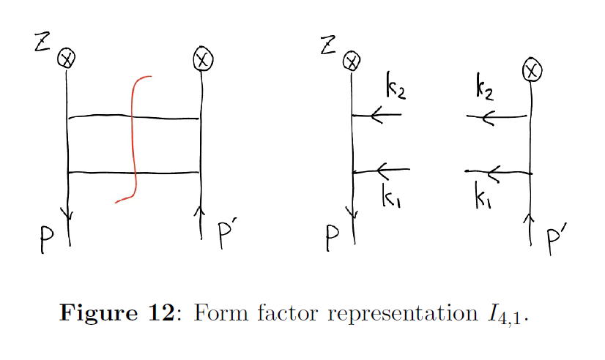

First case: $\vec{p}=0$, heavy intermediate states
This is non-trivial, as one can see from the “cut representations” in perturbative computations. Different cuts/particle numbers conspire to achieve the exponential decay.
This two-particle cut itself does not decay exponentially.
Real singularity: $\vec{k_{1}}=\vec{P}, \vec{k_{2}}=±\vec{P}$.
Finaly state singularity, cancellation after summing over cuts.

Slide 13
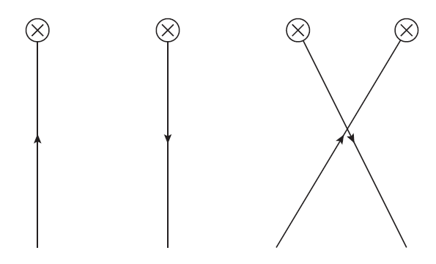
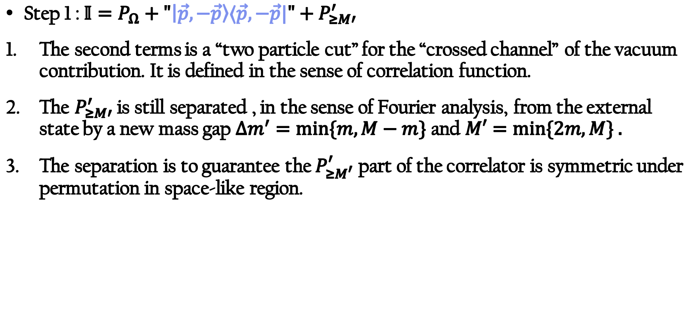
First case: $\vec{p}=0$, heavy intermediate states
Step 1 : $𝕀=P_{Ω}+"\left|\vec{p},−\vec{p}\right\rangle ⟨\vec{p},−\vec{p}|"+P_{≥M′}^{′}$
The second terms is a “two particle cut” for the “crossed channel” of the vacuum contribution. It is defined in the sense of correlation function.
The $P_{≥M′}^{′}$ is still separated , in the sense of Fourier analysis, from the external state by a new mass gap $Δm^{′}=\min{\{m,M−m\}}$ and $M′=\min{\{2m,M\} .}$
The separation is to guarantee the $P_{≥M^{′}}^{′}$ part of the correlator is symmetric under permutation in space-like region.
Tree-level intuition of the construction

Slide 14
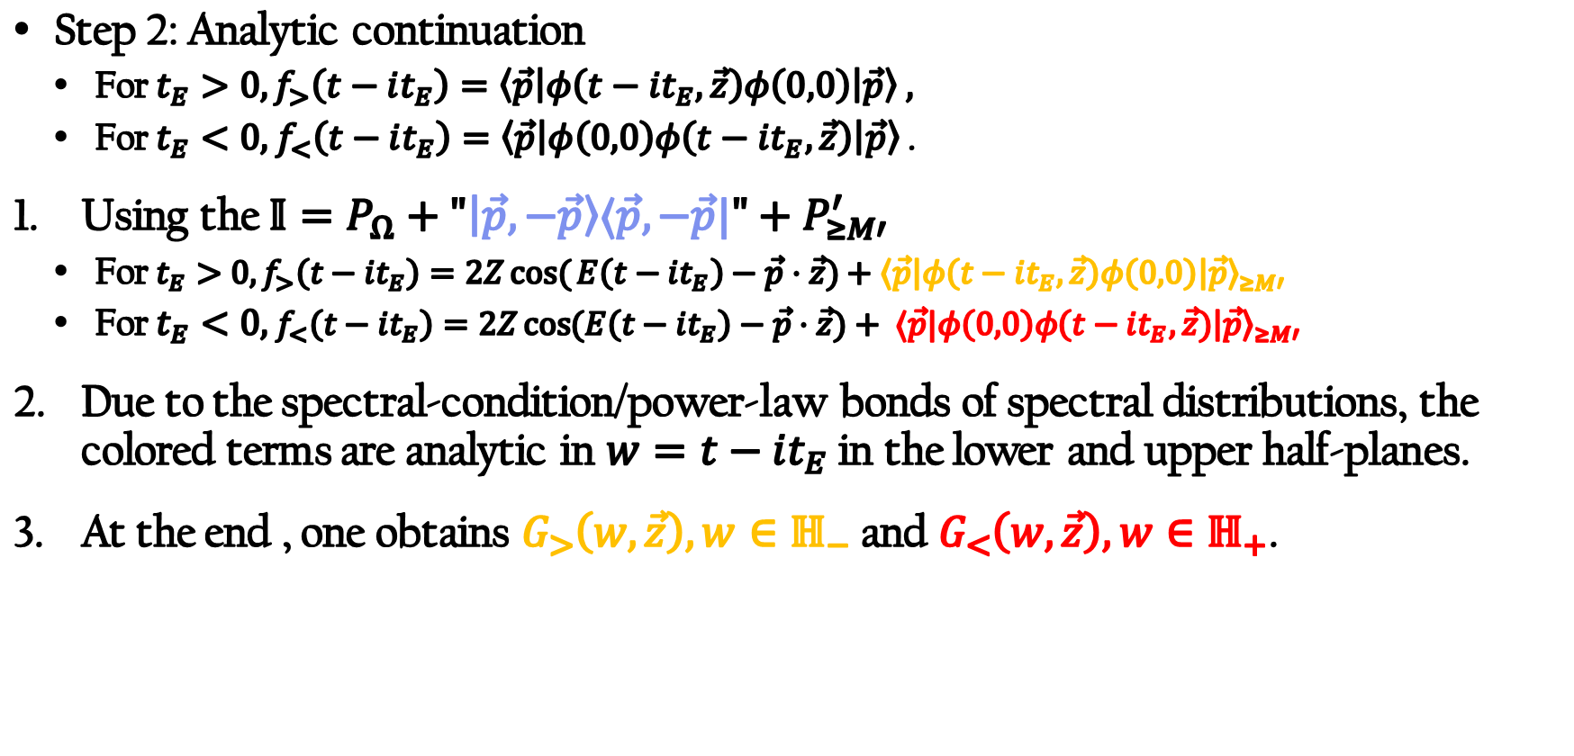
First case: $\vec{p}=0$, heavy intermediate states
Step 2: Analytic continuation
  For $t_{E}>0, f_{>}\left(t−it_{E}\right)=\left\langle \vec{p}\left|φ\left(t−it_{E},\vec{z}\right)φ\left(0,0\right)\right|\vec{p}\right\rangle ,$
  For $t_{E}<0,$ $f_{<}\left(t−it_{E}\right)=$ $\left\langle \vec{p}\left|φ\left(0,0\right)φ\left(t−it_{E},\vec{z}\right)\right|\vec{p}\right\rangle$ .
Using the $𝕀=P_{Ω}+"\left|\vec{p},−\vec{p}\right\rangle ⟨\vec{p},−\vec{p}|"+P_{≥M′}^{′}$
  For $t_{E}>0, f_{>}\left(t−it_{E}\right)=2Zcos({E\left(t−it_{E}\right)−\vec{p}⋅\vec{z})+{\left\langle \vec{p}\left|φ\left(t−it_{E}, \vec{z}\right)φ\left(0,0\right)\right|\vec{p}\right\rangle }_{≥M′}}$
  For $t_{E}<0,$ $f_{<}\left(t−it_{E}\right)=2Z\cos{(E\left(t−it_{E}\right)−\vec{p}⋅\vec{z})+ ⟨\vec{p}|φ\left(0,0\right)φ{\left(t−it_{E},\vec{z}) | \vec{p}\right\rangle }_{≥M′}}$
Due to the spectral-condition/power-law bonds of spectral distributions, the colored terms are analytic in $w=t−it_{E}$ in the lower and upper half-planes.
At the end , one obtains $G_{>}\left(w,\vec{z}\right), w∈ℍ_{−}$ and $G_{<}\left(w, \vec{z}\right), w∈ℍ_{+}$.

Slide 15
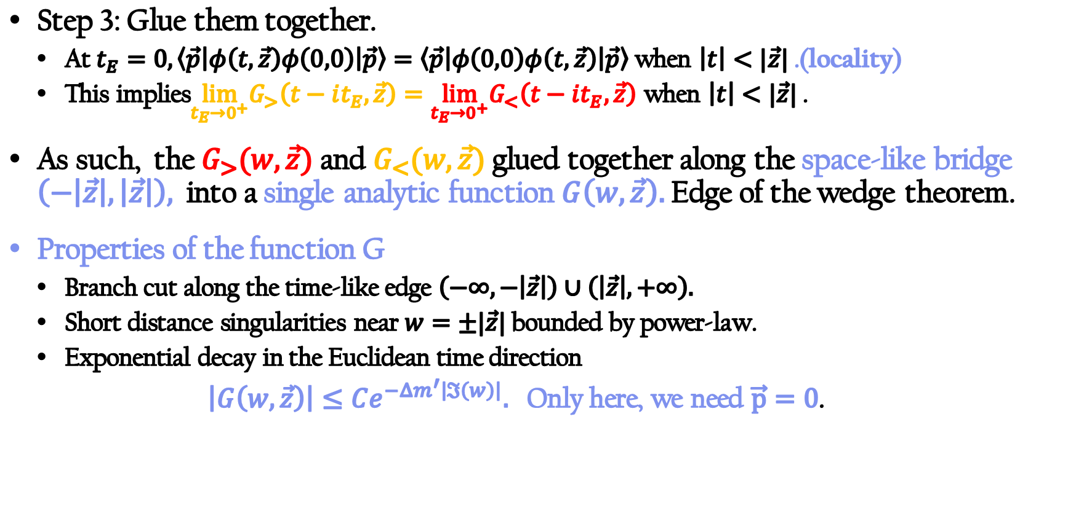
First case: $\vec{p}=0$, heavy intermediate states
Step 3: Glue them together.
  At $t_{E}=0, \left\langle \vec{p}\left|φ\left(t,\vec{z}\right)φ\left(0,0\right)\right|\vec{p}\right\rangle =$ $\left\langle \vec{p}\left|φ\left(0,0\right)φ\left(t,\vec{z}\right)\right|\vec{p}\right\rangle$ when $\left|t\right|<|\vec{z}|$ .(locality)
  This implies$\lim_{t_{E}→0^{+}}G_{>}\left(t−it_{E},\vec{z}\right)=\lim_{t_{E}→0^{+}}G_{<}\left(t−it_{E},\vec{z}\right)$ when $\left|t\right|<|\vec{z}|$ .
As such, the $G_{>}(w,\vec{z})$ and $G_{<}(w,\vec{z})$ glued together along the space-like bridge $\left(−\left|\vec{z}\right|,\left|\vec{z}\right|\right),$ into a single analytic function $G\left(w,\vec{z}\right).$ Edge of the wedge theorem.
Properties of the function G
  Branch cut along the time-like edge $\left(−∞,−\left|\vec{z}\right|\right)∪\left(\left|\vec{z}\right|,+∞\right).$
  Short distance singularities near $w=±|\vec{z}|$ bounded by power-law.
  Exponential decay in the Euclidean time direction
  $\left|G\left(w,\vec{z}\right)\right|≤Ce^{−Δm^{′}\left|ℑ\left(w\right)\right|}.$ Only here, we need $\vec{p}=0$.

Slide 16
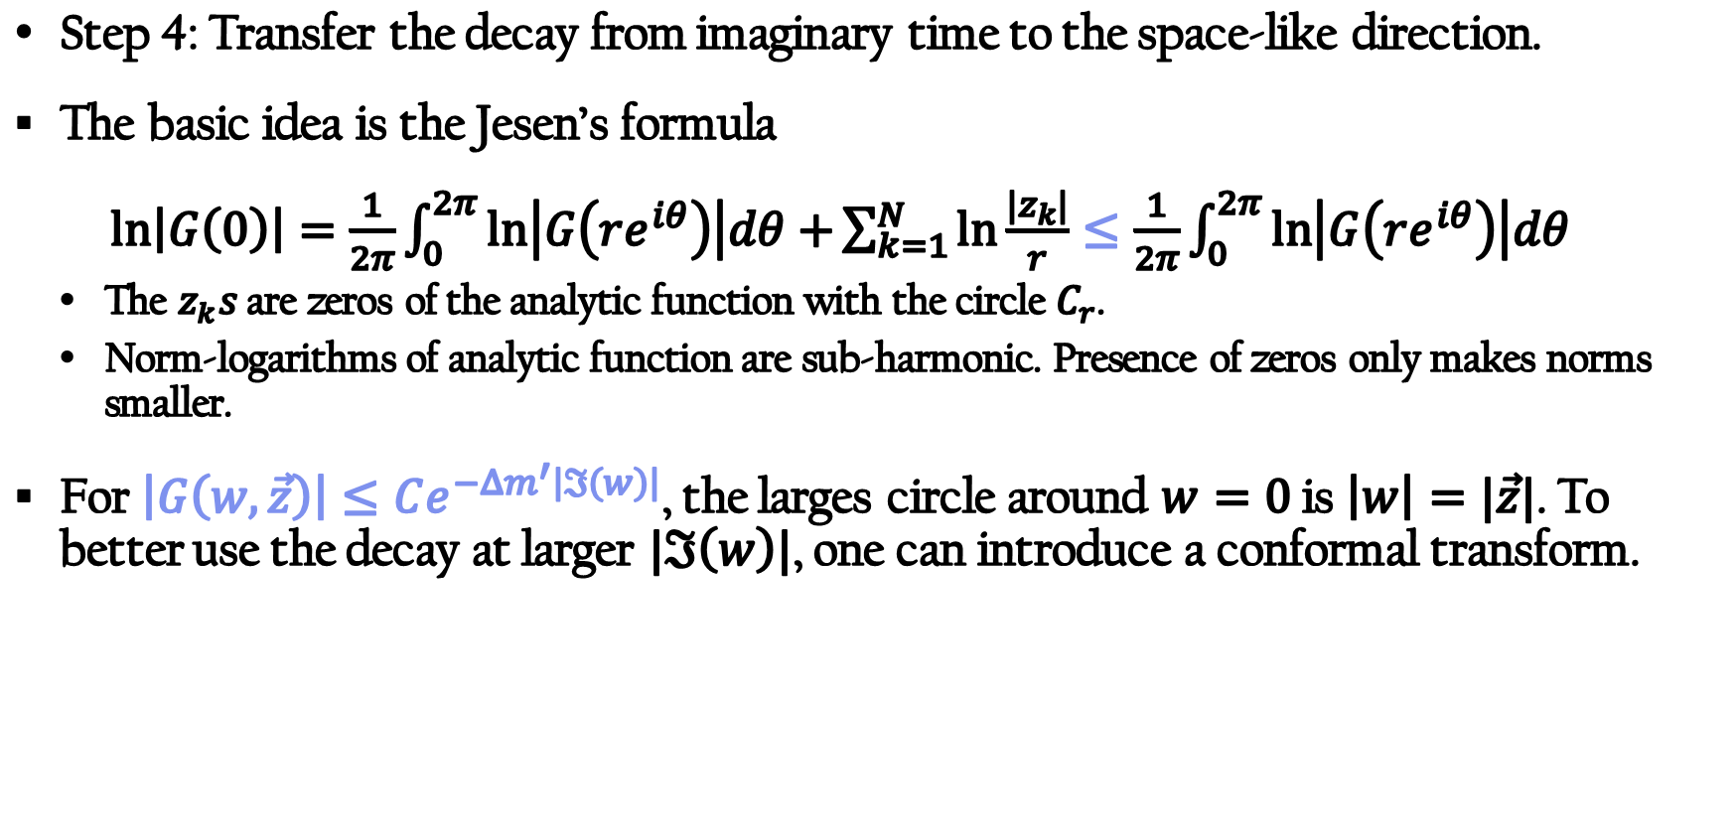
First case: $\vec{p}=0$, heavy intermediate states
Step 4: Transfer the decay from imaginary time to the space-like direction.
The basic idea is the Jesen’s formula
$\ln\left|G\left(0\right)\right|=\frac{1}{2π}\int_{0}^{2π}{\ln\left|G\left(re^{iθ}\right)\right|dθ+}\sum_{k=1}^{N}{\ln{\frac{|z_{k}|}{r}}}≤$ $\frac{1}{2π}\int_{0}^{2π}{\ln\left|G\left(re^{iθ}\right)\right|dθ }$
  The $z_{k}s$ are zeros of the analytic function with the circle $C_{r}$.
  Norm-logarithms of analytic function are sub-harmonic. Presence of zeros only makes norms smaller.
For $\left|G\left(w,\vec{z}\right)\right|≤Ce^{−Δm^{′}\left|ℑ\left(w\right)\right|}$, the larges circle around $w=0$ is $\left|w\right|=|\vec{z}|$. To better use the decay at larger $|ℑ\left(w\right)|$, one can introduce a conformal transform.

Slide 17
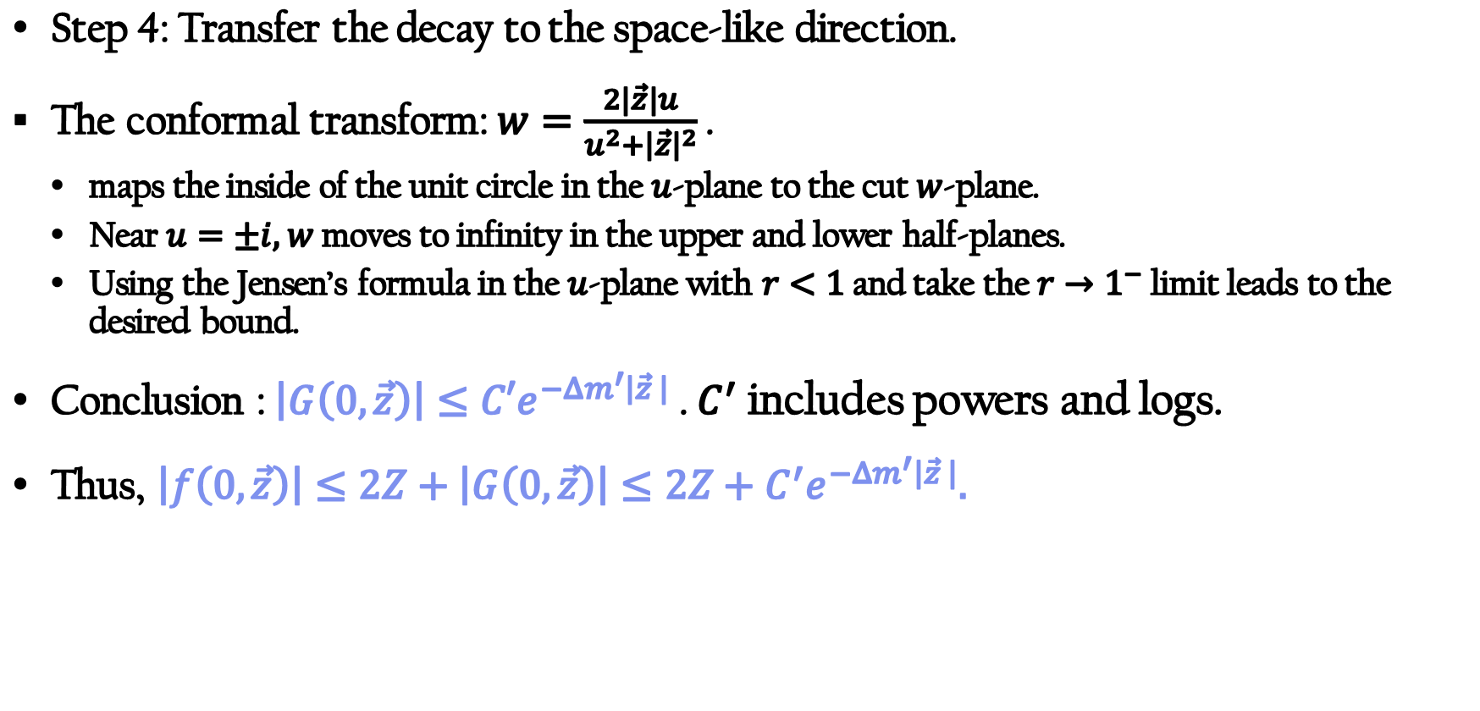
First case: $\vec{p}=0$, heavy intermediate states
Step 4: Transfer the decay to the space-like direction.
The conformal transform: $w=\frac{2|\vec{z}|u}{u^{2}+{\left|\vec{z}\right|}^{2}}$ .
  maps the inside of the unit circle in the $u$-plane to the cut $w$-plane.
  Near $u=±i,$ $w$ moves to infinity in the upper and lower half-planes.
  Using the Jensen’s formula in the $u$-plane with $r<1$ and take the $r→1^{−}$ limit leads to the desired bound.
Conclusion : $\left|G\left(0,\vec{z}\right)\right|≤C′e^{−Δm^{′}\left|\vec{z} \right|}$ . $C^{′}$ includes powers and logs.
Thus, $\left|f\left(0,\vec{z}\right)\right|≤2Z+\left|G\left(0,\vec{z}\right)\right|≤2Z+C^{′}e^{−Δm^{′}\left|\vec{z} \right|}.$

Slide 18
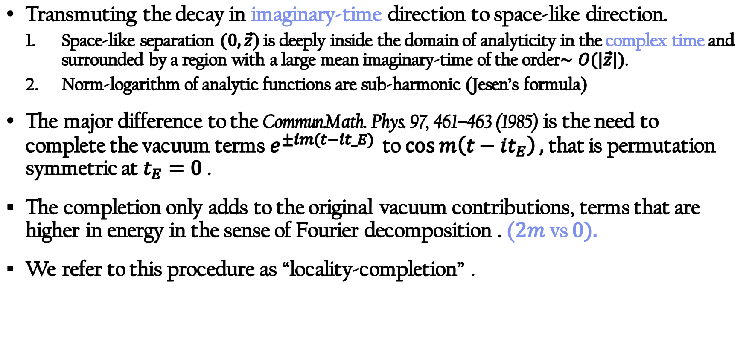
First case: summarize
Transmuting the decay in imaginary-time direction to space-like direction.
  Space-like separation $(0,\vec{z}$) is deeply inside the domain of analyticity in the complex time and surrounded by a region with a large mean imaginary-time of the order$∼O(|\vec{z}|)$.
  Norm-logarithm of analytic functions are sub-harmonic (Jesen’s formula)
The major difference to the Commun.Math. Phys. 97, 461–463 (1985) is the need to complete the vacuum terms$e^{±im(t−it_E) }$ to $\cos{m\left(t−it_{E}\right)},$that is permutation symmetric at $t_{E}=0$ .
The completion only adds to the original vacuum contributions, terms that are higher in energy in the sense of Fourier decomposition . ($2m$vs $0).$
We refer to this procedure as “locality-completion” .

Slide 19
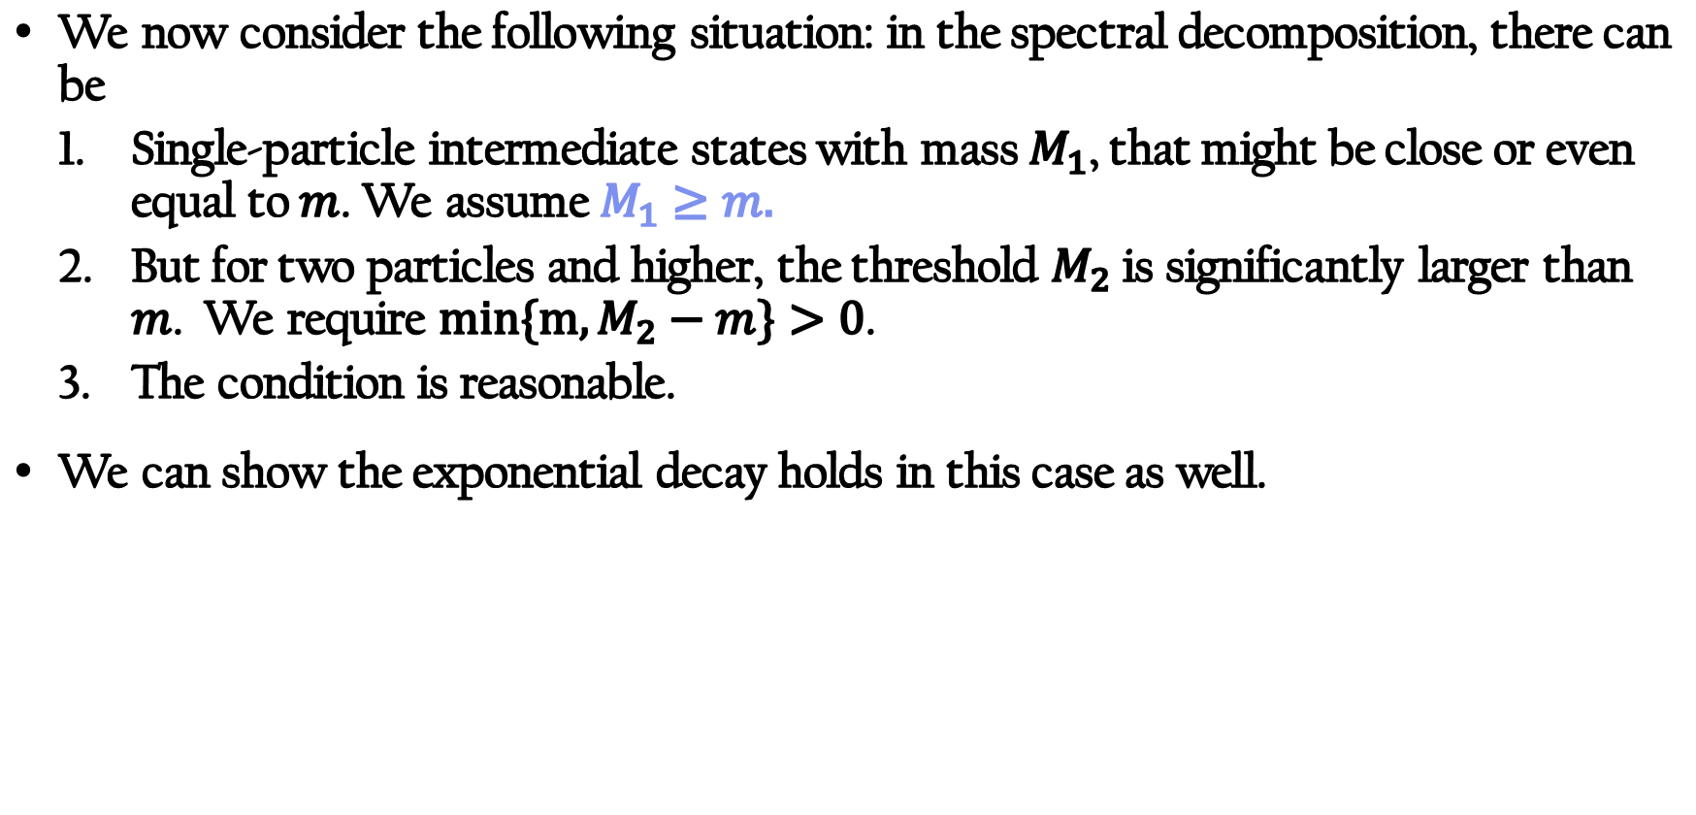
Second case: light one-particle intermediate states
We now consider the following situation: in the spectral decomposition, there can be
  Single-particle intermediate states with mass $M_{1}$, that might be close or even equal to $m$. We assume $M_{1}≥m.$
  But for two particles and higher, the threshold $M_{2}$ is significantly larger than $m$. We require $min\{m, M_{2}−m\}>0$.
  The condition is reasonable.
We can show the exponential decay holds in this case as well.

Slide 20
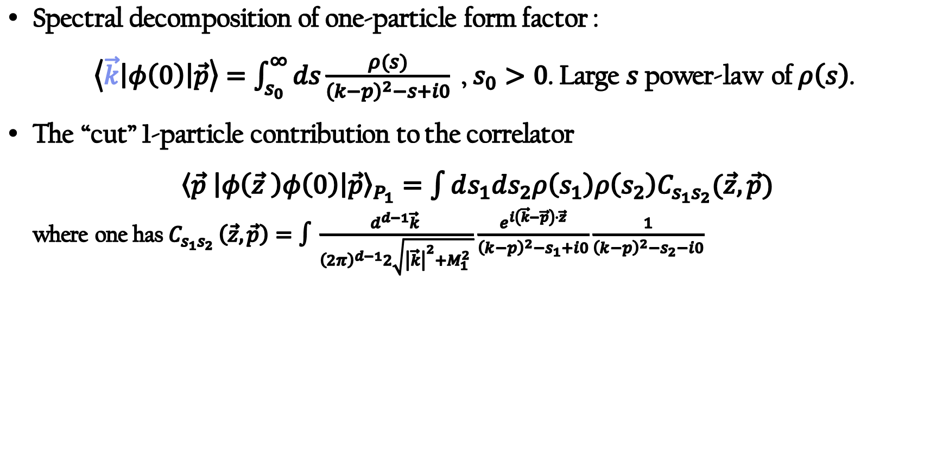
Second case: light one-particle intermediate states
Spectral decomposition of one-particle form factor :
$\left\langle \vec{k}\left|φ\left(0\right)\right|\vec{p}\right\rangle =\int_{s_{0}}^{∞}{ds}\frac{ρ(s)}{{\left(k−p\right)}^{2}−s+i0}$ , $s_{0}>0$. Large $s$ power-law of $ρ\left(s\right)$.
The “cut” 1-particle contribution to the correlator
${\left\langle \vec{p} \left|φ\left(\vec{z} \right)φ\left(0\right)\right|\vec{p}\right\rangle }_{P_{1}}=\int{ds_{1}ds_{2}ρ\left(s_{1}\right)ρ\left(s_{2}\right)C_{s_{1}s_{2}}(\vec{z},\vec{p})}$
  where one has $C_{s_{1}s_{2} }\left(\vec{z},\vec{p}\right)=∫\frac{d^{d−1}\vec{k} }{{\left(2π\right)}^{d−1}2\sqrt{{\left|\vec{k}\right|}^{2}+M_{1}^{2} }}\frac{e^{i\left(\vec{k}−\vec{p}\right)⋅\vec{z}}}{{\left(k−p\right)}^{2}−s_{1}+i0}\frac{1}{{\left(k−p\right)}^{2}−s_{2}−i0}$

Slide 21
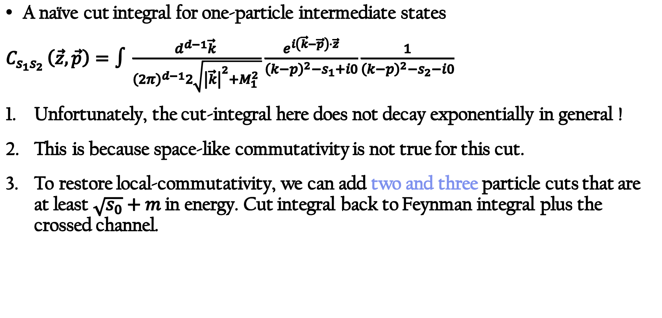
Second case: light one-particle intermediate states
A naïve cut integral for one-particle intermediate states
$C_{s_{1}s_{2} }\left(\vec{z},\vec{p}\right)=∫\frac{d^{d−1}\vec{k} }{{\left(2π\right)}^{d−1}2\sqrt{{\left|\vec{k}\right|}^{2}+M_{1}^{2} }}\frac{e^{i\left(\vec{k}−\vec{p}\right)⋅\vec{z}}}{{\left(k−p\right)}^{2}−s_{1}+i0}\frac{1}{{\left(k−p\right)}^{2}−s_{2}−i0}$
Unfortunately, the cut-integral here does not decay exponentially in general !
This is because space-like commutativity is not true for this cut.
To restore local-commutativity, we can add two and three particle cuts that are at least $\sqrt{s_{0}}+m$ in energy. Cut integral back to Feynman integral plus the crossed channel.

Slide 22
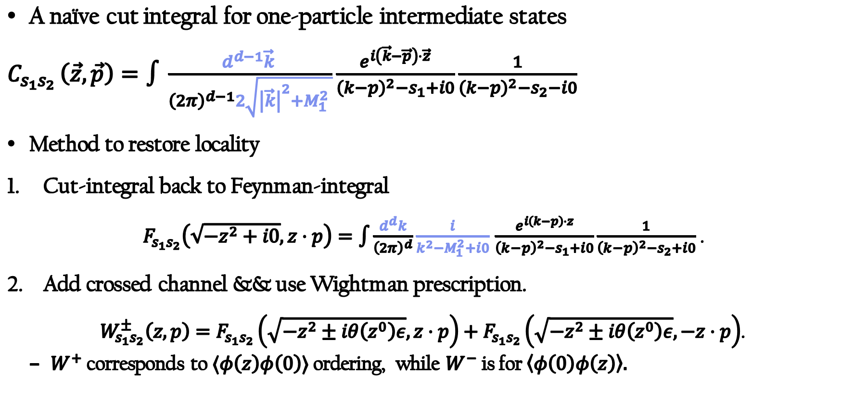
Second case: light one-particle intermediate states
A naïve cut integral for one-particle intermediate states
$C_{s_{1}s_{2} }\left(\vec{z},\vec{p}\right)=∫\frac{d^{d−1}\vec{k} }{{\left(2π\right)}^{d−1}2\sqrt{{\left|\vec{k}\right|}^{2}+M_{1}^{2} }}\frac{e^{i\left(\vec{k}−\vec{p}\right)⋅\vec{z}}}{{\left(k−p\right)}^{2}−s_{1}+i0}\frac{1}{{\left(k−p\right)}^{2}−s_{2}−i0}$
Method to restore locality
Cut-integral back to Feynman-integral
$F_{s_{1}s_{2}}\left(\sqrt{−z^{2}+i0}, z⋅p\right)=\int{\frac{d^{d}k}{{\left(2π\right)}^{d}}\frac{i}{k^{2}−M_{1}^{2}+i0}}$ $\frac{e^{i\left(k−p\right)⋅z}}{{\left(k−p\right)}^{2}−s_{1}+i0}\frac{1}{{\left(k−p\right)}^{2}−s_{2}+i0}$ .
Add crossed channel && use Wightman prescription.
$W_{s_{1}s_{2}}^{±}\left(z,p\right)=F_{s_{1}s_{2}}\left(\sqrt{−z^{2}±iθ\left(z^{0}\right)ε},z⋅p\right)+F_{s_{1}s_{2}}\left(\sqrt{−z^{2}±iθ\left(z^{0}\right)ε},−z⋅p\right)$.
  $W^{+}$ corresponds to $⟨φ\left(z\right)φ\left(0\right)⟩$ ordering, while $W^{−}$ is for $\left\langle φ\left(0\right)φ\left(z\right)\right\rangle .$

Slide 23
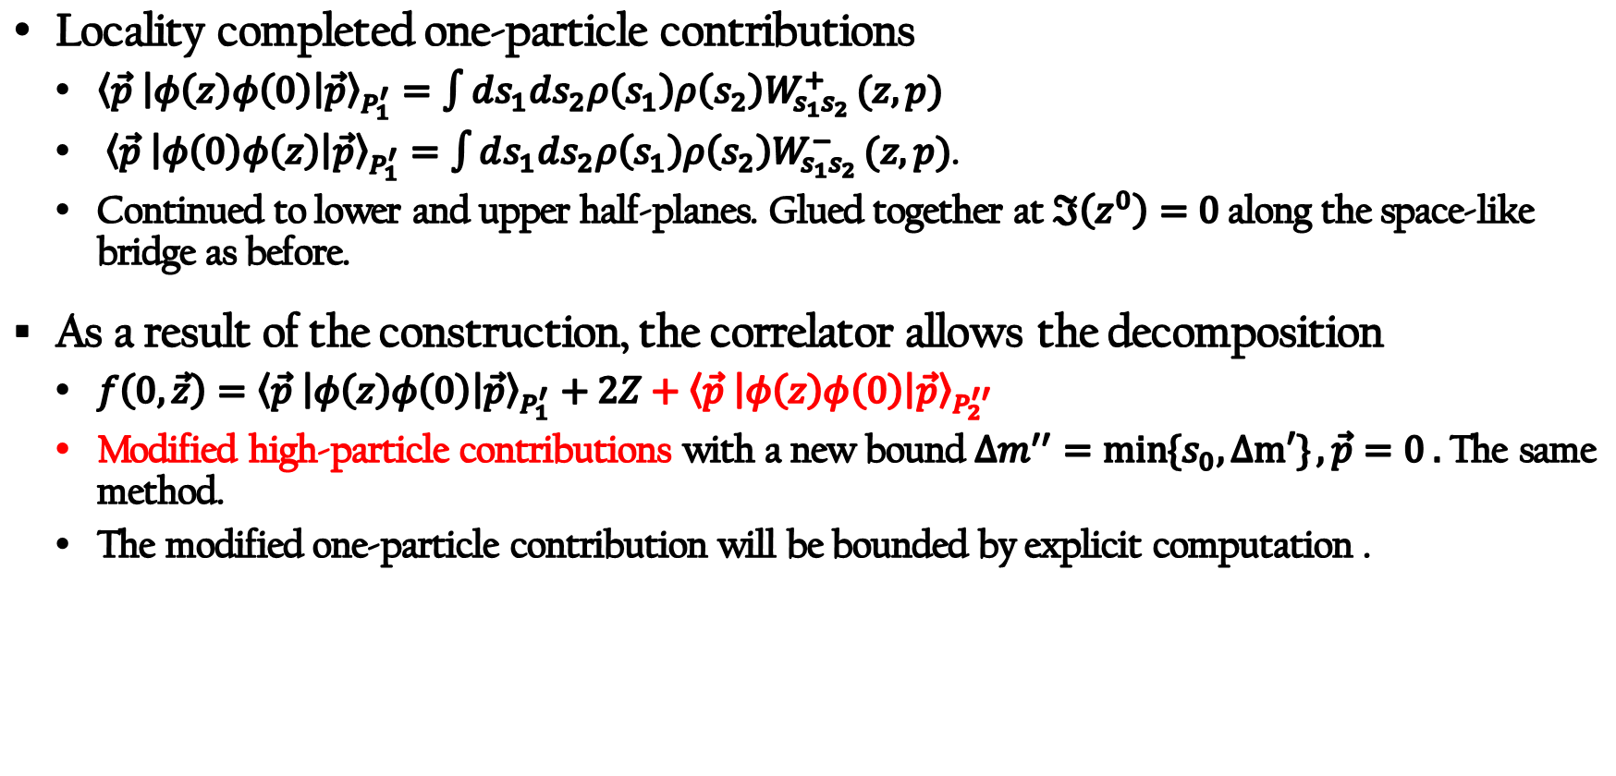
Second case: light one-particle intermediate states
Locality completed one-particle contributions
  ${\left\langle \vec{p} \left|φ\left(z\right)φ\left(0\right)\right|\vec{p}\right\rangle }_{P_{1}^{′}}=\int{ds_{1}ds_{2}ρ\left(s_{1}\right)ρ\left(s_{2}\right)W_{s_{1}s_{2}}^{+}}(z,p)$
  ${\left\langle \vec{p} \left|φ\left(0\right)φ\left(z\right)\right|\vec{p}\right\rangle }_{P_{1}^{′}}=\int{ds_{1}ds_{2}ρ\left(s_{1}\right)ρ\left(s_{2}\right)W_{s_{1}s_{2}}^{−}}(z,p)$.
  Continued to lower and upper half-planes. Glued together at $ℑ\left(z^{0}\right)=0$ along the space-like bridge as before.
As a result of the construction, the correlator allows the decomposition
  $f\left(0,\vec{z}\right)={\left\langle \vec{p} \left|φ\left(z\right)φ\left(0\right)\right|\vec{p}\right\rangle }_{P_{1}^{′}}+2Z+{\left\langle \vec{p} \left|φ\left(z\right)φ\left(0\right)\right|\vec{p}\right\rangle }_{P_{2}^{′′}}$
  Modified high-particle contributions with a new bound $Δm^{′′}=\min{\{s_{0},Δm′\}}, \vec{p}=0 .$ The same method.
  The modified one-particle contribution will be bounded by explicit computation .

Slide 24
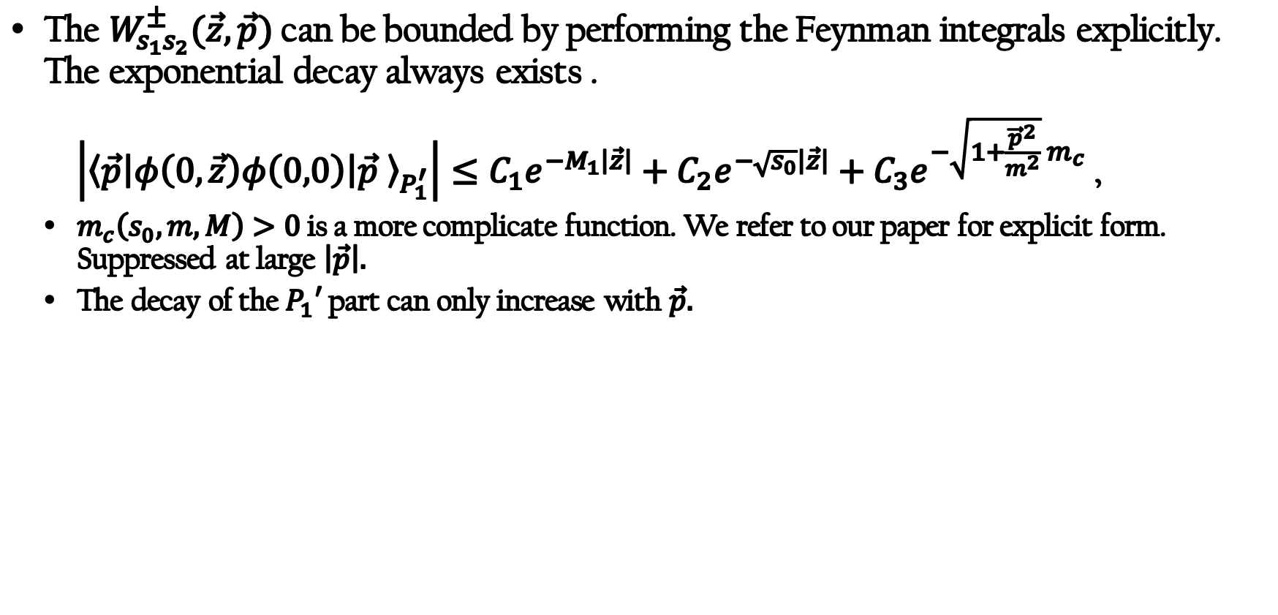
Second case: light one-particle intermediate states
The $W_{s_{1}s_{2}}^{±}(\vec{z},\vec{p})$ can be bounded by performing the Feynman integrals explicitly. The exponential decay always exists .
$\left|{\left\langle \vec{p}\left|φ\left(0,\vec{z}\right)φ\left(0,0\right)\right|\vec{p} \right\rangle }_{P_{1}^{′}}\right|≤C_{1}e^{−M_{1}\left|\vec{z}\right|}+C_{2}e^{−\sqrt{s_{0}}\left|\vec{z}\right|}+C_{3}e^{−\sqrt{1+\frac{{\vec{p}}^{2}}{m^{2}}} m_{c}}$ ,
  $m_{c}\left(s_{0}, m, M\right)>0$ is a more complicate function. We refer to our paper for explicit form. Suppressed at large $\left|\vec{p}\right|.$
  The decay of the $P_{1}′$ part can only increase with $\vec{p}.$

Slide 25
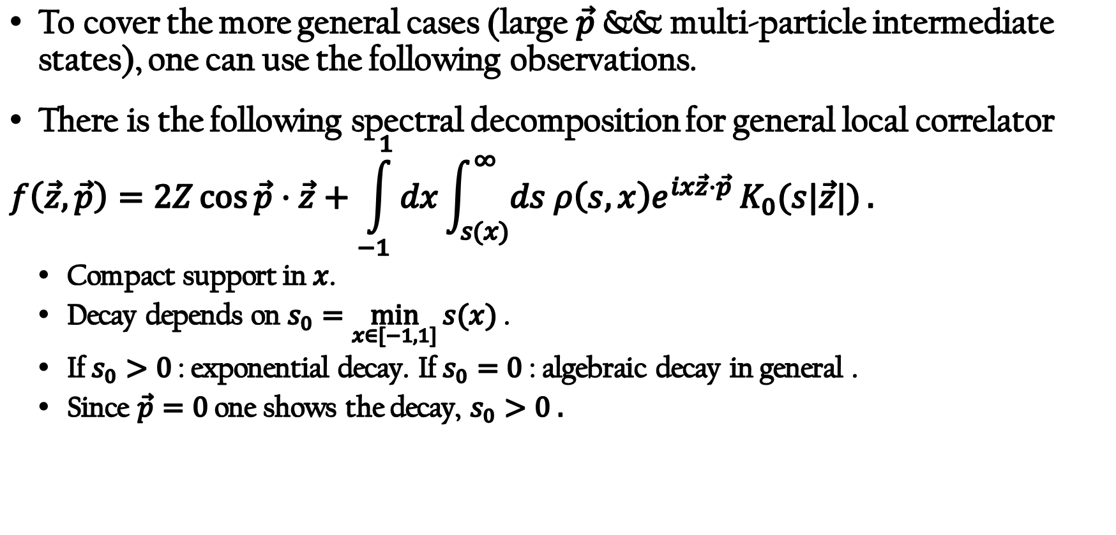
More general case: all order bounds in $φ^{4}$/$φ^{3}$
To cover the more general cases (large $\vec{p}$ && multi-particle intermediate states), one can use the following observations.
There is the following spectral decomposition for general local correlator
$$f\left(\vec{z},\vec{p}\right)=2Z\cos{\vec{p}⋅\vec{z}}+\int_{−1}^{1}{dx}\int_{s(x)}^{∞}{ds ρ\left(s,x\right)e^{ix\vec{z}⋅\vec{p} }K_{0}(s|\vec{z}|)}.$$
  Compact support in $x$.
  Decay depends on $s_{0}=\min_{x∈[−1,1]}{s(x)}$ .
  If $s_{0}>0$ : exponential decay. If $s_{0}=0$ : algebraic decay in general .
  Since $\vec{p}=0$ one shows the decay, $s_{0}>0 .$

Slide 26
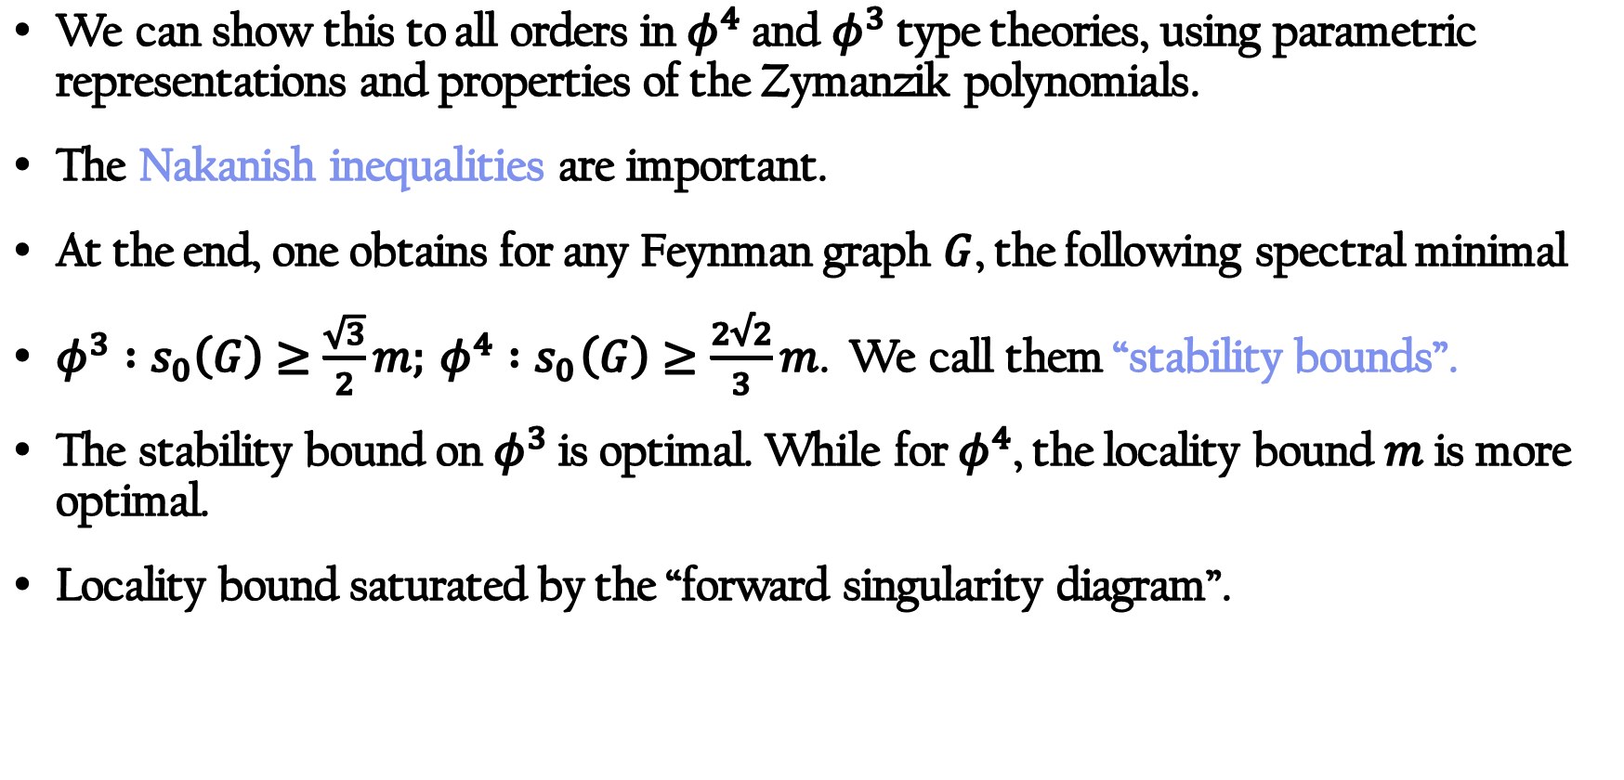
More general case: all order bounds in $φ^{4}$/$φ^{3}$
We can show this to all orders in $φ^{4}$ and $φ^{3}$ type theories, using parametric representations and properties of the Zymanzik polynomials.
The Nakanish inequalities are important.
At the end, one obtains for any Feynman graph $G$, the following spectral minimal
${φ^{3} :s}_{0}\left(G\right)≥\frac{\sqrt{3}}{2}m;{ φ^{4} :s}_{0}\left(G\right)≥\frac{2√2}{3}m$. We call them “stability bounds”.
The stability bound on $φ^{3}$ is optimal. While for $φ^{4}$, the locality bound $m$ is more optimal.
Locality bound saturated by the “forward singularity diagram”.
N. Nakanishi, Progress of Theoretical Physics Supplement 18, 1 (1961)
A. Jaffe, Communications in Mathematical Physics 1, 127 (1965)

Slide 27
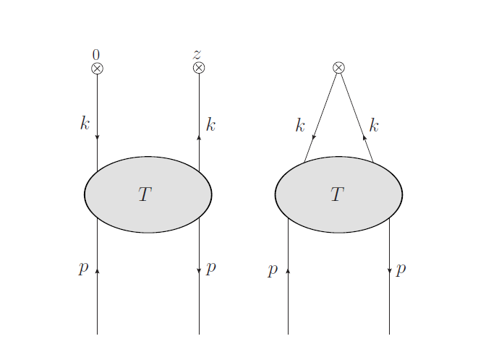

More general case: all order bounds in $φ^{4}$/$φ^{3}$
The exponential decay of the graph G on the left is related to graph polynomials of the contracted graph $\tilde{G}$ on the right.
The crucial exponential is
$$\exp{(−\frac{z^{2}U_{G}\left(x\right)}{4ρU_{\tilde{G}}\left(x\right)}−m^{2}ρ(1−\frac{𝒱_{ \tilde{G}}(x)}{𝒱_{G}(x)}}))$$
$\frac{U_{G}}{U_{ \tilde{G}}}≥1$ , $1−\frac{𝒱_{ \tilde{G}}\left(x\right)}{𝒱_{G}\left(x\right)}≥\frac{\sqrt{3}}{2}\left(φ^{3}\right)\&\frac{2\sqrt{2}}{3}(φ^{4})$
Threshold of the contracted graph $\tilde{G}$.

Slide 28
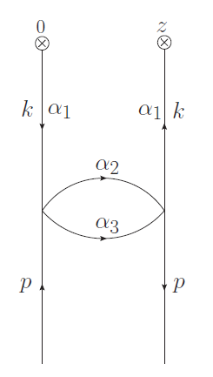
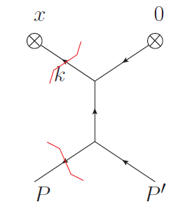
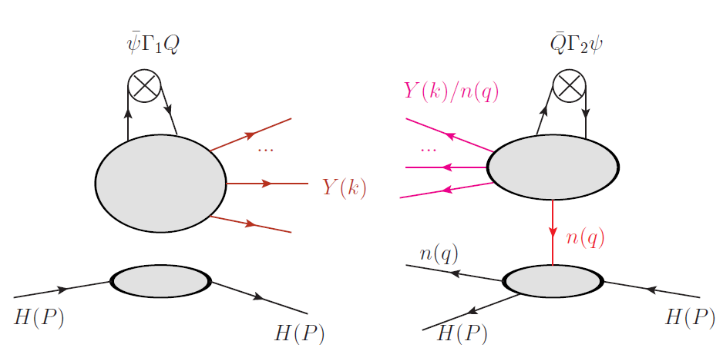

More general case: all order bounds in $φ^{4}$/$φ^{3}$
Locality bound saturated by the “forward singularity diagram”.
The mass difference is $2m−m=m$
The actual decay is also $m$.
In parametric representation, generated in the region $α_{1}≫ \{α_{2},α_{3},α_{4}\}$

Slide 29
Outline
Part I: Introduction
Part II: General arguments
Part III: Two examples

Slide 30
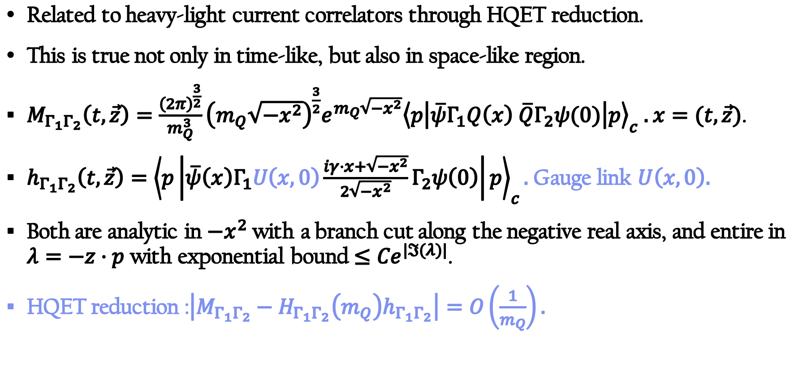
Example 1: Correlators with gauge-links
Related to heavy-light current correlators through HQET reduction.
This is true not only in time-like, but also in space-like region.
$M_{Γ_{1}Γ_{2}}\left(t,\vec{z}\right)=\frac{{\left(2π\right)}^{\frac{3}{2}}}{m_{Q}^{3}}{\left(m_{Q}\sqrt{−x^{2}}\right)}^{\frac{3}{2}}e^{m_{Q}\sqrt{−x^{2}}}{\left\langle p\left|\overline{ψ}Γ_{1}Q\left(x\right) \overline{Q}Γ_{2}ψ(0)\right|p\right\rangle }_{c} .$ $x=(t,\vec{z})$.
$h_{Γ_{1}Γ_{2}}\left(t,\vec{z}\right)={\left\langle p\left|\overline{ψ}\left(x\right)Γ_{1}U\left(x,0\right)\frac{iγ⋅x+\sqrt{−x^{2}}}{2\sqrt{−x^{2}}}Γ_{2}ψ\left(0\right)\right|p\right\rangle }_{c}.$ Gauge link $U\left(x,0\right).$
Both are analytic in $−x^{2}$ with a branch cut along the negative real axis, and entire in $λ=−z⋅p$ with exponential bound $≤{Ce}^{|ℑ(λ)|}$.
HQET reduction :$\left|M_{Γ_{1}Γ_{2}}−H_{Γ_{1}Γ_{2}}\left(m_{Q}\right)h_{Γ_{1}Γ_{2}}\right|=O\left(\frac{1}{m_{Q}}\right).$

Slide 31
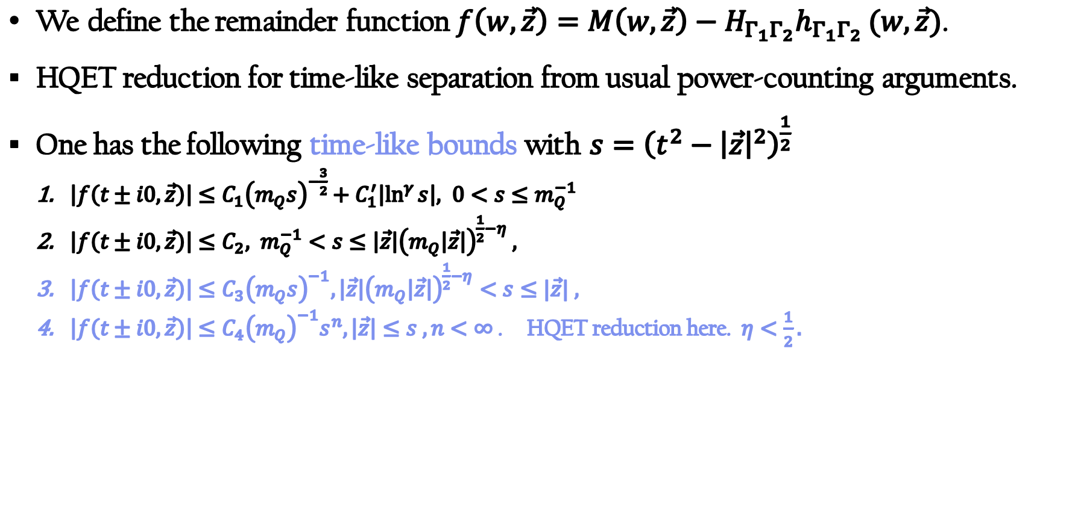
Example 1: Correlators with gauge-links
We define the remainder function $f\left(w,\vec{z}\right)=M\left(w,\vec{z}\right)−H_{Γ_{1}Γ_{2}}h_{Γ_{1}Γ_{2} }(w,\vec{z})$.
HQET reduction for time-like separation from usual power-counting arguments.
One has the following time-like bounds with $s={\left(t^{2}−{\left|\vec{z}\right|}^{2}\right)}^{\frac{1}{2}}$
  $\left|f\left(t±i0,\vec{z}\right)\right|≤C_{1}{\left(m_{Q}s\right)}^{−\frac{3}{2}}+C_{1}^{′}\left|\ln^{γ}{s}\right|, 0<s≤m_{Q}^{−1}$
  $\left|f\left(t±i0,\vec{z}\right)\right|≤C_{2}, m_{Q}^{−1}<s≤\left|\vec{z}\right|{\left(m_{Q}\left|\vec{z}\right|\right)}^{\frac{1}{2}−η} ,$
  $\left|f\left(t±i0,\vec{z}\right)\right|≤C_{3}{\left(m_{Q}s\right)}^{−1}, \left|\vec{z}\right|{\left(m_{Q}\left|\vec{z}\right|\right)}^{\frac{1}{2}−η}<s≤|\vec{z}| ,$
  $\left|f\left(t±i0,\vec{z}\right)\right|≤C_{4}{\left(m_{Q}\right)}^{−1}s^{n}, \left|\vec{z}\right|≤s , n<∞$. HQET reduction here. $η<\frac{1}{2}.$

Slide 32
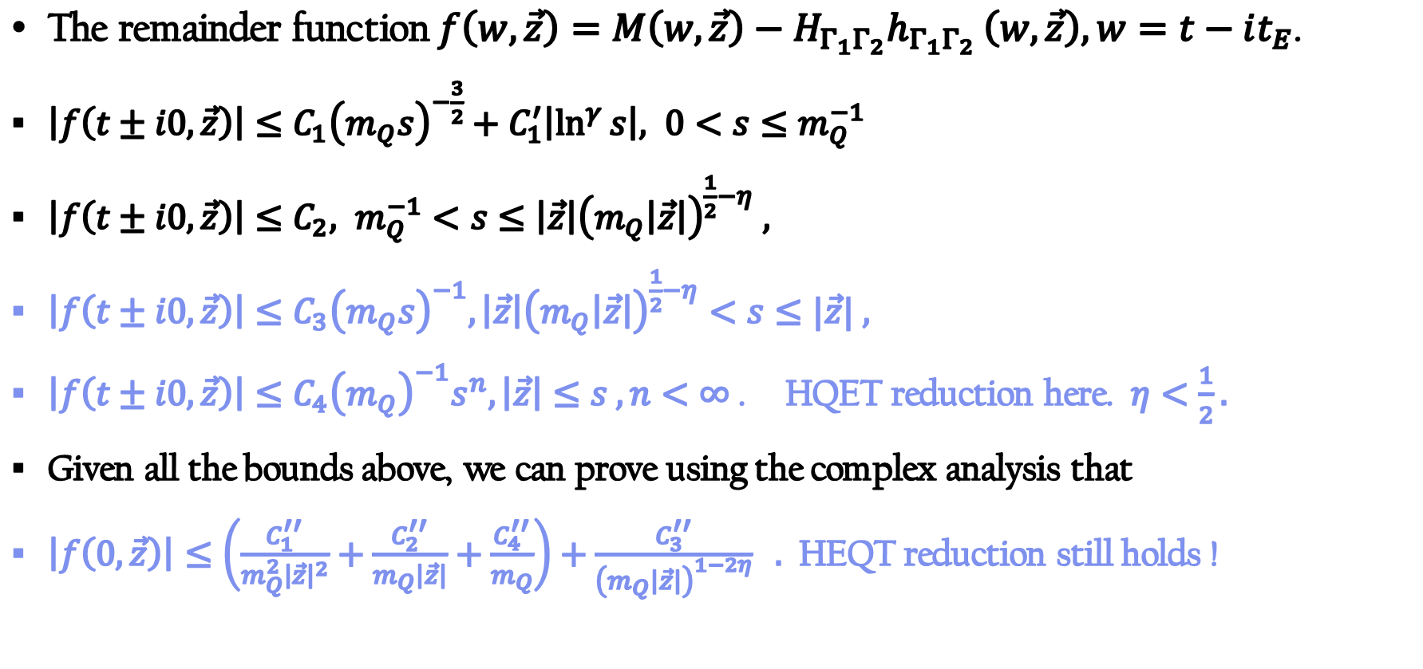
Example 1: Correlators with gauge-links
The remainder function $f\left(w,\vec{z}\right)=M\left(w,\vec{z}\right)−H_{Γ_{1}Γ_{2}}h_{Γ_{1}Γ_{2} }\left(w,\vec{z}\right), w=t−it_{E}$.
$\left|f\left(t±i0,\vec{z}\right)\right|≤C_{1}{\left(m_{Q}s\right)}^{−\frac{3}{2}}+C_{1}^{′}\left|\ln^{γ}{s}\right|, 0<s≤m_{Q}^{−1}$
$\left|f\left(t±i0,\vec{z}\right)\right|≤C_{2}, m_{Q}^{−1}<s≤\left|\vec{z}\right|{\left(m_{Q}\left|\vec{z}\right|\right)}^{\frac{1}{2}−η} ,$
$\left|f\left(t±i0,\vec{z}\right)\right|≤C_{3}{\left(m_{Q}s\right)}^{−1}, \left|\vec{z}\right|{\left(m_{Q}\left|\vec{z}\right|\right)}^{\frac{1}{2}−η}<s≤|\vec{z}| ,$
$\left|f\left(t±i0,\vec{z}\right)\right|≤C_{4}{\left(m_{Q}\right)}^{−1}s^{n}, \left|\vec{z}\right|≤s , n<∞$. HQET reduction here. $η<\frac{1}{2}.$
Given all the bounds above, we can prove using the complex analysis that
$\left|f\left(0,\vec{z}\right)\right|≤\left(\frac{C_{1}^{′′}}{m_{Q}^{2}{\left|\vec{z}\right|}^{2}}+\frac{C_{2}^{′′}}{m_{Q}\left|\vec{z}\right|}+\frac{C_{4}^{′′}}{m_{Q}}\right)+\frac{C_{3}^{′′}}{{\left(m_{Q}\left|\vec{z}\right|\right)}^{1−2η}} .$ HEQT reduction still holds !

Slide 33
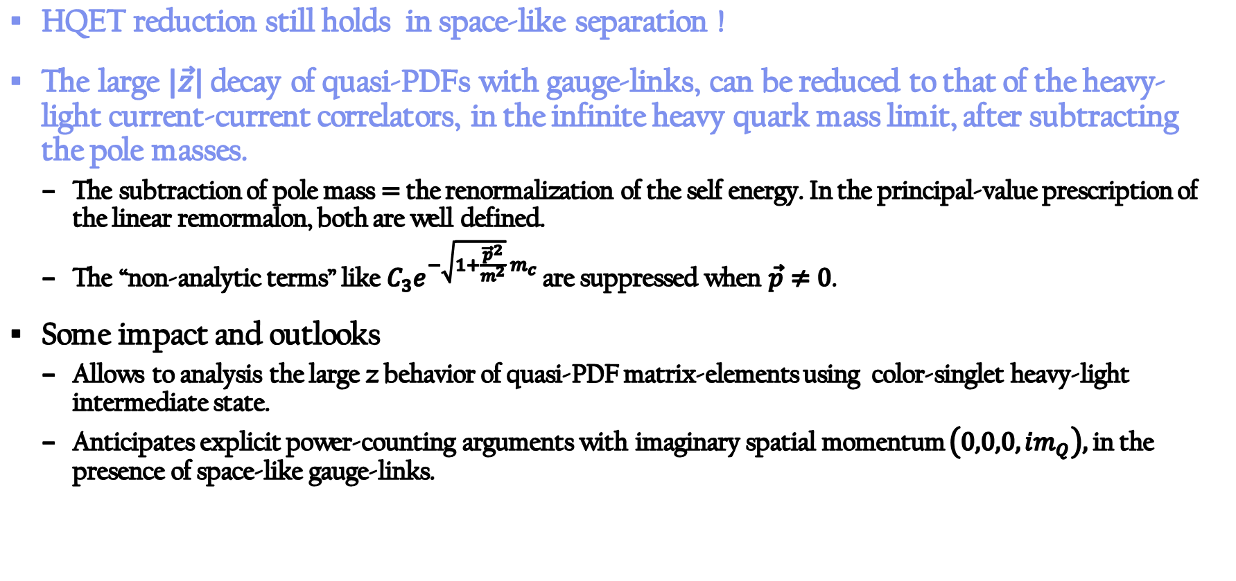
Example 1: Correlators with gauge-links
HQET reduction still holds in space-like separation !
The large $|\vec{z}|$ decay of quasi-PDFs with gauge-links, can be reduced to that of the heavy-light current-current correlators, in the infinite heavy quark mass limit, after subtracting the pole masses.
  The subtraction of pole mass $=$ the renormalization of the self energy. In the principal-value prescription of the linear remormalon, both are well defined.
  The “non-analytic terms” like $C_{3}e^{−\sqrt{1+\frac{{\vec{p}}^{2}}{m^{2}}} m_{c}}$ are suppressed when $\vec{p}≠0$.
Some impact and outlooks
  Allows to analysis the large z behavior of quasi-PDF matrix-elements using color-singlet heavy-light intermediate state.
  Anticipates explicit power-counting arguments with imaginary spatial momentum $\left(0,0,0,im_{Q}\right),$in the presence of space-like gauge-links.

Slide 34
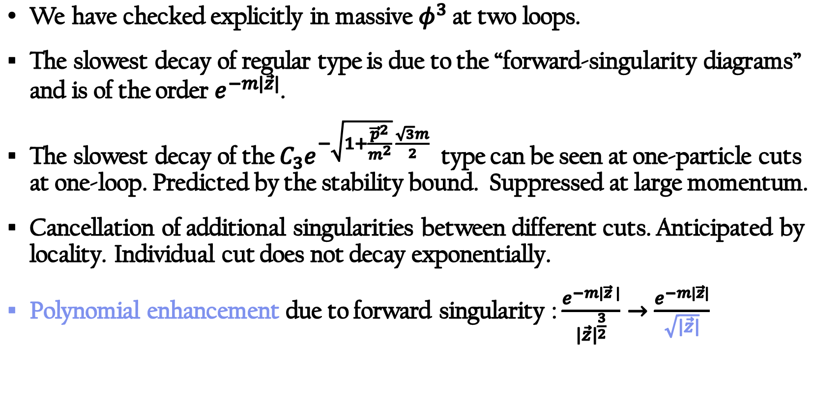

Example 2: Two loop massive $φ^{3}$
We have checked explicitly in massive $φ^{3}$ at two loops.
The slowest decay of regular type is due to the “forward-singularity diagrams” and is of the order $e^{−m|\vec{z}|}$.
The slowest decay of the $C_{3}e^{−\sqrt{1+\frac{{\vec{p}}^{2}}{m^{2}}} \frac{\sqrt{3}m}{2}}$ type can be seen at one-particle cuts at one-loop. Predicted by the stability bound. Suppressed at large momentum.
Cancellation of additional singularities between different cuts. Anticipated by locality. Individual cut does not decay exponentially.
Polynomial enhancement due to forward singularity : $\frac{e^{−m|\vec{z} |}}{{|\vec{z}|}^{\frac{3}{2}}}→\frac{e^{−m|\vec{z}|}}{\sqrt{|\vec{z}|}}$

Slide 35
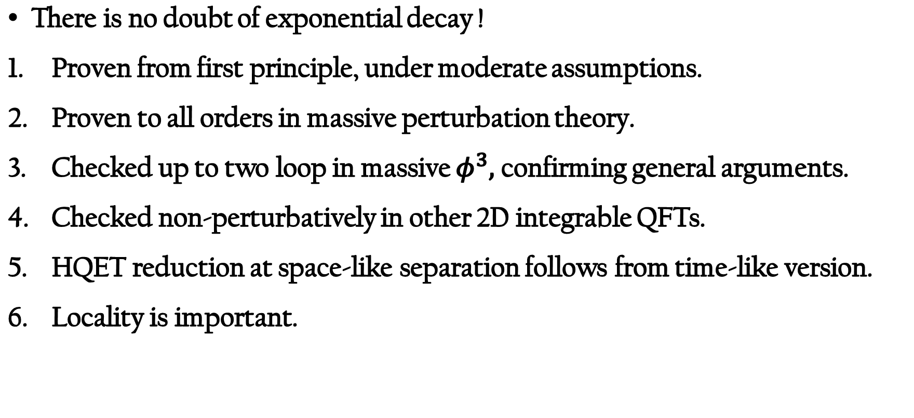
Conclusion
There is no doubt of exponential decay !
Proven from first principle, under moderate assumptions.
Proven to all orders in massive perturbation theory.
Checked up to two loop in massive $φ^{3},$ confirming general arguments.
Checked non-perturbatively in other 2D integrable QFTs.
HQET reduction at space-like separation follows from time-like version.
Locality is important.

