Slide 1

Entanglement in High Energy Physics
I. Zahed
Krakow 23’

Slide 2
Most of my discussion of the EE in HEP is for strongly coupled theories e.g. QCD, QED2. For weak coupling see e.g. Yizhuang Liu and others at this meeting.

Slide 3
Many thanks to:
My collaborators are many over may years and will be listed below

Slide 4
Outline
EE in pp
EE in DIS
EE in QED2

Slide 5
EE in pp

Slide 6
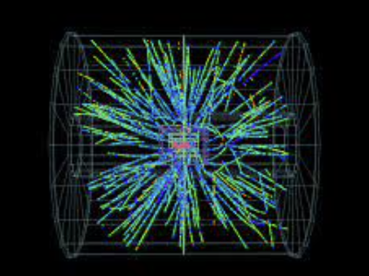
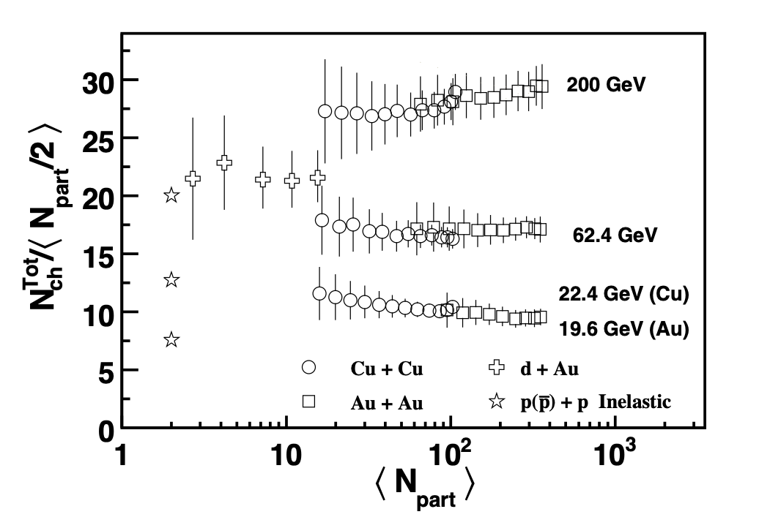
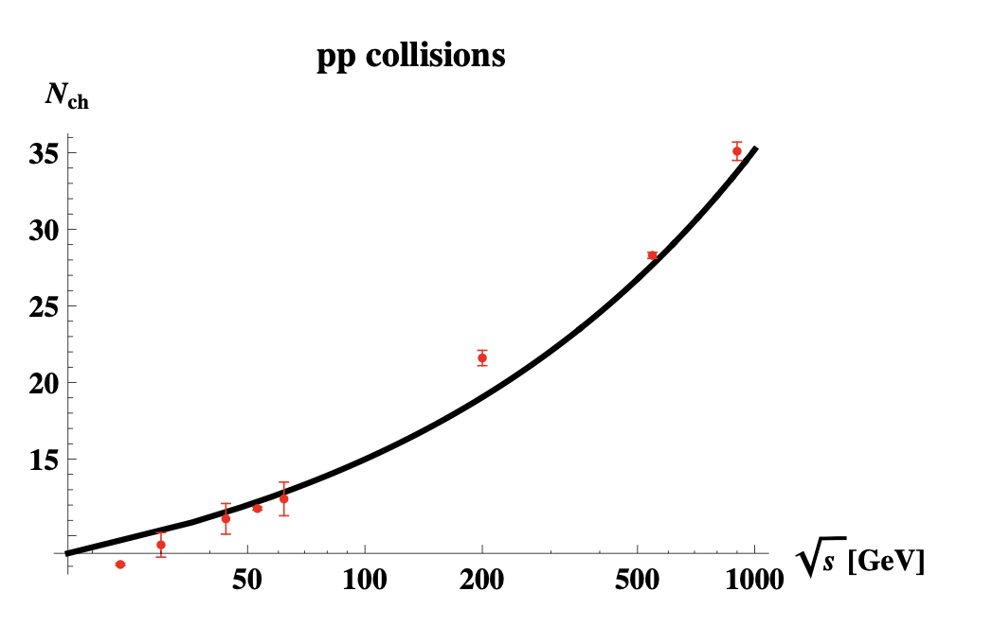
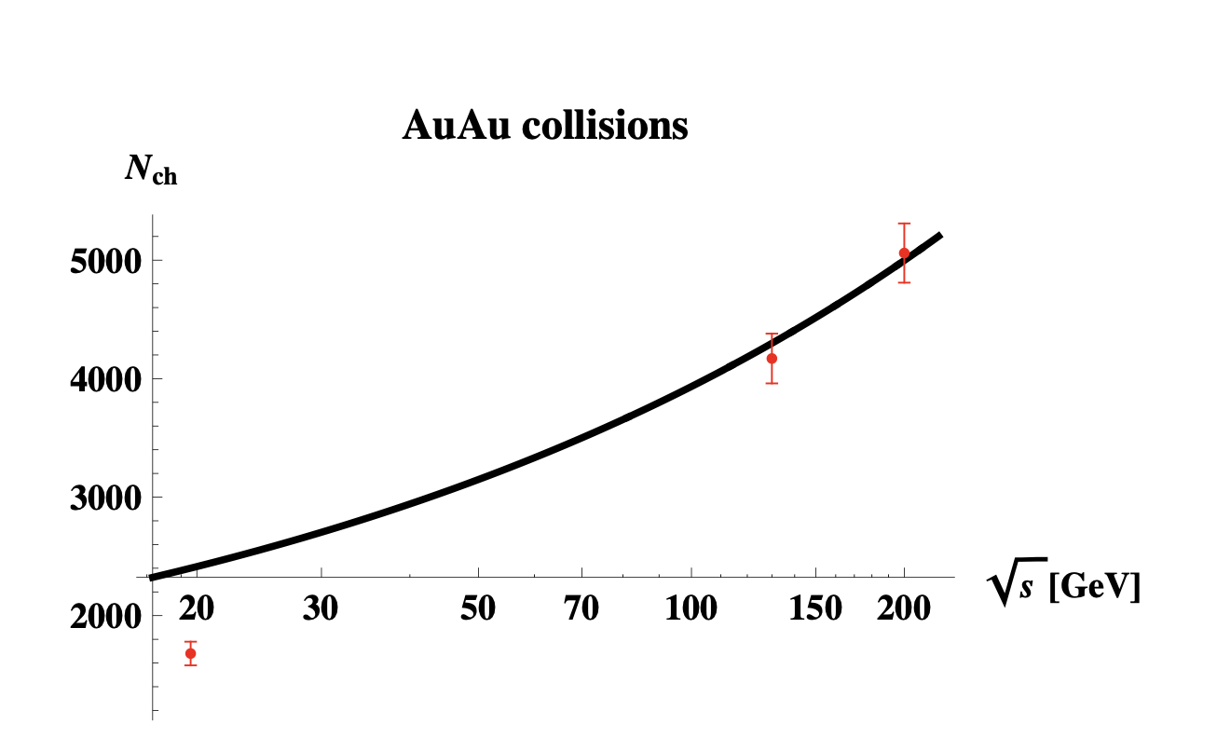
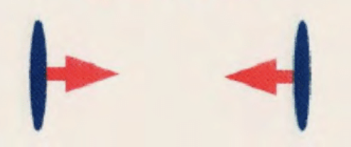
Quantum entropy in pp and AA
STAR
Phobos 06’
Stoffers-Zahed 12’
Stoffers-Zahed 12’

Slide 7
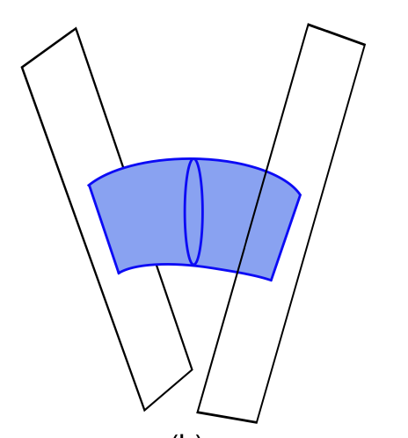
Stringy pp
Basar-Kharzeev-Yee-Zahed 12
In AdS see:
Rho-Sin-Zahed 99’
Janik-Peschanski 00’,
Polshinski-Strassler 01’, …

Slide 8
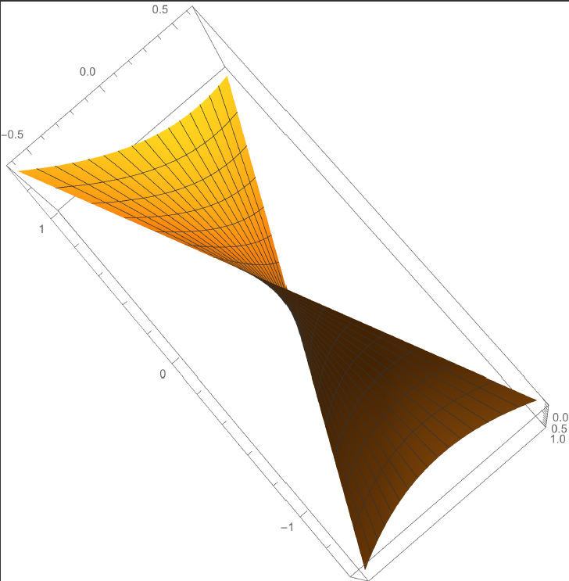
Hyperbolic surface

Slide 9
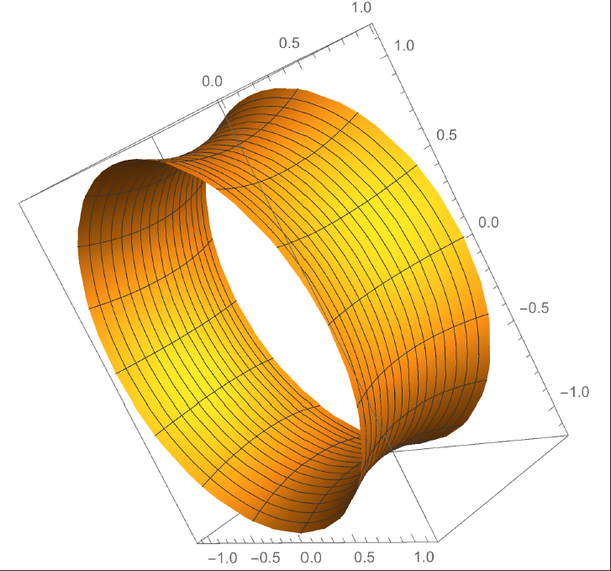
Worldsheet instanton

Slide 10
pp cross section
See also Janik-Peshanski in AdS

Slide 11
Quantum entropy in the string
Stoffers-Zahed 12’
Liu-Zahed 18’

Slide 12
Entangled density matrix
Following Dima’s presentation of KL 17’ work for EE in DIS in the Pomeron regime at weak coupling, it was clear that the string Pomeron entropy in SZ 12’ is KL 17’ EE at strong coupling!

Slide 13
Discretized pp string

Slide 14
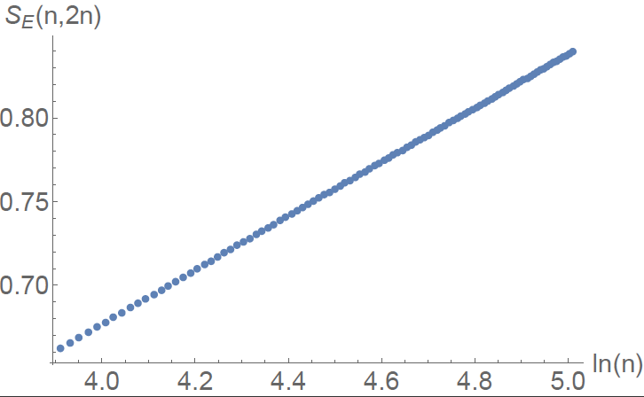
Entanglement = “Thermal”
Liu-Zahed 18’
Stoffers-Zahed 12’

Slide 15
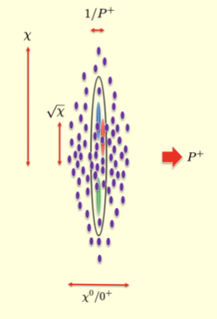
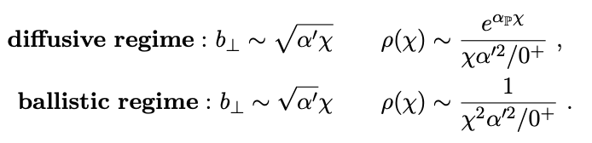
Wee string bits from pp-2PI
Liu-Nowak-Zahed 23’

Slide 16
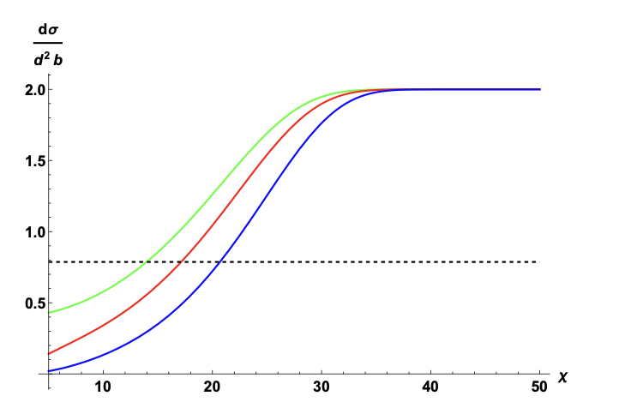
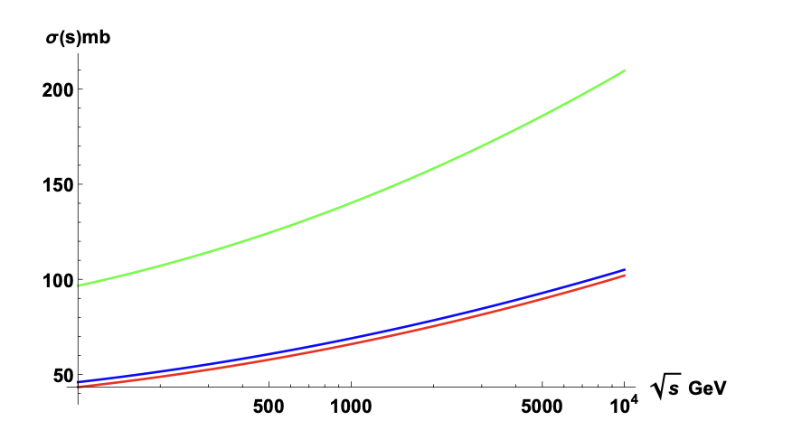

Stringy pp: saturation and bound
b=2,4,6
Liu-Nowak-Zahed 23’

Slide 17
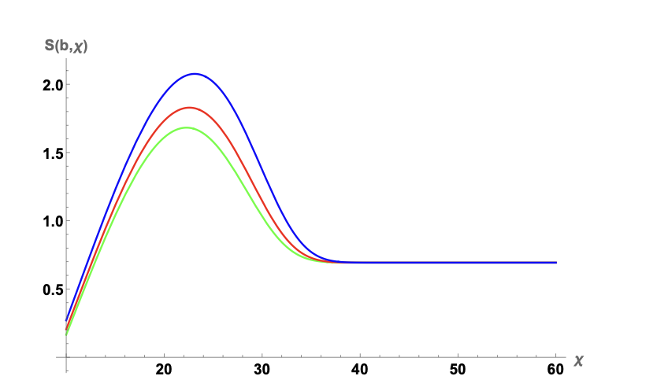
EE and Froissart bound
b=2,4,6
Liu-Nowak-Zahed 23

Slide 18
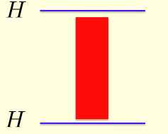
EE, “Black-hole” and saturation

Slide 19
Kolmogorov-Sinai entropy rate
Diffusive
Shadowing
Consistent with GW criterium above!

Slide 20
EE in DIS

Slide 21
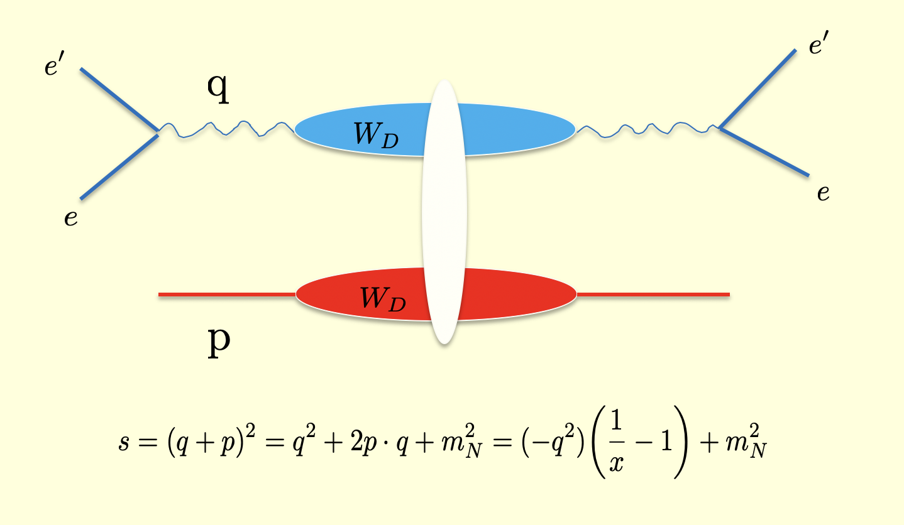
DIS at low-x = pp at large-s and small-t
pp
DIS

Slide 22
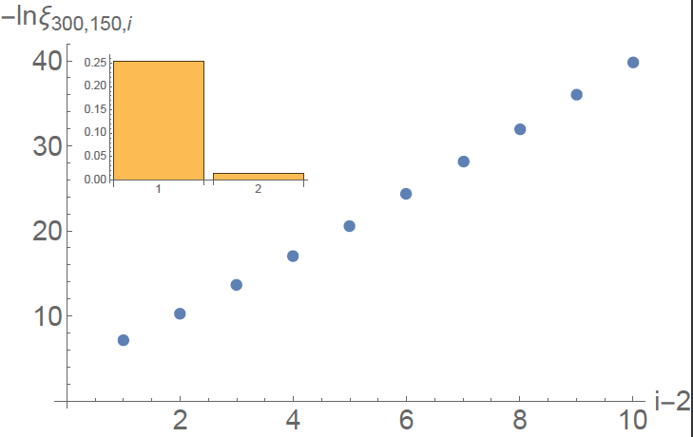
Eigenvalues of Entangled density matrix
Liu-Zahed 18’

Slide 23
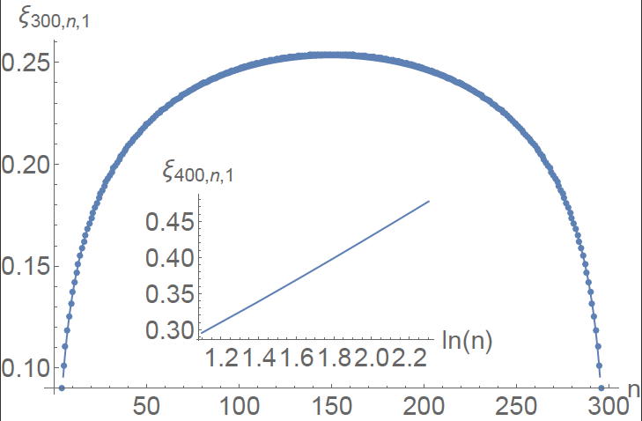
Distribution of string bits

Slide 24
Kolmogorov-like cascade

Slide 25
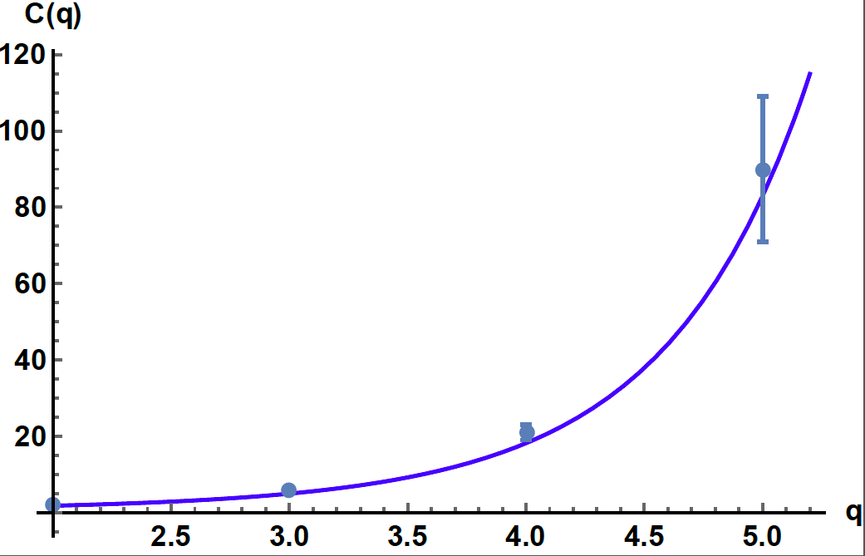
Multiplicity moments in pp@LHC
CMS 10’
Liu-Nowak-Zahed

Slide 26
F2(x) at low-x

Slide 27
Worldsheet fermions at low-x
Liu-Nowak-Zahed 23’
See also zahed in SGP 18’

Slide 28
Sea modified EE entropy
Liu-Nowak-Zahed 23’

Slide 29
EE in QED2

Slide 30
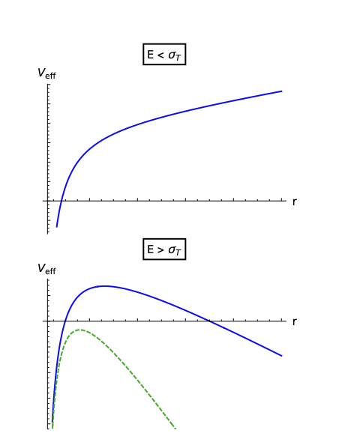
Schwinger pair creation in QCD
Grieninger-Kharzeev-Zahed 23’

Slide 31
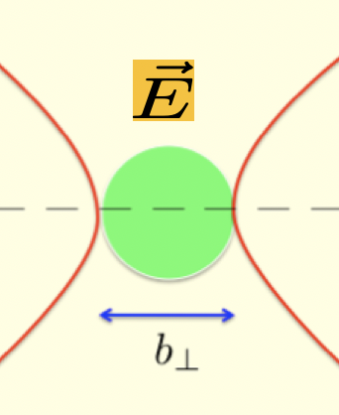
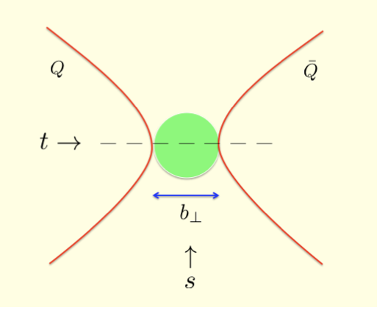
Dual string
Schwinger 51’
Semenoff-Zarembo 11’

Slide 32
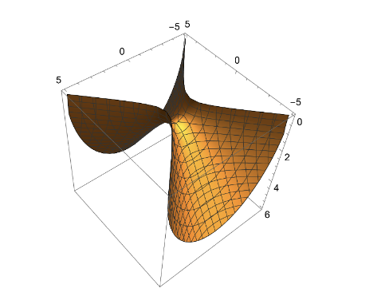
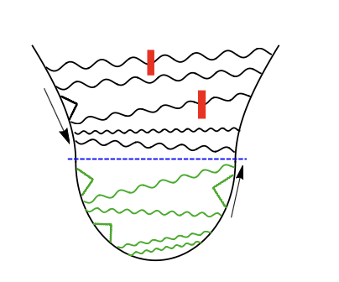
Vacuum EE from dual string
Radiation?
Vacuum!
Jensen-Obannon 13’
Grieninger-Kharzeev-Zahed 23’

Slide 33
Radiation EE from dual black string
Minkowski
Euclidean
Grieninger-Kharzeev-Zahed 23’
See also Lewkowycz-Maldacena 14’

Slide 34
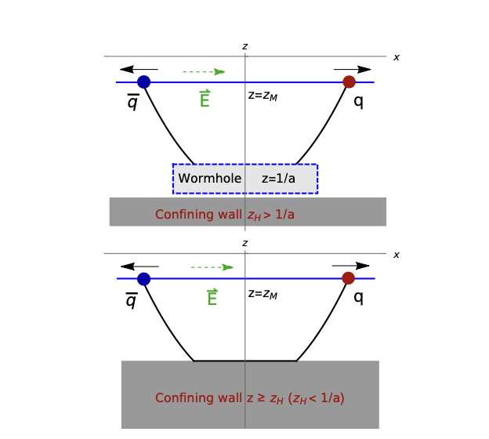
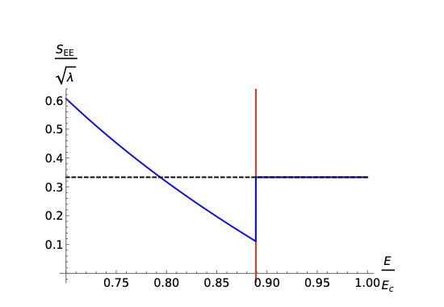
EE with confinement
Grieninger-Kharzeev-Zahed 23

Slide 35
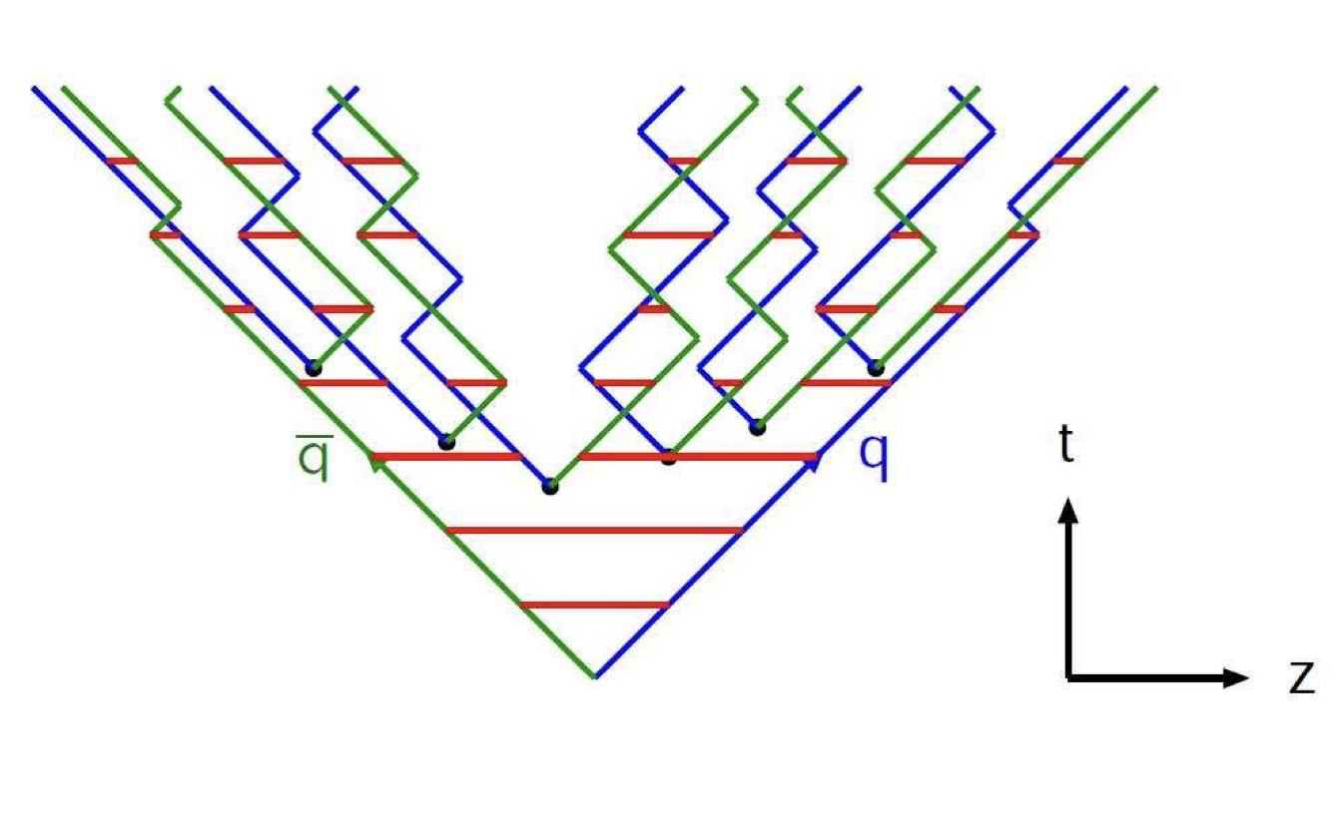
EE in Lund model and KNO scaling
Lonblad 17’
Grieninger-Kharzeev-Zahed 23
KNO and thermal-like!
Expected from KNO : Liu-Nowak-Zahed 23

Slide 36
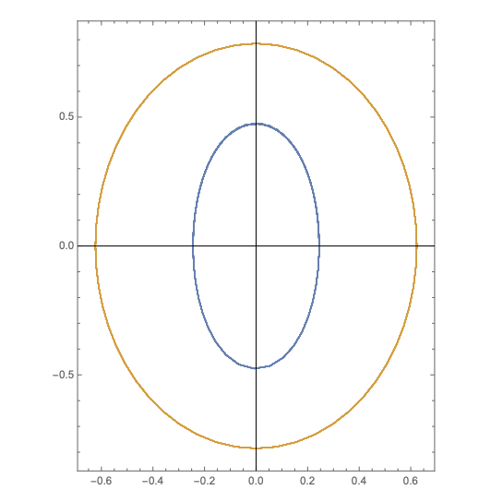
Time-dependent pair creation
Dunne-Schubert 05’

Slide 37
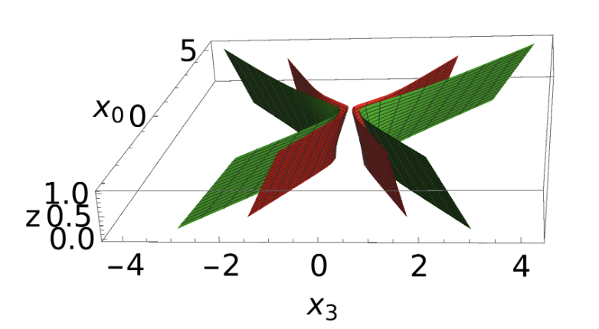
Falling wormhole
Grieninger-Kharzeev-Zahed 23’

Slide 38
Radiation EE from falling wormhole
Grieninger-Kharzeev-Zahed 23’

Slide 39
Conclusions:
1. Entanglement is perversive in high energy physics : it is captured by pQCD at weak coupling and NG in 4D or dual gravity in 10D at strong coupling!
2. The worldline/worldsheet instanton calculus offers a semi-classical estimation of the entangled density matrix.
3. The EE in pp and AA collisions explains how a coherent process can yield so much incoherence promptly
4. The maximum EE is observed when KNO scaling is thermal-like.

